Slide 1
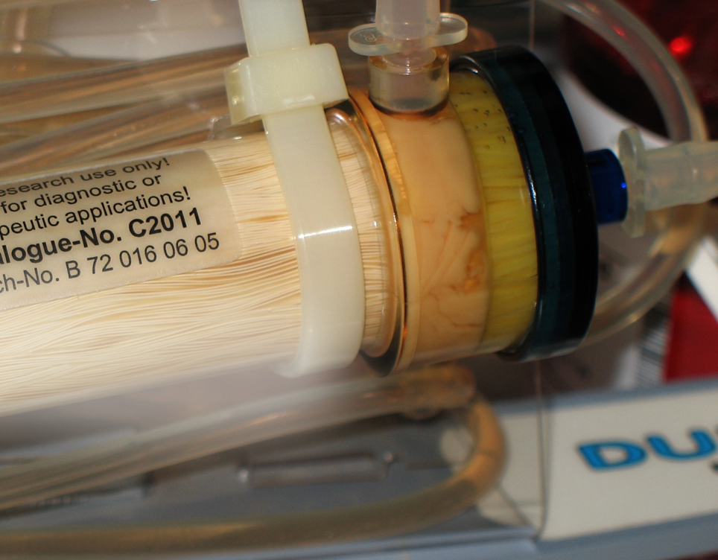
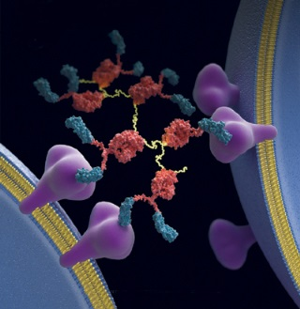
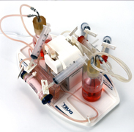
Hollow Fiber Infection Model for Antibiotic PK/PD
www.fibercellsystems.com
By John J. S. Cadwell
Notes:
FiberCell Systems, the only supplier of laboratory scale hollow fiber bioreactor systems since 2001

Slide 3
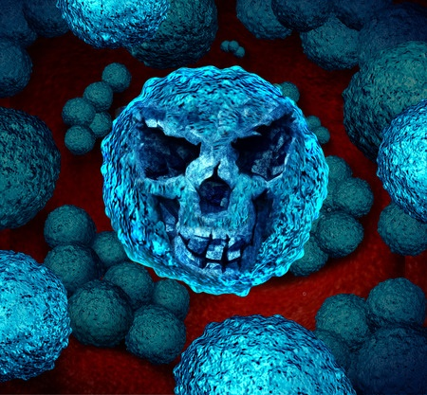
Antibiotic Resistance
Emerging antibiotic resistance is a major health concern
2 million people in the U.S. infected with antibiotic resistant bacteria last year
23,000 people died as a result of these infections, many more die from complications
Most deaths related to antibiotic resistance occur in hospitals and nursing homes
Notes:
Cell culture devices through the ages. The tools used for cell culture haven’t changed fundamentally in 100 years, now they are made of plastic instead of glass for disposability. They all have two things in common 1) cells are attached to a non-porous support and scale-up can involve just more flasks.

Slide 4
Lack of New Antibiotics
Only 2 systemic antibiotic agents approved since 2008
16 approved between 1983 and 1987
3 reasons:
Scientific: Easy to discover antibiotics have already been found
Economic: Antibiotics represent a poor return on investment and new antibiotics reserved for difficult cases
Regulatory: FDA approval process increasingly complex and expensive.

Slide 5
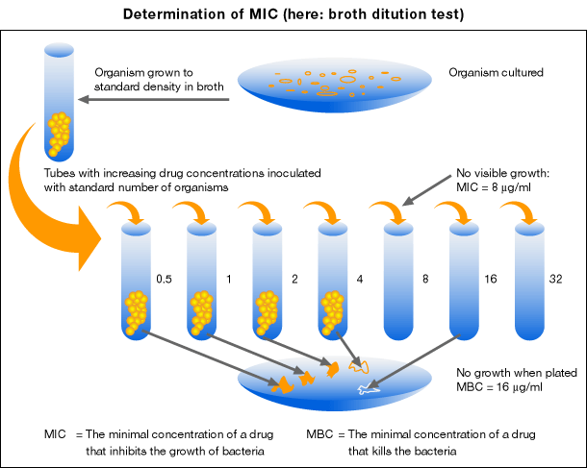
MIC: Minimum Inhibitory Concentration
Lowest concentration of a drug that prevents a bacterial inoculum from growing to visibly detectable levels
Time a drug concentration remains above the MIC
Ratio of maximal drug concentration to MIC
Ratio of the area under the concentration time curve to MIC

Slide 6
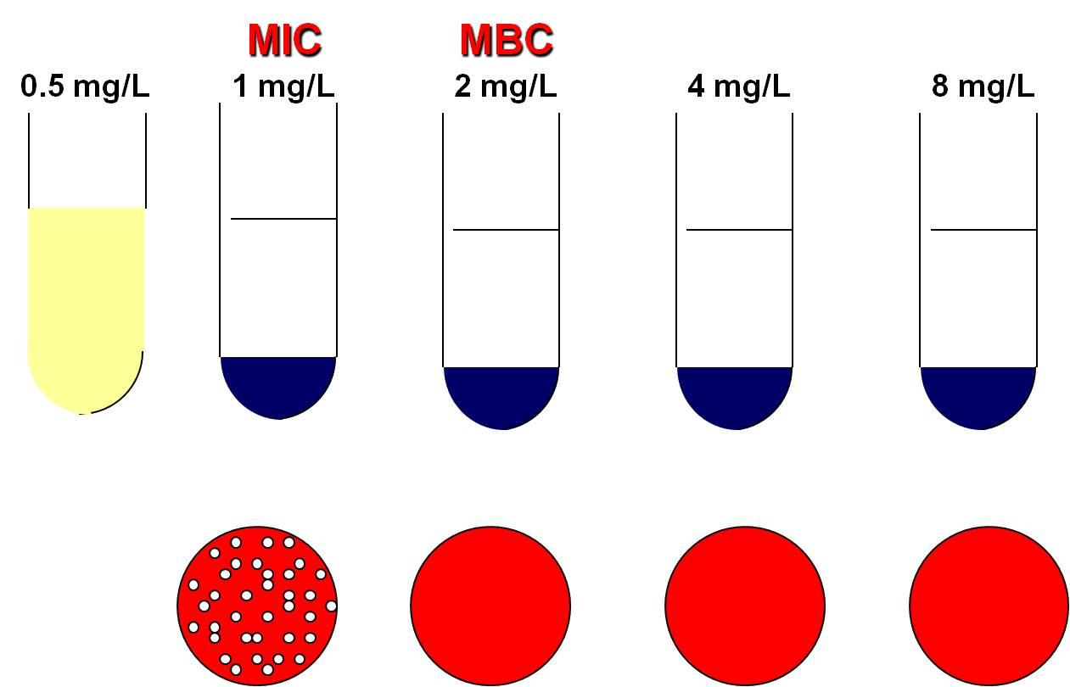
MIC tells us nothing about:
Bacteriostatic or bactericidal
Time or dosage dependent
Rate of Bacterial killing
Post-antibiotic effect
Dosing profiles that prevent or facilitate resistance
Notes:
Feast or famine cycle. The cells are exposed to constantly changing conditions with their optimum conditions for protein and antibody production being only a small part of this cycle. Just when things get good it is time to split the cells and start the process all over again.

Slide 7
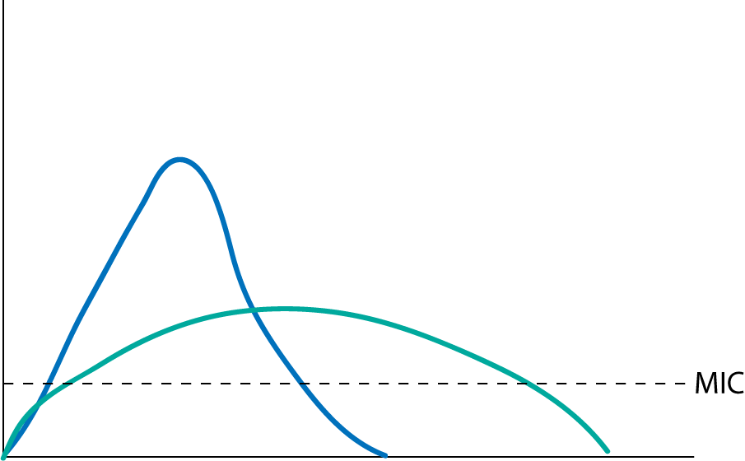
Antibiotic efficacy is tied to both concentration and time.

Slide 8
In vitro Testing Methods
Broth dilution test
Antimicrobial gradient test
Disc diffusion test
E-test

Slide 9
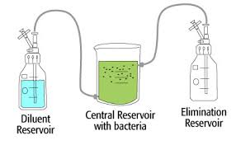
Assays in which both time and concentration are variable:
Time kill assay
Mouse thigh infection model
Hollow fiber infection model

Slide 10
Time Kill Assay, One Compartment
Open system, not bio safe
Bacteria numbers change over time
Large volume requires large amount of drug and diluent
Rapid changes in drug concentration not possible, cannot model short half-lifes

Slide 11
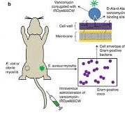
Mouse Thigh Infection Model
PK/PD may not mimic human values
Cannot sample over time
Hard to do large numbers of bacteria to reveal resistance
Many infections cannot be modeled in mouse

Slide 12
Hollow Fiber Infection Model

Slide 13
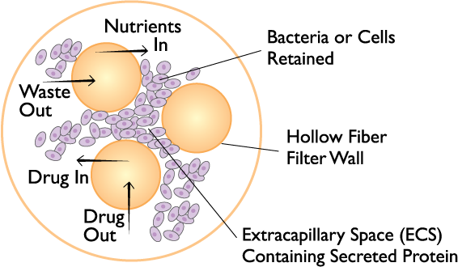
Hollow Fiber Cross-Section

Slide 14
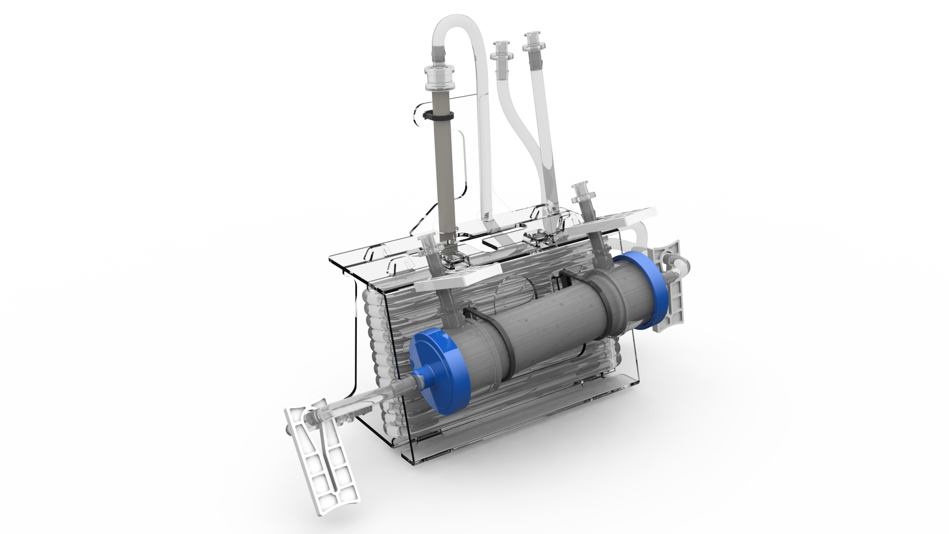
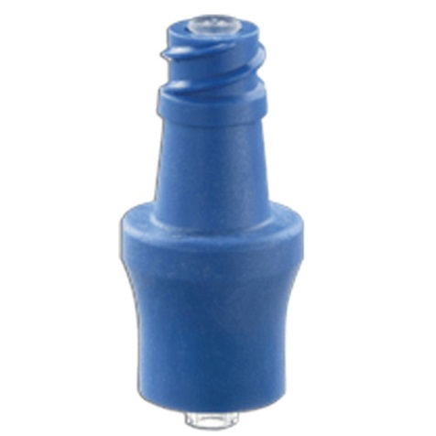
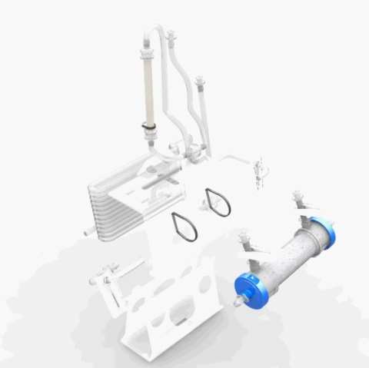

Slide 15
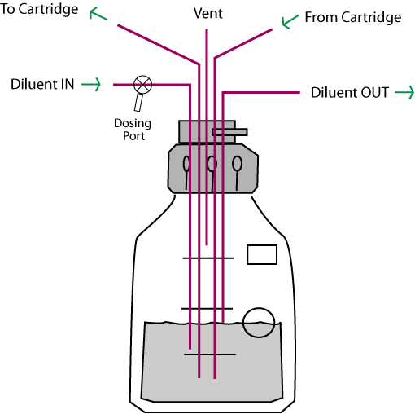
Reservoir cap

Slide 16
Advantages of the Hollow Fiber Infection Model
Closed, bio-safe system
Sampling over time
Large number of organism can be tested, revealing resistance
Precisely simulates human PK/PD
Repetitive sampling over time, both drug and organism
Total kill
Single use, disposable, consistent
Two drug models can be tested
Can model both dosing curve and elimination curve
Can look at bacteria in different growth phases and in combination with cells. Antiviral PK/PD as well.

Slide 17
Hollow Fiber Pretest Study Scheme

Slide 18
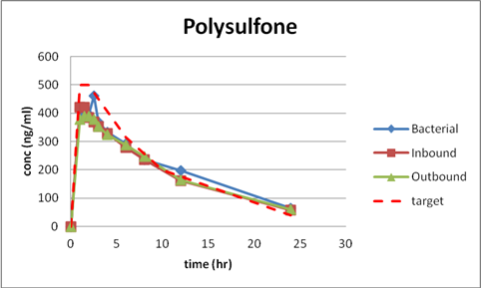

Slide 19
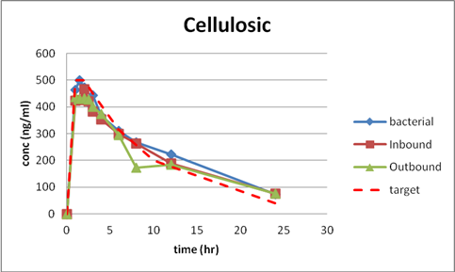

Slide 20
PK Profile

Slide 21
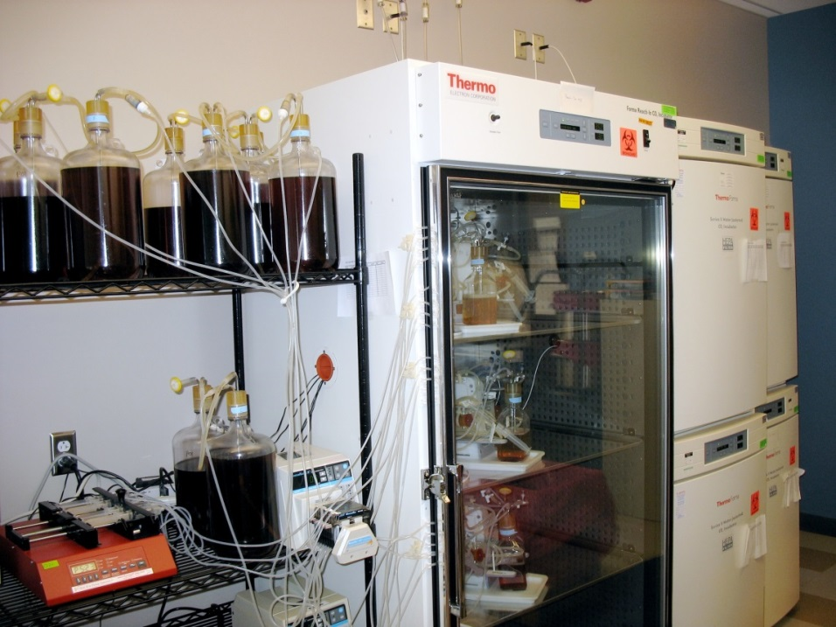
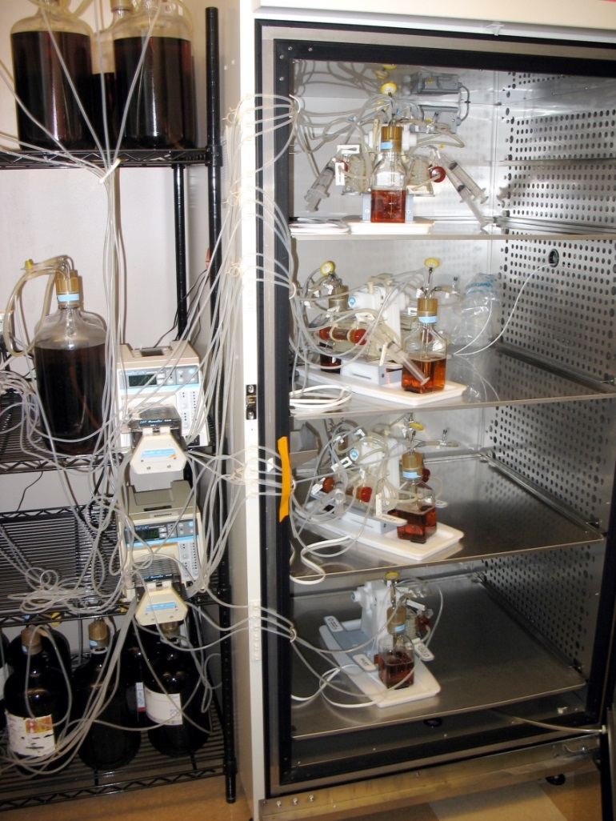

Slide 22
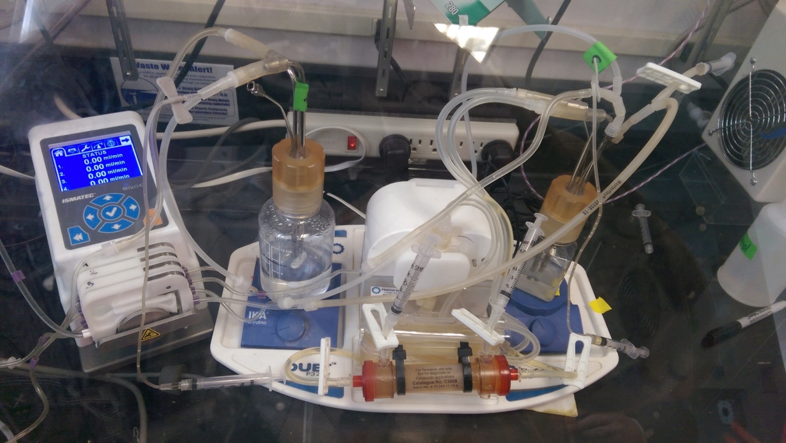
Anaerobic Chamber

Slide 23
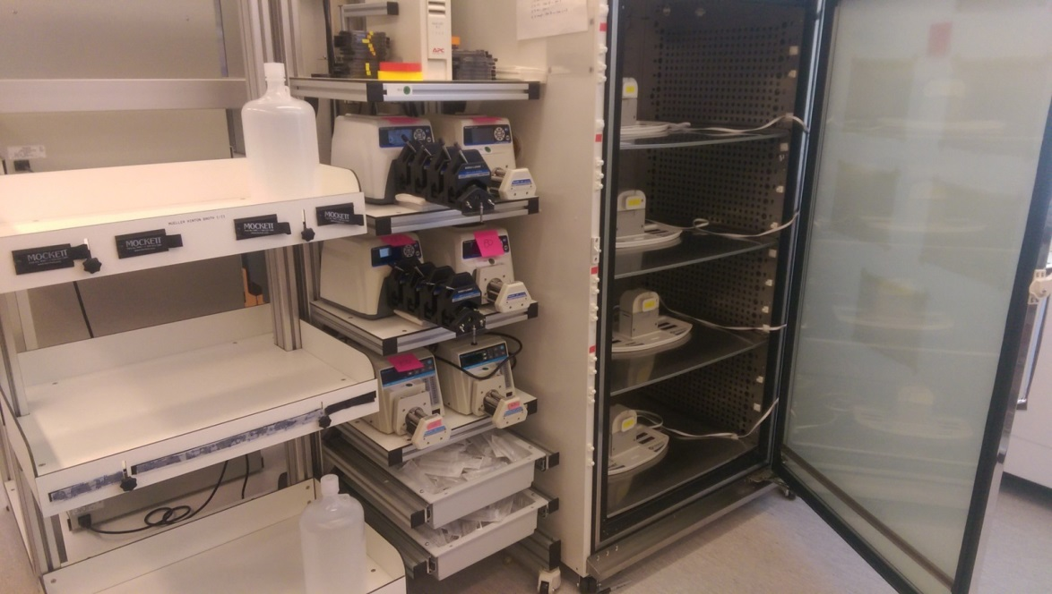
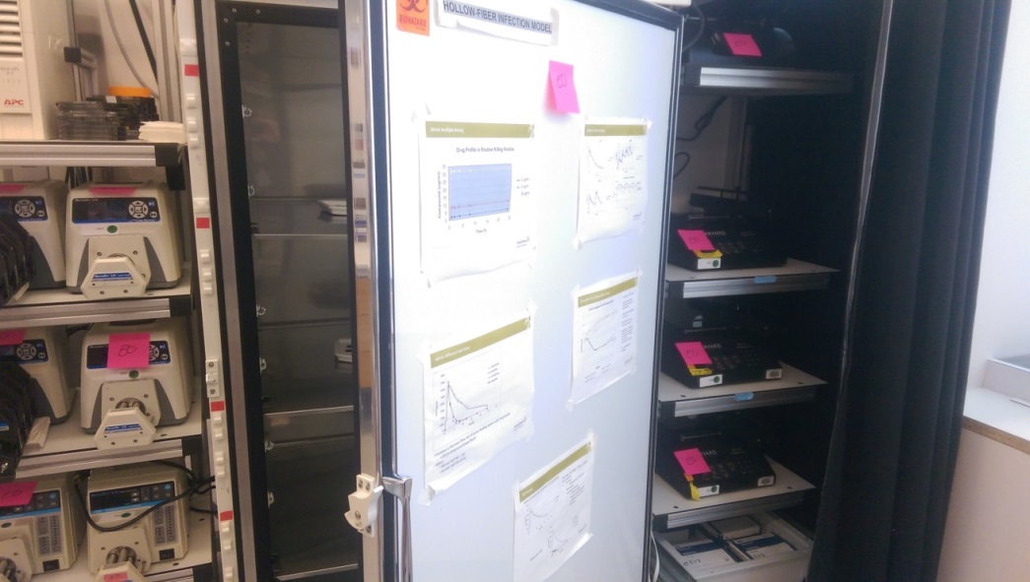

Slide 24
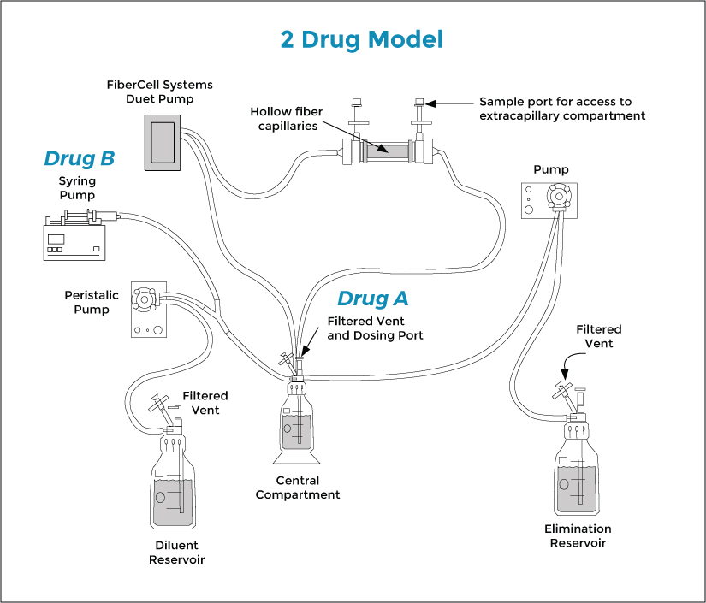
Two Drug Model

Slide 25
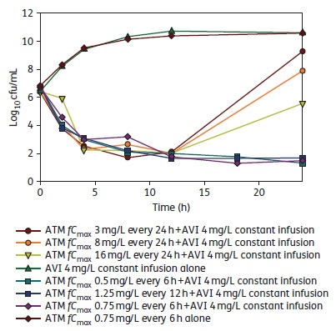
Drug Combination – Aztreonam/Avibactam
AVI 4 mg/L alone
ATM 0.75 mg/L-6 hrs alone
ATM 3 mg/L-24 hrs + AVI 4 mg/L
ATM 8 mg/L-24 hrs + AVI 4 mg/L
ATM 16 mg/L-24 hrs + AVI 4 mg/L
ATM 0.5 mg/L-6 hrs + AVI 4 mg/L
ATM 1.25 mg/L-12 hrs + AVI 4 mg/L
ATM 0.75 mg/L-6 hrs + AVI 4 mg/L
Bacteria regrow after 4~8 hrs with once-daily dosing.
When administered more frequently, total suppression was achieved at 24 hrs.

Slide 26
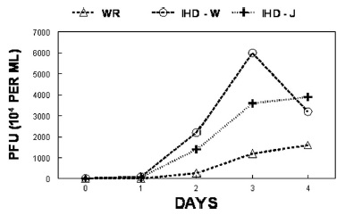
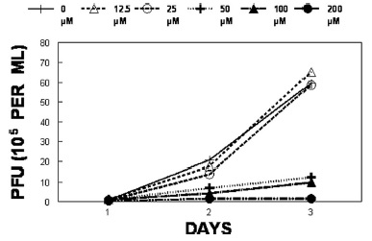
Drug Toxicology – Cidofovir for Vaccinia Virus
0 μM
12.5 μM
25 μM
50 μM
100 μM
200 μM
3 strains of Vaccinia Virus grow well in FiberCell Systems bioreactor
3 μM of Cidofovir represent largest dose administered to human
200 μM of Cidofovir ensure nearly complete suppression of virus

Slide 27
Pediatric Therapy for TB
Different bacillary burden
Distribution of disease (not just in lungs)
Drug metabolism and distribution
Toxicity
Adult regimen treatment for 18 months, more than 25% of children develop hearing loss

Slide 28
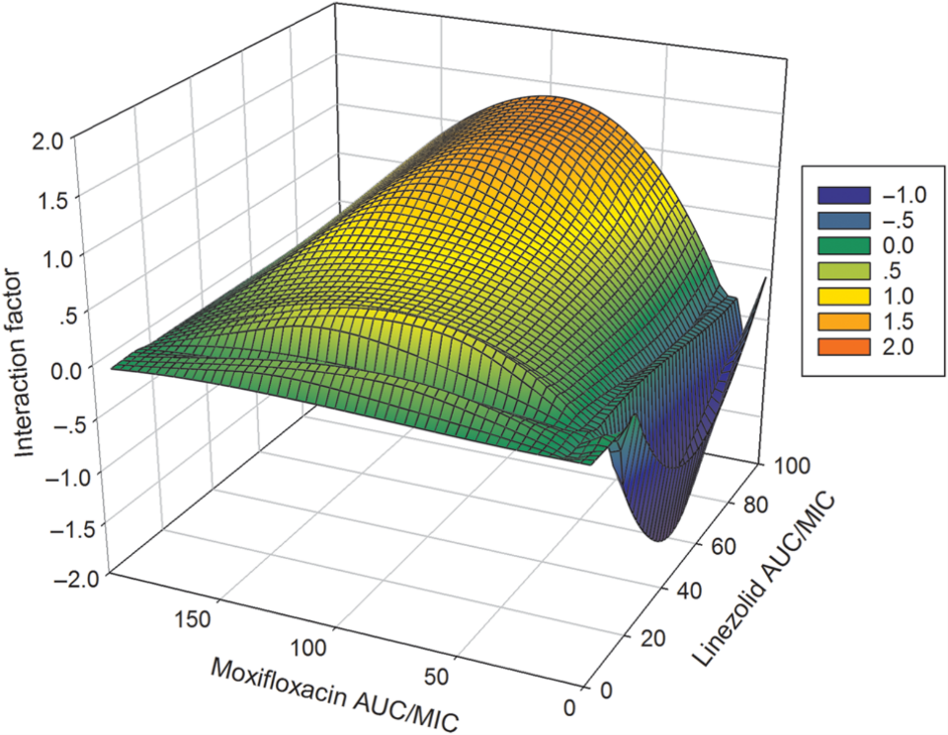
From: Concentration-Dependent Synergy and Antagonism of Linezolid and Moxifloxacin in the Treatment of Childhood Tuberculosis: The Dynamic Duo
Exposure-response surface for the linezolid-moxifloxacin combination effect against intracellular Mycobacterium tuberculosis, in wells. The figure shows antagonism on the surface bounded by moxifloxacin 0- to 24-hour area under the curve (AUC_{0–24})/minimum inhibitory concentration (MIC) ratios of 11.52–19.20 and linezolid AUC_{0–24}/MIC ratios of 12.0–22.08, shown in deep blue. The interaction factor was −0.02 (95% confidence interval [CI], −.03 to −.01). The zone of synergy was narrower, and was a ridge along a linezolid AUC_{0–24}/MIC ratio of 9.12 bounded by moxifloxacin AUC_{0–24}/MIC ratios of 19.2–192 with an interaction factor of 0.01 (95% CI, .01–.01). The rest of the surface, shown in shades of green, demonstrated additivity based on the finding that the observed effect minus the expected effect was zero.
Notes:
28

Slide 29
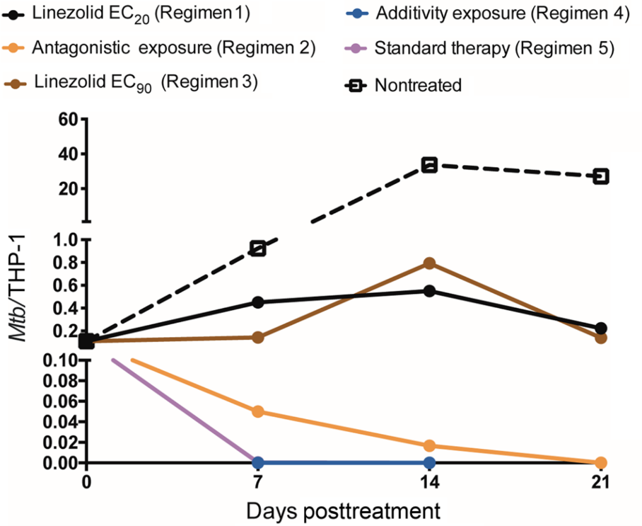
From: Concentration-Dependent Synergy and Antagonism of Linezolid and Moxifloxacin in the Treatment of Childhood Tuberculosis: The Dynamic Duo
Effect of microbial burden on THP-1 cells when expressed as a ratio of colony-forming units to number of THP-1 monocytes. Estimates are mean and standard deviation for 3 replicate hollow fiber systems. The number on bacteria per THP-1 cell is a composite of bacterial burden and drug toxicity–related viability of THP-1. The pattern and ranking order of regimens based on kill rates did not change, even when taking survival of THP-1 cells into account, and follows that of total bacterial burden shown in Figure . The slopes for the additivity exposure (regimen 4) and standard therapy regimen overlap completely, so that only one is visible in the figure. Abbreviations: EC₂₀, exposure associated with 20% of maximal kill; EC₉₀, exposure associated with 90% of maximal kill; Mtb, Mycobacterium tuberculosis.
Notes:
29

Slide 30
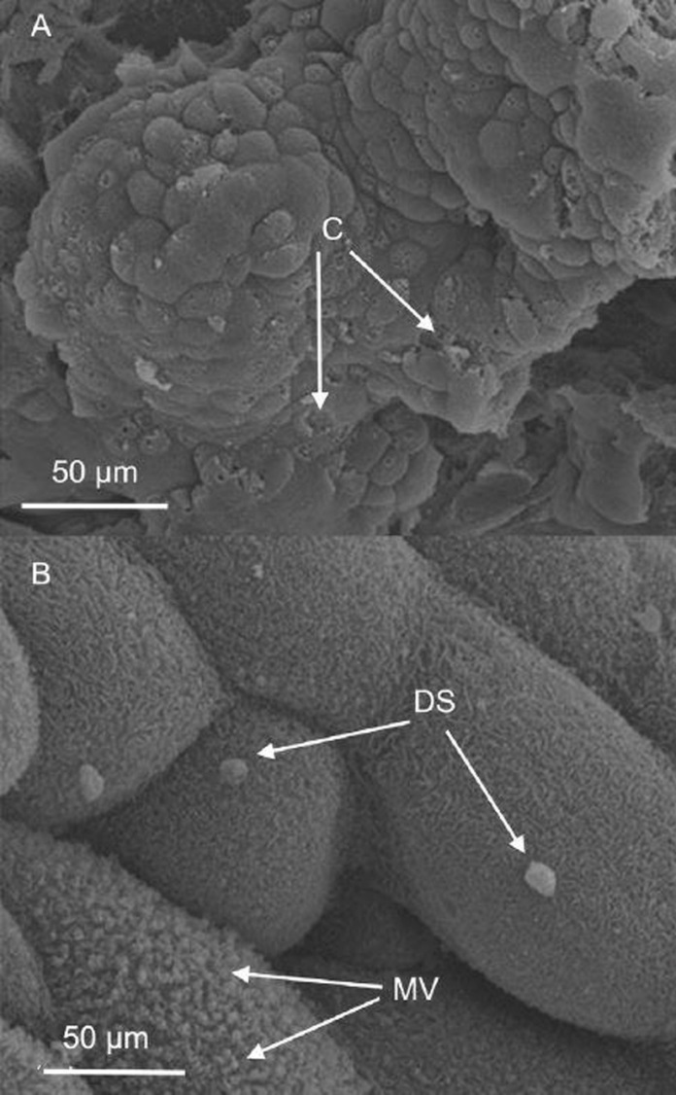
Cryptosporidium Model

Slide 31
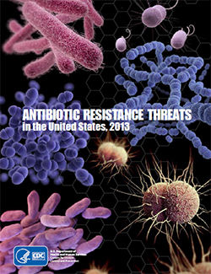
Regulatory position
EMA endorsement for TB
FDA expected to follow suit
Cartridges manufactured under ISO-14644-1 class 8

Slide 32
The hollow fiber infection model is a complementary and additional tool for drug development, to be implemented at the earliest stages
Optimal dose selection and route of administration
Optimal dosing schedule
Possible combination therapies
Defines emerging resistance
Defines total kill
Post-approval drug regimen optimization
Can support trial design for Phase I, II, III and IV clinical trials

Slide 33
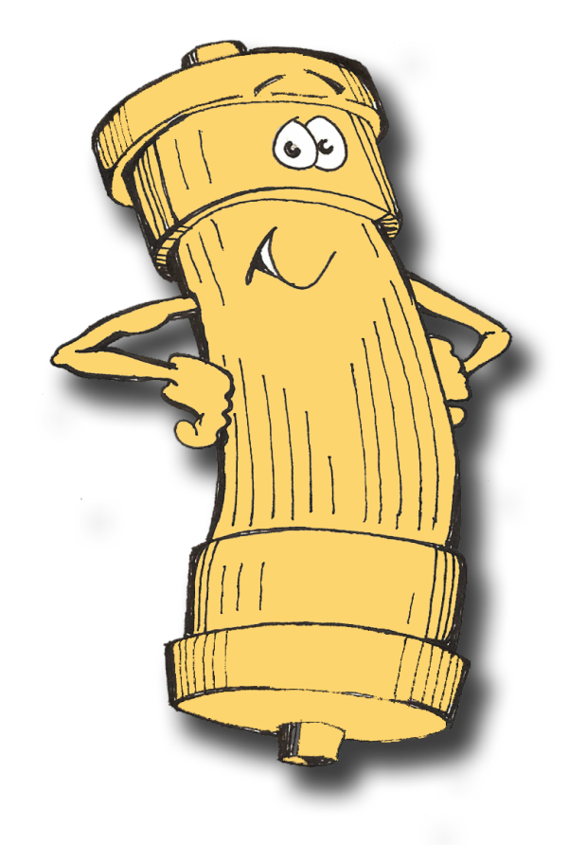
Thank you.

