Slide 1
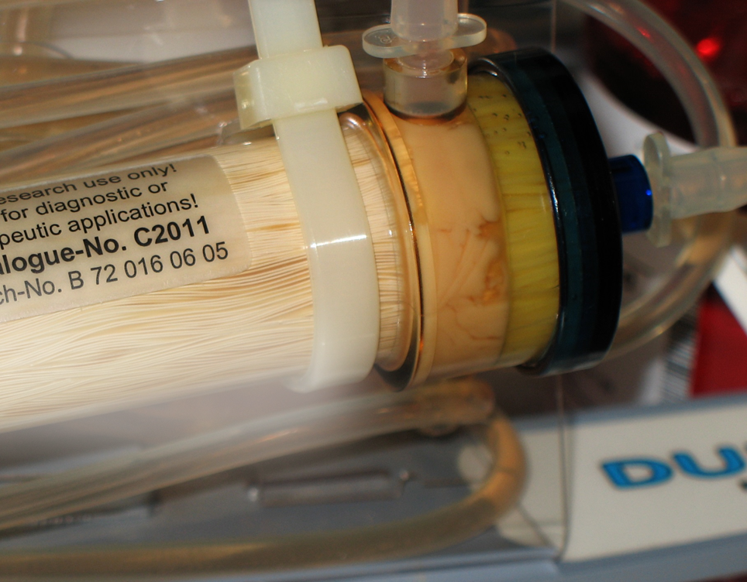

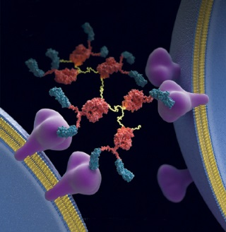
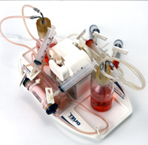
Beyond 3-D: Recapitulating Nature for Optimal Bioproduction
www.fibercellsystems.com
By John J. S. Cadwell
Notes:
FiberCell Systems, the only supplier of laboratory scale hollow fiber bioreactor systems since 2001

Slide 2
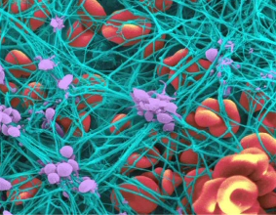
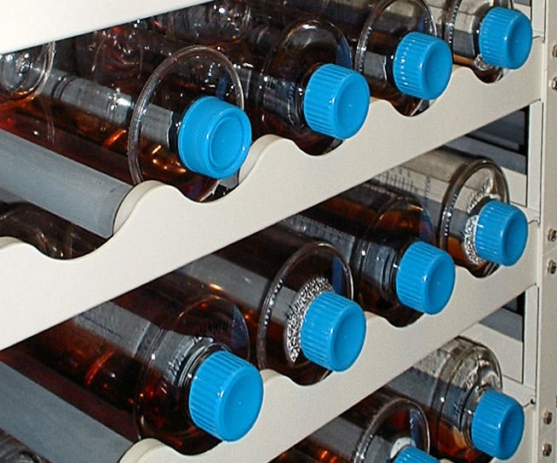
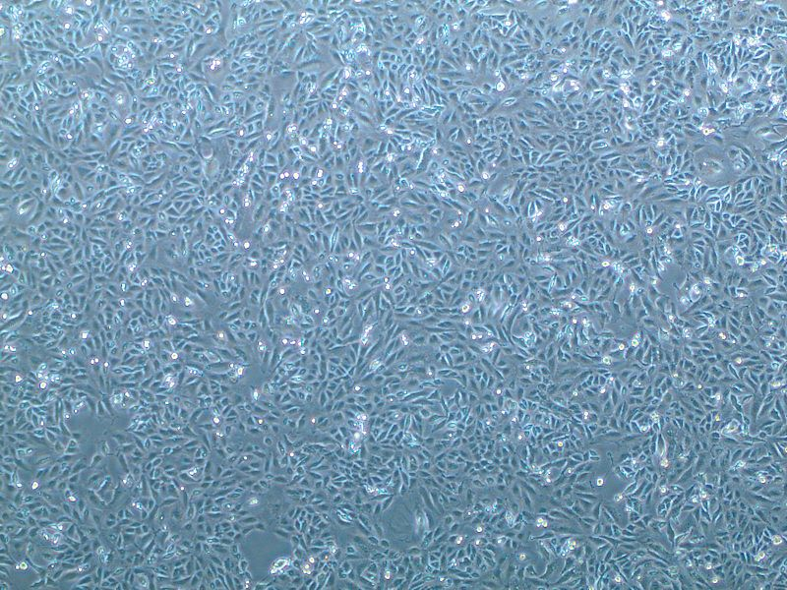
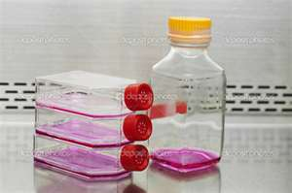
Cell Culture Through the Ages

Slide 3
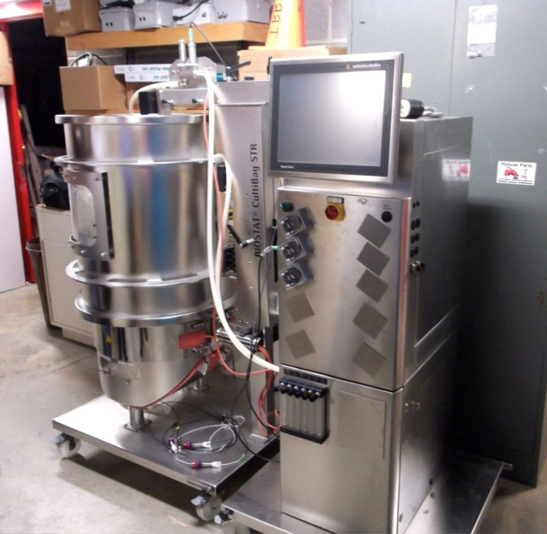
Cell Culture Options for Scale-up
Roller Bottles
Cell Factory
Cell Cube
Cell Culture Bags
Spinner Flasks
Bioreactors
Notes:
Scale up options are all based upon surface area increases but the cells are still bound to a non-porous plastic surface. Larger scale systems rely upon micro-carriers or some other sort of non-porous support or the adaptation of the cells to suspension culture using specialty mediums. The culture of cells under these conditions are non-physiologic.

Slide 4
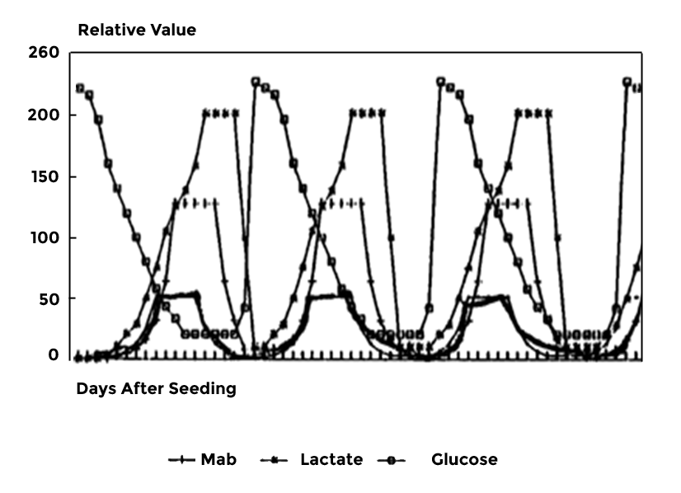
“Feast or Famine”
www.fibercellsystems.com
Notes:
Feast or famine cycle. The cells are exposed to constantly changing conditions with their optimum conditions for protein and antibody production being only a small part of this cycle. Just when things get good it is time to split the cells and start the process all over again.

Slide 5
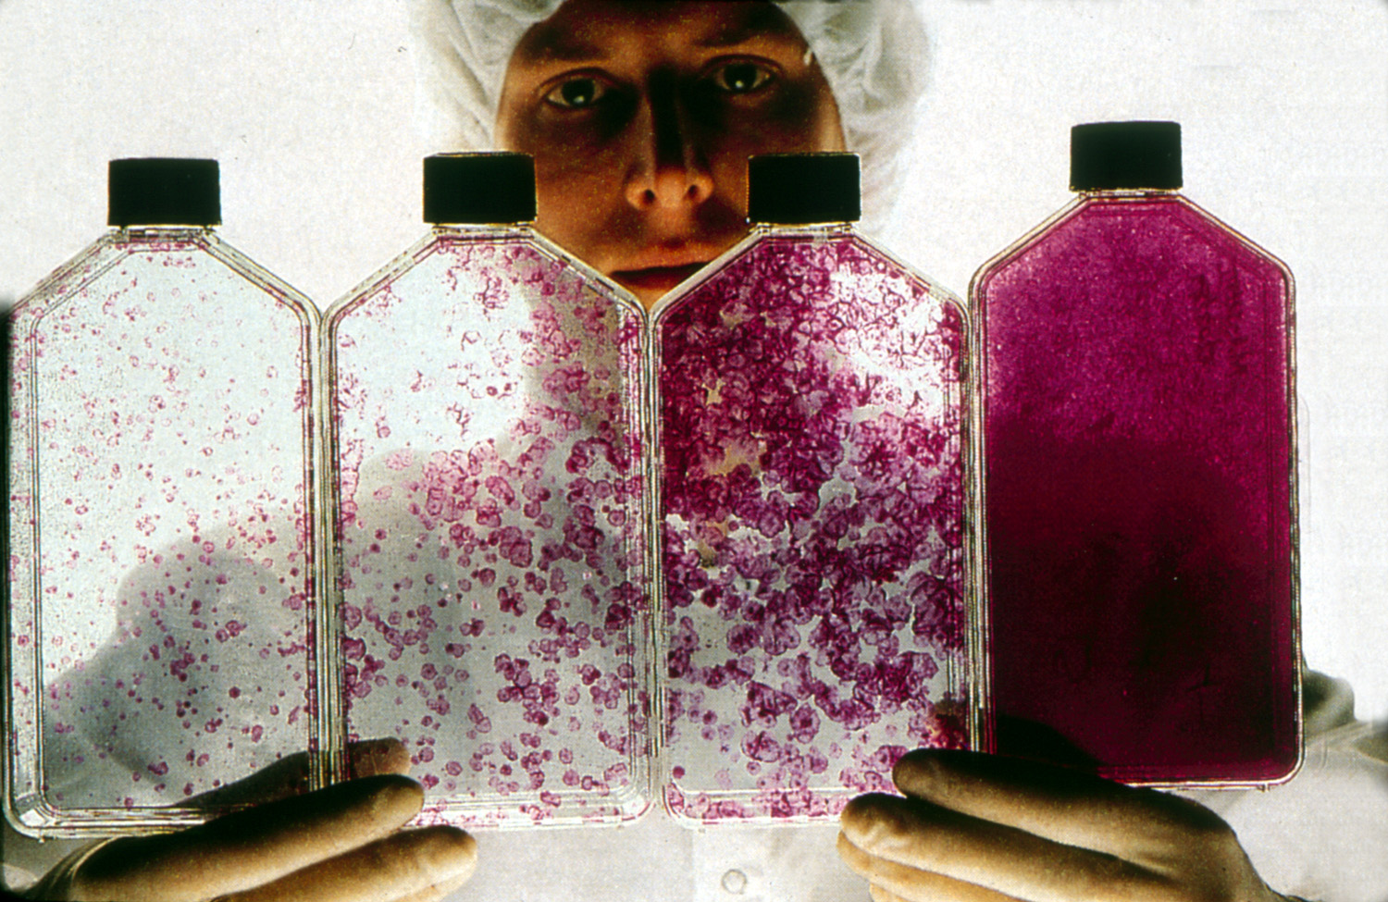
Notes:
Cells are sensitive to plating density. Since the nutrients come from the top down when cells reach confluence it is necessary to split the cells, otherwise the bottom layer does not receive oxygen and nutrients and the cells peel off and die.

Slide 6
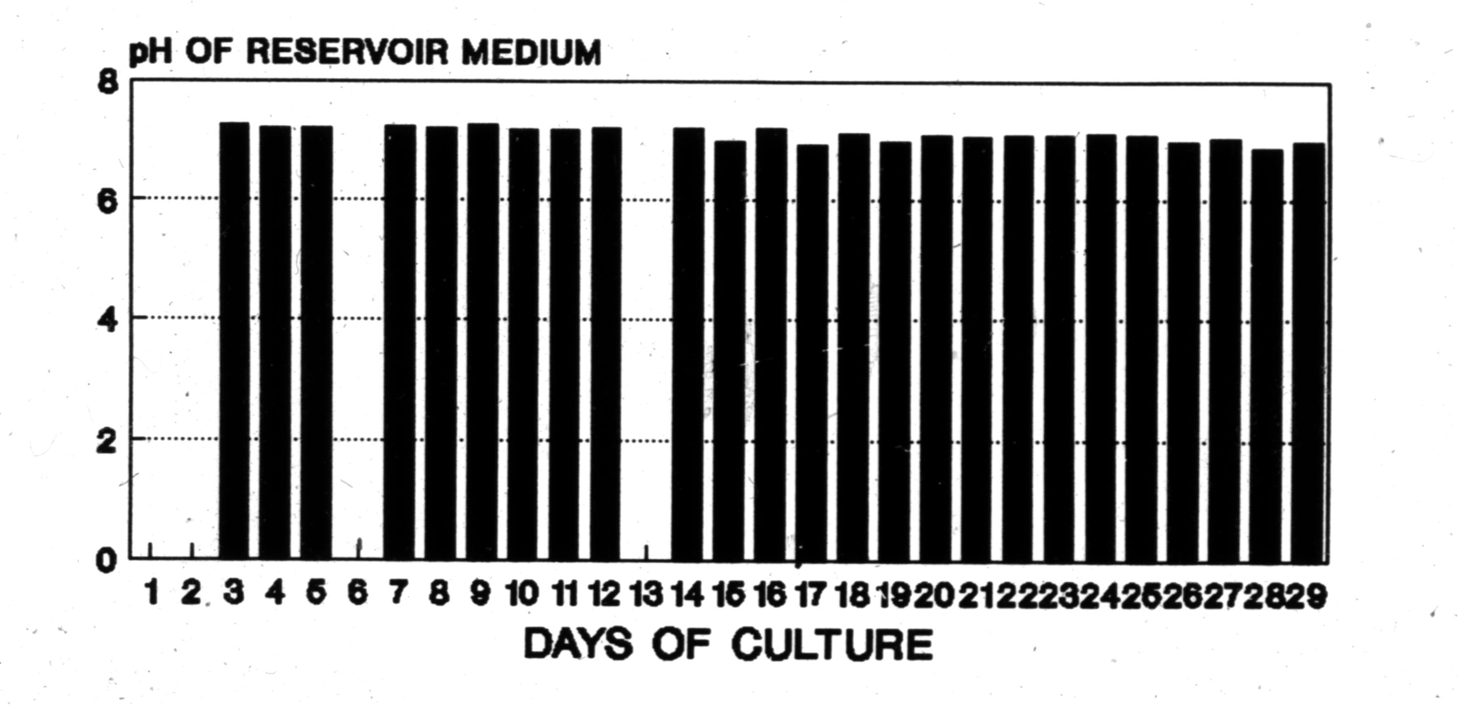
Hollow Fiber Culture of CHO Cells, pH Changes
Notes:
Hollow fiber cell culture maintains the cells at their optimum growth and production conditions consistently for long term culture. A glioma cell line has been maintained for 2 years of continuous culture, a hybridoma for one year of continuous production. Cytokines are concentrated around the cells eliminating lag phase, the cells do not need to be split and product is concentrated.

Slide 7
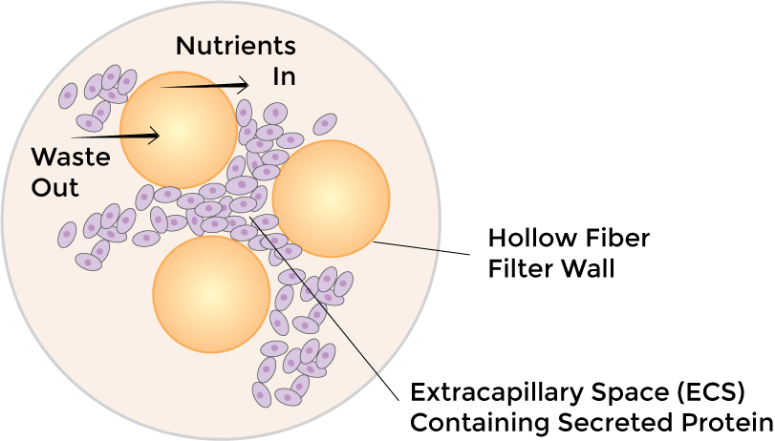
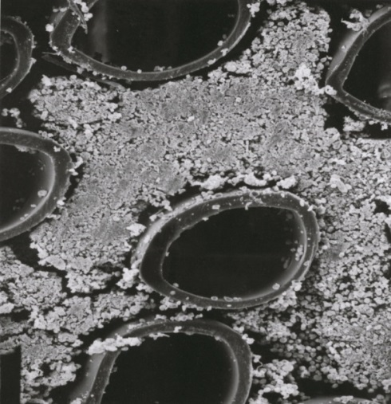
Hollow Fiber: How it works
Notes:
Cells densely populated in FiberCell Systems hollow fiber bioreactor. When harvesting it is not unusual to collect a 1-5 ml pellet. The cells at the end of the cartridge are viable due to the high gross filtration rate of the fibers.

Slide 8
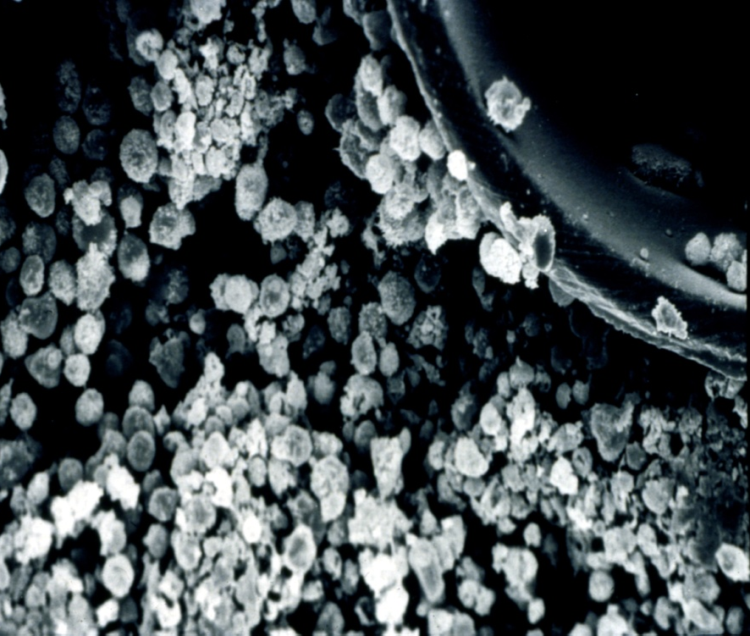
HF Culture of Lymphocytes
10⁸ + cells/mL
“Wavy” fibers optimized for suspension cells
High cell density permits adaptation to lower serum concentrations and protein-free medium such as CDM-HD
Notes:
High cell density permits the reduction of dependence upon serum, lower concentration of serum, serum free medium or CDM HD can support cells at this high density. FiberCell utilized wavy fibers resulting in even distribution of the fiber bundle inside the cartridge optimizing it for suspension cells as well as adherent cells.

Slide 9
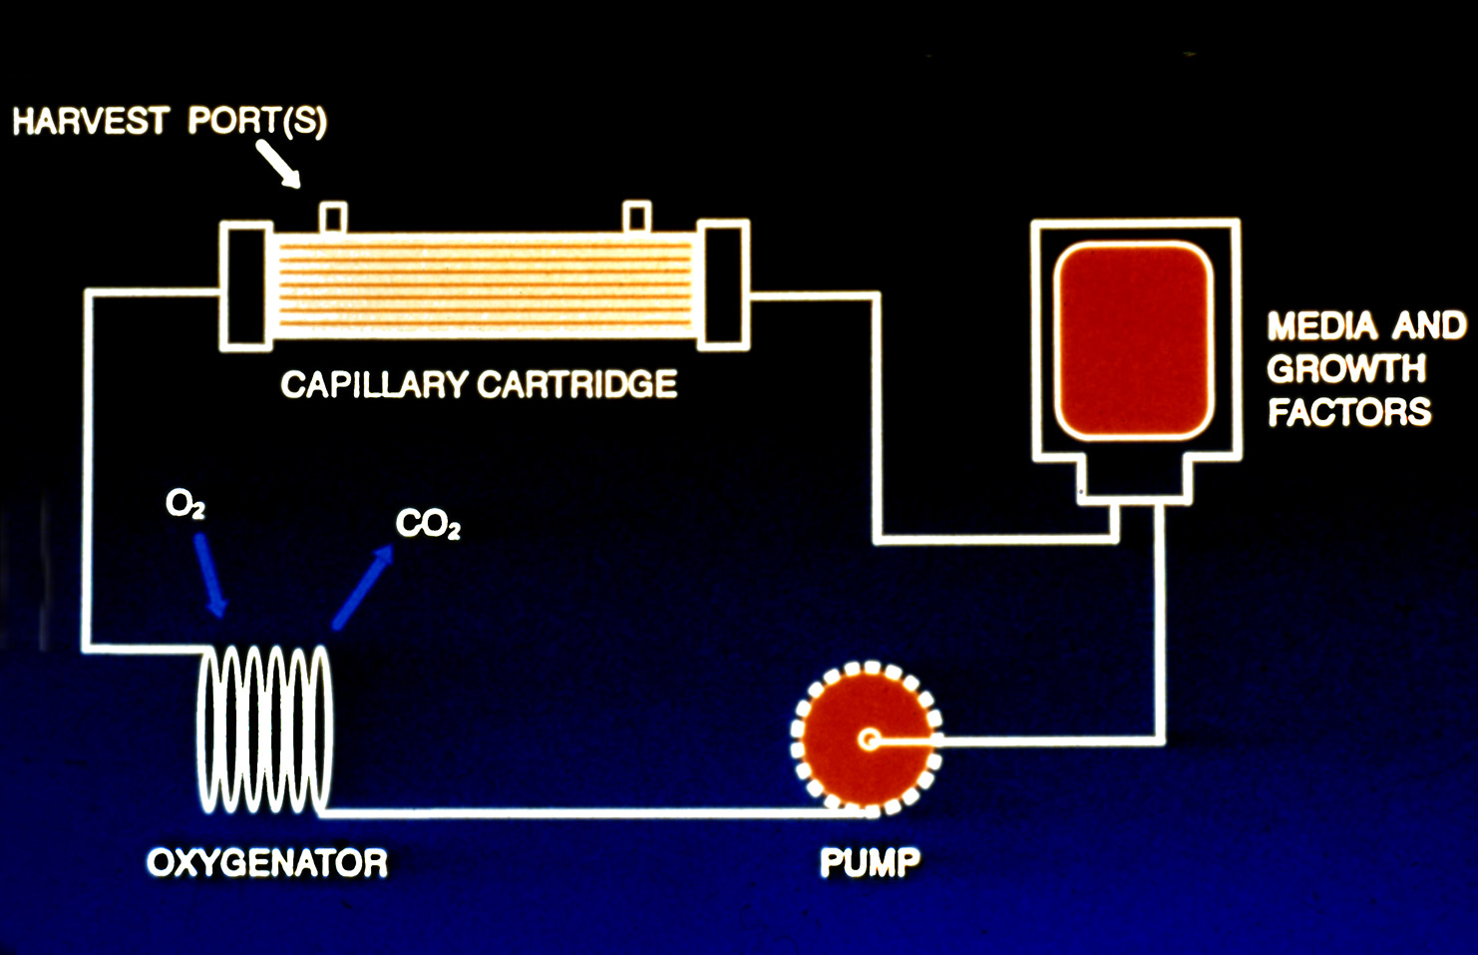
Positive pressure displacement pump
Silicone tubing for gas exchange
Closed, bio-safe system
Notes:
Schematic of the cartridge system. FiberCell utilizes a proprietary positive pressure displacement pump system, a squishy pump, that uses two one way check valves and a piston to generate up to 140 mls/minute flow rate with no wear on the pump tubing. Pulsatile flow enhances exchange across the fibers. The system is totally sealed for bio-safety, making culture of pathogens easy,

Slide 10
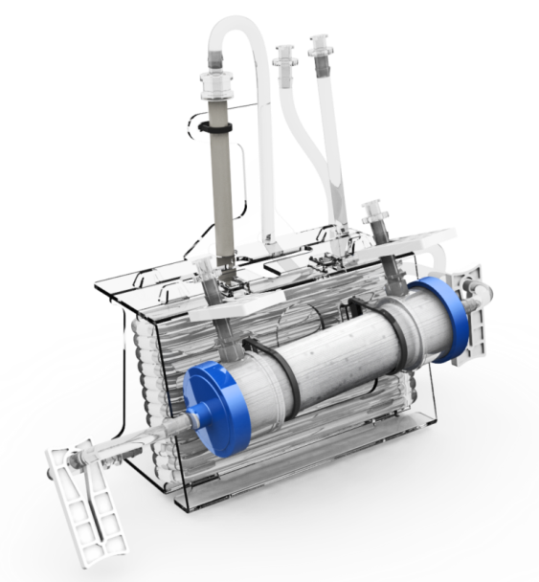
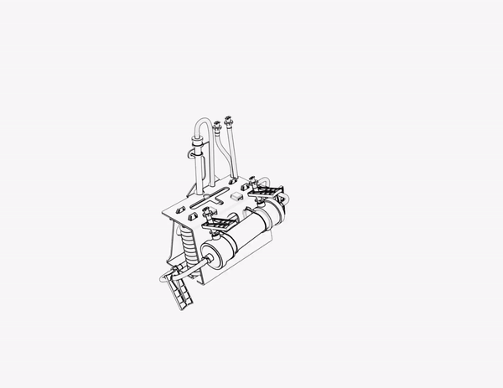

Slide 11
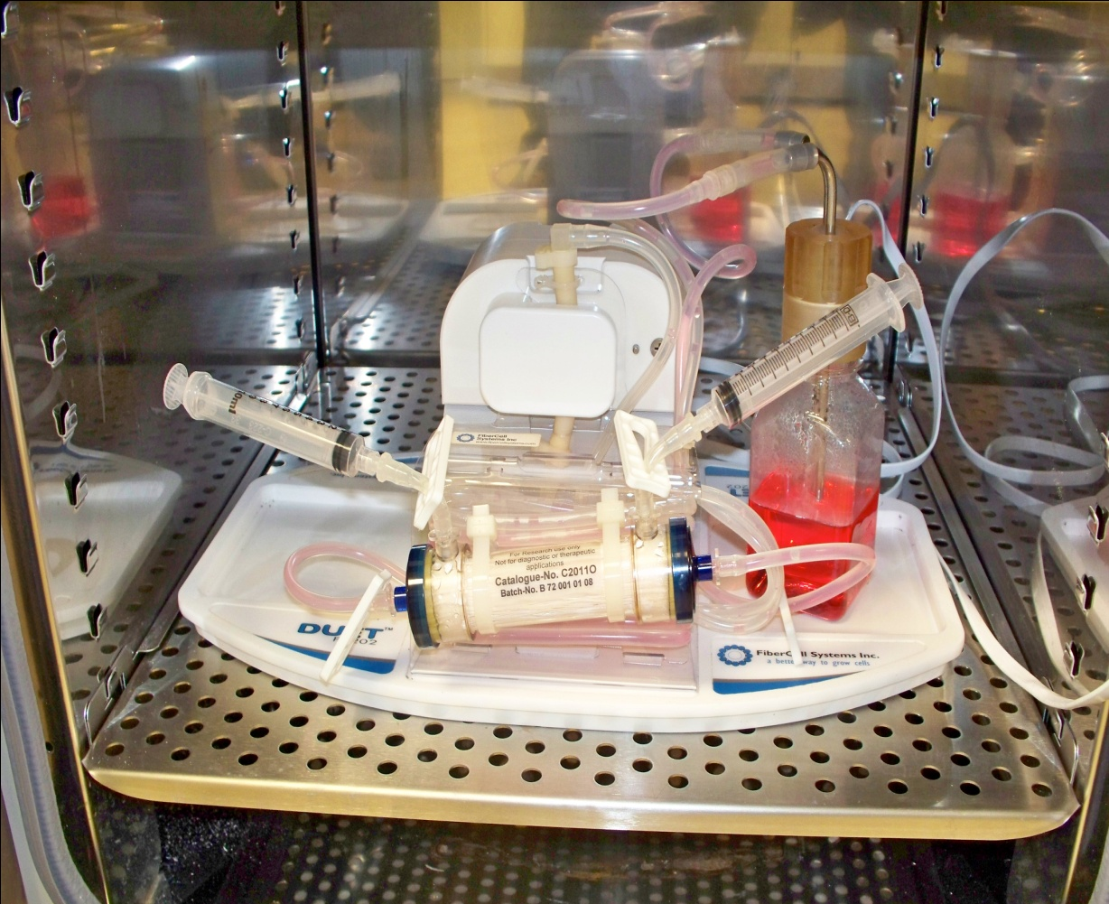
In the Laboratory
Fits in any standard sized incubator
Gas controlled by incubator
Temperature controlled by incubator
Thin cord for power
www.fibercellsystems.com
Notes:
The FiberCell Duet pump utilizes a thin cord to pass through the door of the incubator. Gas and temperature is controlled by the incubator. Gas exchange takes place across the loop of silicone tubing at the back of the flow path.

Slide 12
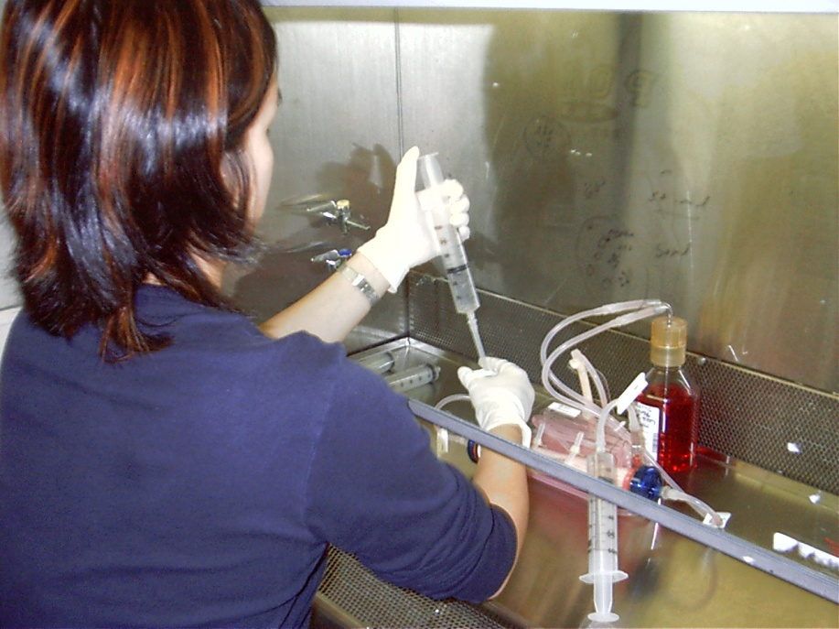
Working with the cartridge
Moves easily into hood
Good sterile technique always a plus
Maintenance only 15 minutes per day
Harvest product and measure glucose consumption
Notes:
Easy to work with. Always wear a lab coat and use good sterile technique.

Slide 13
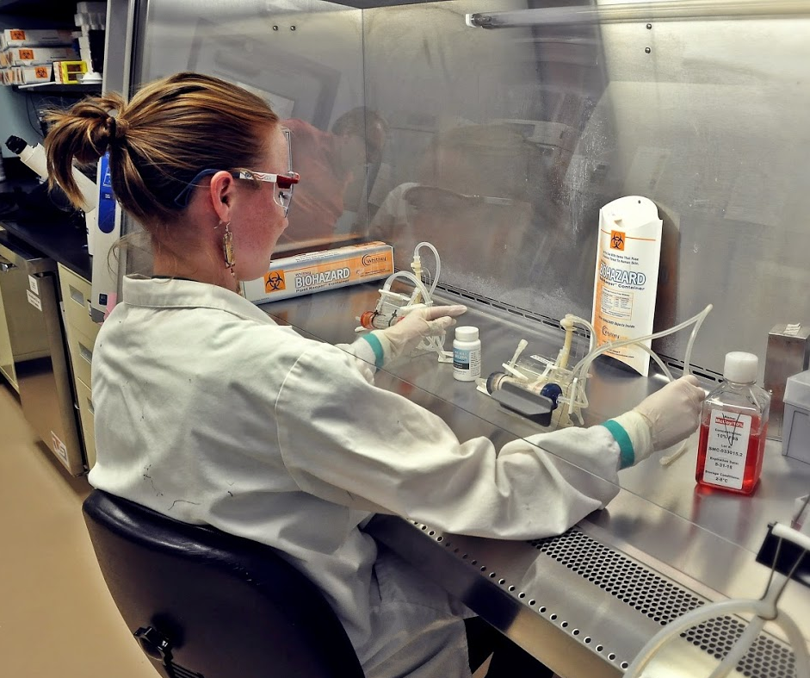
HF Applications
Monoclonal antibody production
Recombinant protein production
Conditioned medium
Exosome production
Endothelial cell culture under shear stress
Cell co-cultivation
in vitro toxicology
Notes:
Culturing in a hollow fiber bioreactor is the most in vivo like way to grow cells.

Slide 14
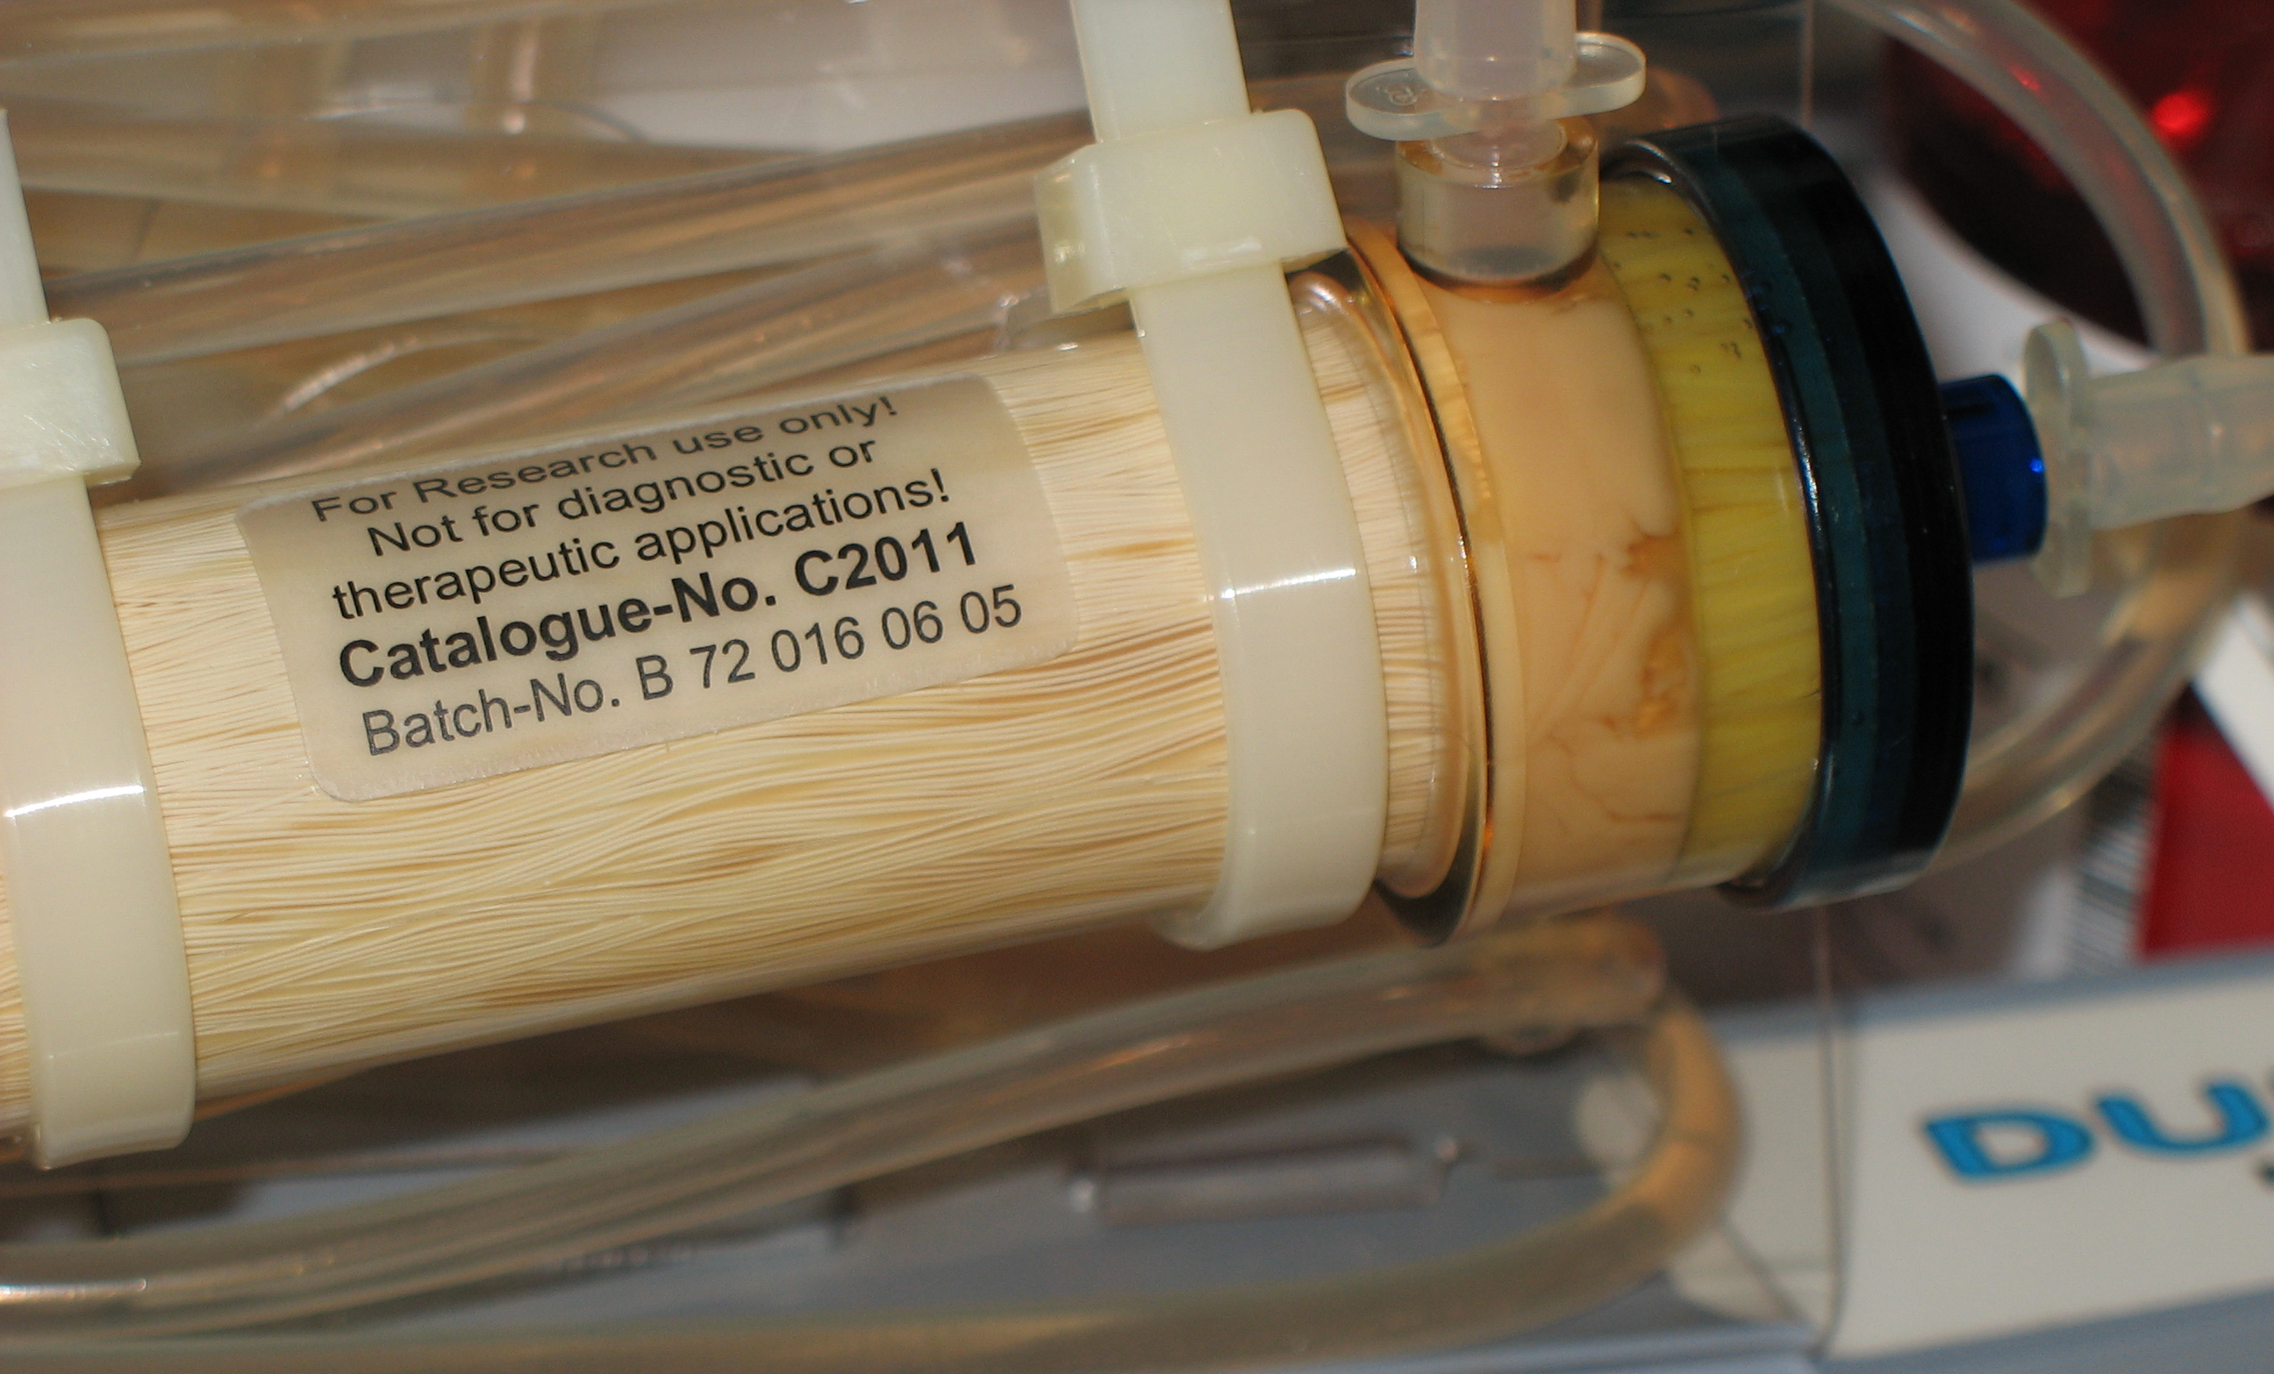
Notes:
Cells densely populated in FiberCell Systems hollow fiber bioreactor. When harvesting it is not unusual to collect a 1-5 ml pellet. The cells at the end of the cartridge are viable due to the high gross filtration rate of the fibers.

Slide 15
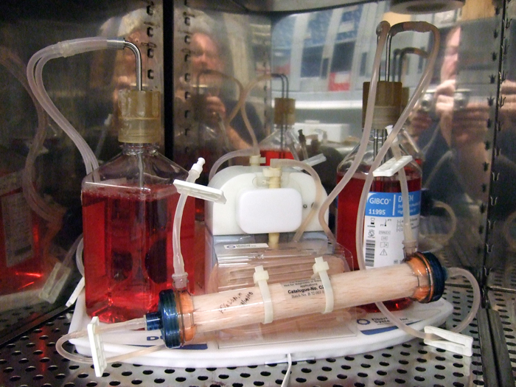
Advantages of Hollow Fiber Cell Culture
Concentrated product
Uniform and complete post-translational modifications
Low apoptosis, less contamination with intracellular proteins and DNA
Consistency of production over many months
Protein-free medium (CDM-HD)

Slide 16
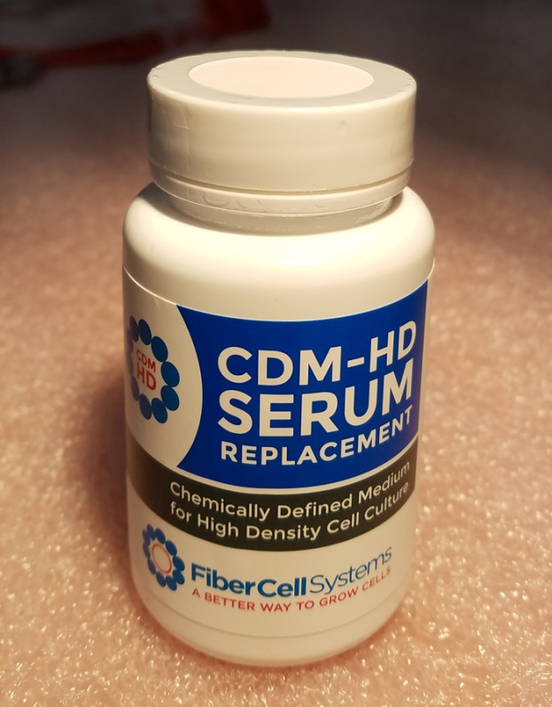
CDM-HD Serum Replacement
Optimized and simplified for HFBR
Contains no surfactants
Chemically defined, protein-free
cGMP compliant
Lot-to-lot consistency
Ship at ambient, store at 4˚C
Notes:
CDM Hd is a protein free, animal component free chemically defined serum replacement optimized for hollow fiber cell culture. It is the first time that a simplified medium takes advantage of specific cell culture conditions (i.e. high cell density) found in a bioreactor.

Slide 17
Mab Production using CDM-HD
MAb 1
week 2-3
MAb 1
week 4
MAb 2
week
MAb 2
week 4
TGF Beta diffuses out
Mab trapped in ECS
Easily adapt to SFM/CDM-HD
Lower endotoxin
.5 to 5 mg/mL conc.
5-100 mg per harvest
Continuous production for over 6 months
MAb 2
week 3
Mab 1:
168 mg in 60 mL volume, 2.8 mg/mL.
9 L of medium consumed, 3 weeks culture.
170
130
95
72
55
Heavy Chain
43
Mab 2:
159 mg in 70 mL volume, 2.3 mg/mL.
11 L of medium consumed, 3weeks culture.
34
26
Light
Chain
Notes:
Easily produce 100 mgs or more of antibody per week. These antibodies were produced using DMEM and CDM HD at 10%. Please note, this is not purified antibody but a straight harvest from the cartridge. Note the lack of contaminating proteins from serum or cytoplasmic proteins from the cells.

Slide 18
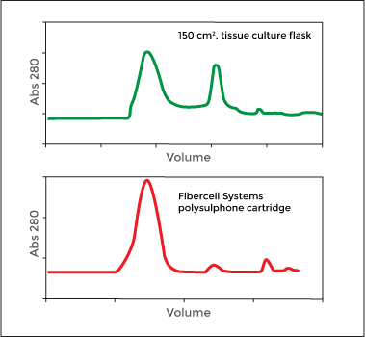
Recombinant Protein Production
Both suspension and adherent cell types
100x+ higher concentration
Easily adapt to SFM
Can provide improved protein folding
Notes:
Gel filtration chromatography of a hexeramized IgG produced in CHO cells. Top graph shows results when cells are cultured in flasks, bottom trace shows results when cultured in a FiberCell Catalog number C2018. 95% of the protein is now produced as a properly folded hexamer, better cell culture conditions in the cartridge result in better protein folding and production.

Slide 19

Journal of Biological Chemistry, Sept 2007
Notes:
Hexeramized IgG produced in CHO cells in the C2018 cartridge. .5 gram produced in 60 days in a total harvested volume of less than 5 liters. This is a cryo-electron tomograph of the actual protein showing the 6 IgG1 subunits held together with 3 IgA tails. The Fv region has been replaced with CD 4 receptor. It is shown cross-linking two HIV viruses together via attachment to the GP120 protein on the surface of the virus, inactivating the virus.

Slide 20
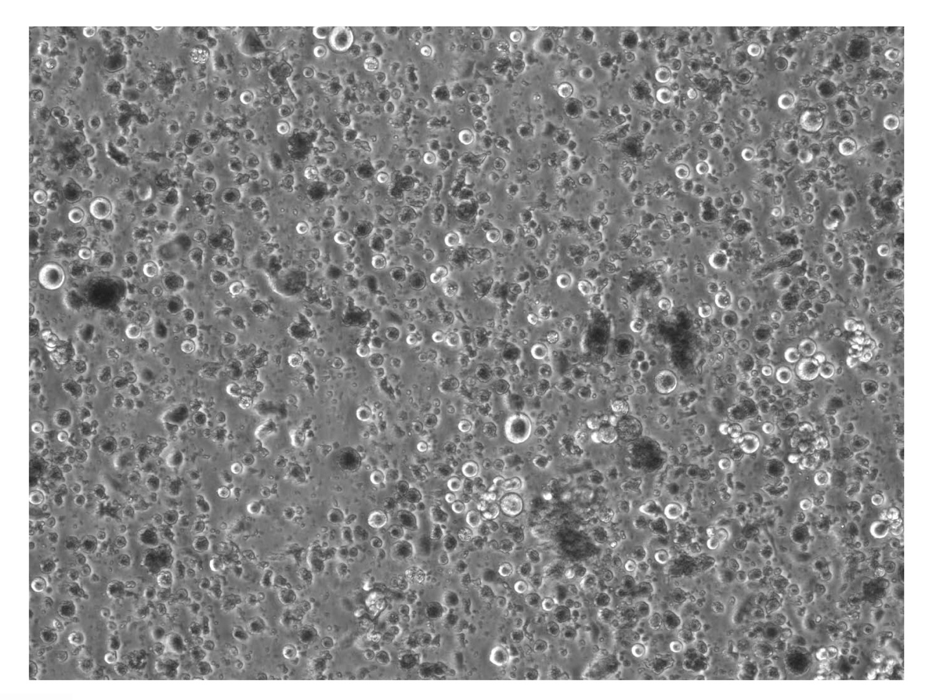
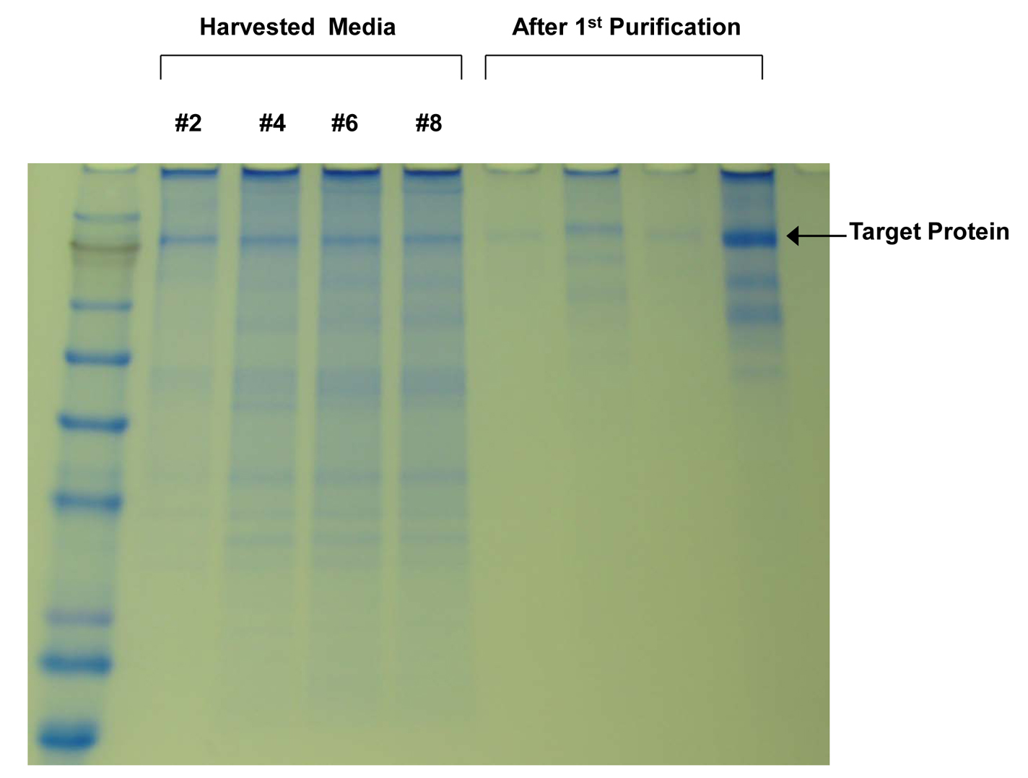
Raw Harvests from DG44 CHO Cell Line
Notes:
Raw harvest from hollow fiber bioreactor. The protein of interest makes up the majority of protein present.

Slide 21
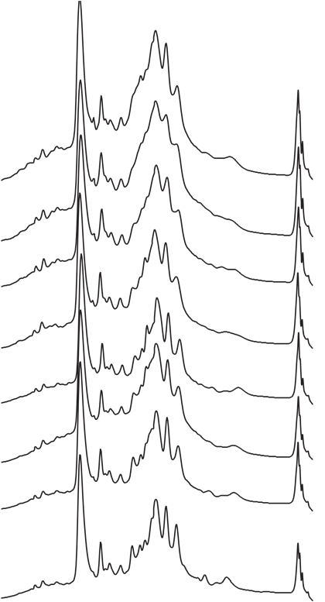
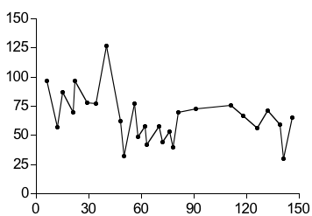
Stable Cytokine Production in HFBR
Over 5 Months
Cytokine
RP-HPLC Analysis, Serum Free Harvest
HFBR Production - mg/L
29
Cytokine, mg/L
42
60
74
Day
89
Day
103
118
137

Slide 22
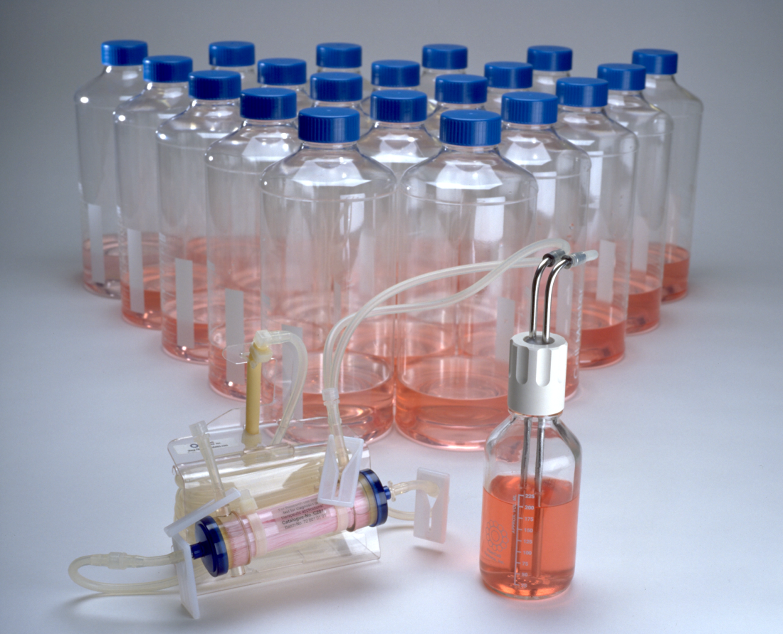
HFBR Equivalents
A single harvest from C2011 can equal 20 roller bottles per day
A single harvest from C2018 can equal 200 roller bottles per day
10 mL harvest volume can equal 1 liter of cell culture supernatent
Notes:
A single hollow fiber cartridge can replace 100’s of roller bottles over months of culture.

Slide 23
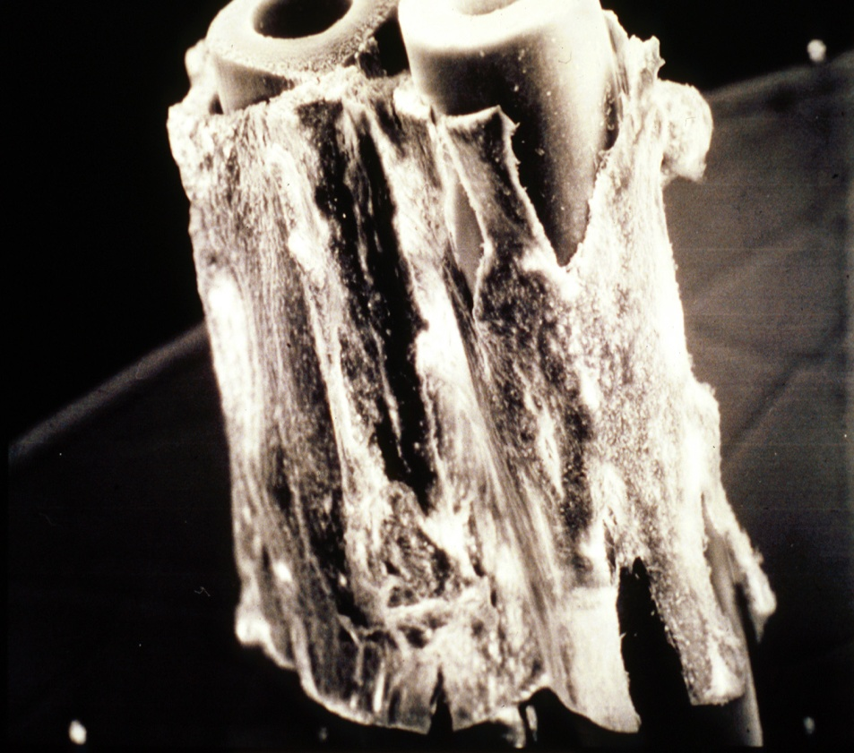
Asymmetric Cell Co-Cultivation
Co-cultivation of endothelial cells (inside) and vascular smooth muscle (outside)
Brain endothelial and astroglial cells to form in vitro blood brain barrier
Notes:
Demonstration of the 3-D culturing of endothelial cells on the inside of the cartridge and vascular smooth muscle on the outside. As the shear stress changes on the endothelial cells g protein formation and endothelin receptor expression in the smooth muscle cells is directly affected.

Slide 24
Flattened Endothelial Cells on Inside of Fibers
Inside of hollow fiber
Crack! Likely to be a result of trying to mount a sliced hollow fiber during microscopy
Pore
Endothelial cell
These endothelial cells had been adhered to the inside of the fiber and subjected to minimal shear force over night followed by a minimum of 5 hours at 10 dynes/cm². This was based on results we saw when testing the application of a different system that can apply shear force to channels lined with endothelial cells while visible under a microscope. This other system also allowed us to discover that endothelial cells will detach and roll away after alignment if a bubble passes over them so we eliminate all bubbles from the system to preserve the endothelial layer.

Slide 25
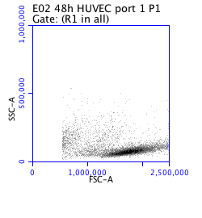
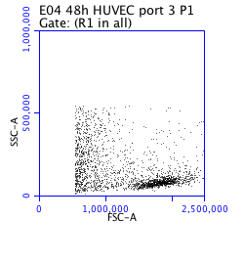
CLL Cells Actively Migrate into the
Extra-vascular Space
Circulating
Compartment
Extra-vascular space (migrated
compartment)
Scanning electron micrograph of the outside of a hollow fiber after circulation of CLL cells around the system.
CLL cells

Slide 26
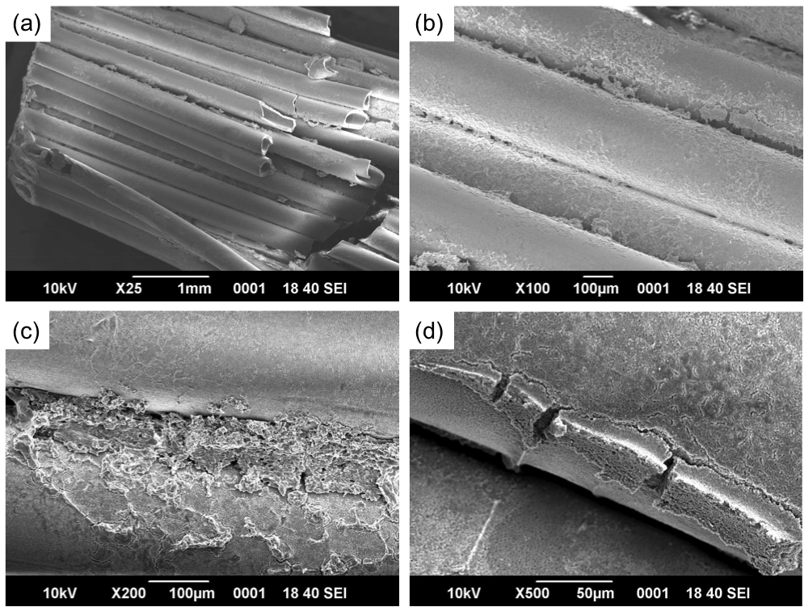
Bone Marrow Stroma/HSC Co-Culture

Slide 27
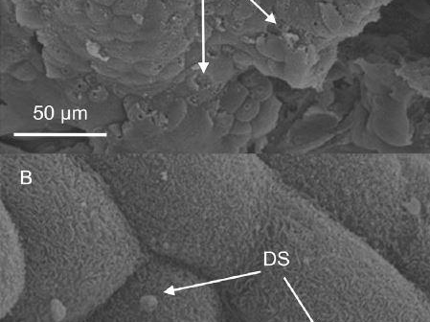
Cryptosporidium Culture in an Artificial Gut Model
Notes:
Demonstration of the 3-D culturing of endothelial cells on the inside of the cartridge and vascular smooth muscle on the outside. As the shear stress changes on the endothelial cells g protein formation and endothelin receptor expression in the smooth muscle cells is directly affected.

Slide 28
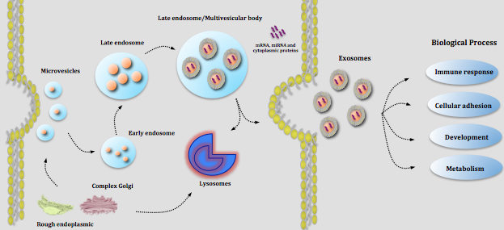
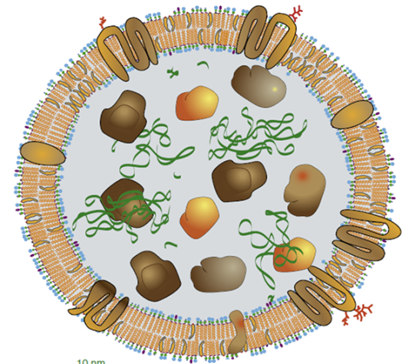
Exosomes
Cell-derived vesicles in biological fluids
Including medium of cultured cells
Diameter between 30 and 100 nm
Contain cellular proteins and RNA
Facilitate cell-to-cell transfer of cargo
May play a role in cell-to-cell signaling
May mediate adaptive immune responses

Slide 29
Human Adipose Derived Adult MSC
 | 130 T225 Flasks | One C2011 Bioreactor
Harvest Volume | 4000 mL | 120 mL
Protein | 0.9 mg | 28.45 mg
Particles | 1.6x10¹⁰ | 8.6x10¹¹

Slide 30
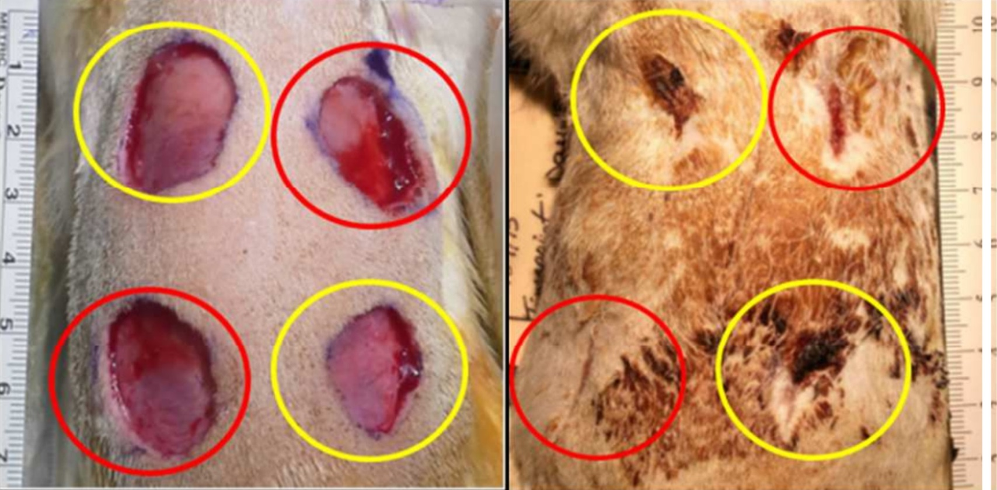
Exosome Mediated Wound Healing

Slide 31
Advantages for Exosome Production
Large numbers of cells can be cultured in a small space
Secreted exosomes are concentrated
Continuous production over several months
Serum can be used without contamination from endogenous exosomes
CDM-HD can be used for cGMP production
Cell proliferation may be limited

Slide 32
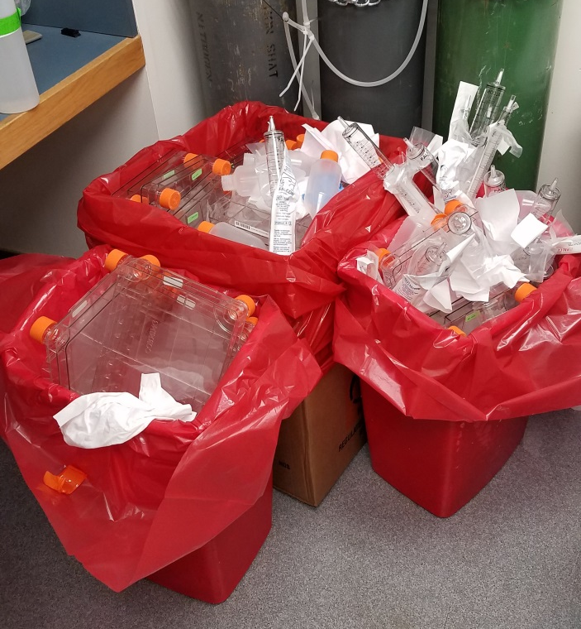
Plastic Waste Generated by 1x10⁹ Cells

Slide 33
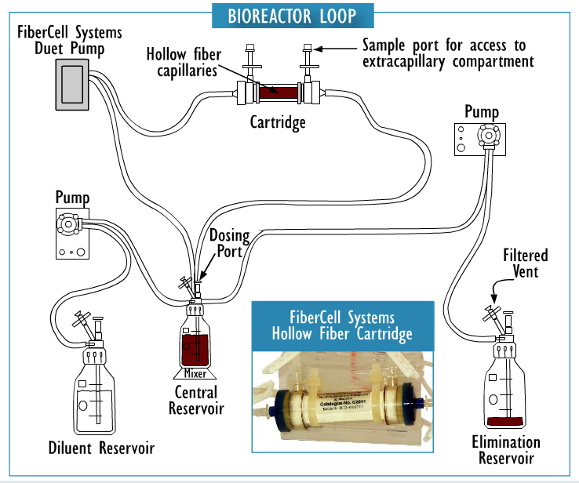
Time Course Dependent Modeling of Human Antibiotic PK/PD

Slide 34


FiberCell Systems HFBR in Space

Slide 35
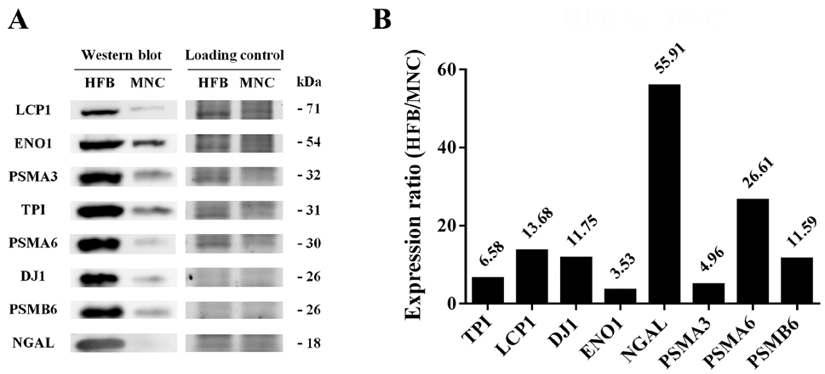
Secretome Analysis for Cancer Biomarker Discovery
Comparison of Flask vs. HFBR

Slide 36
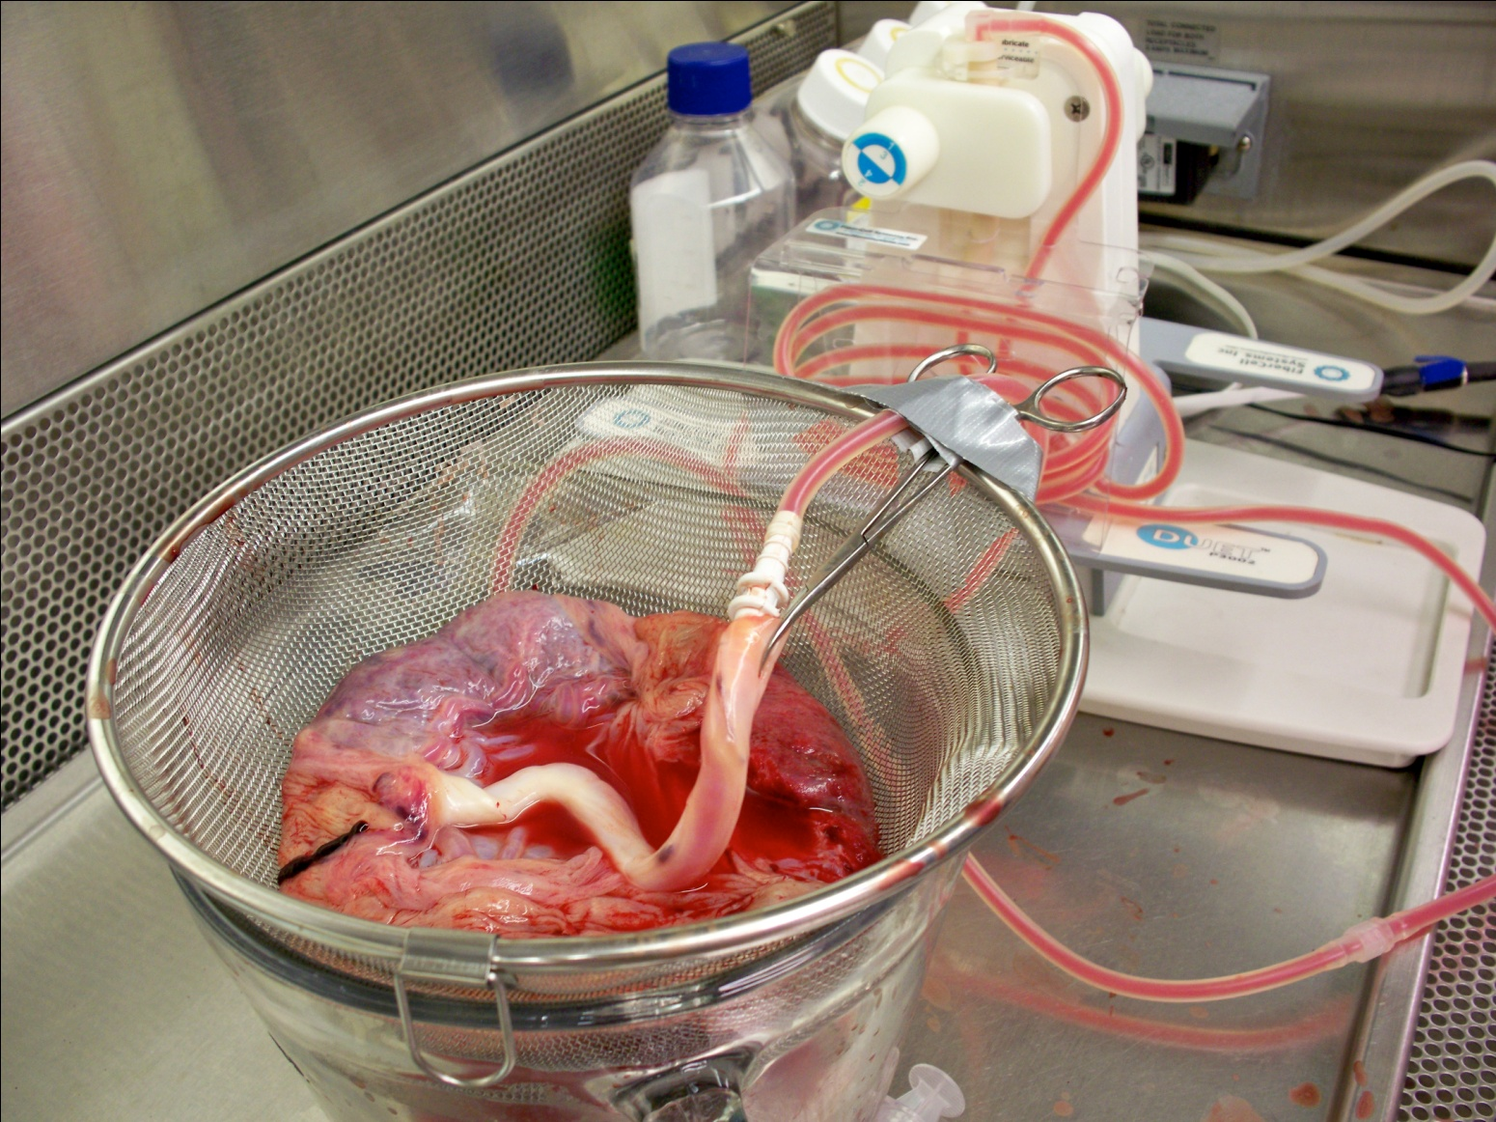
Pulsatile Perfusion of Placenta

Slide 37
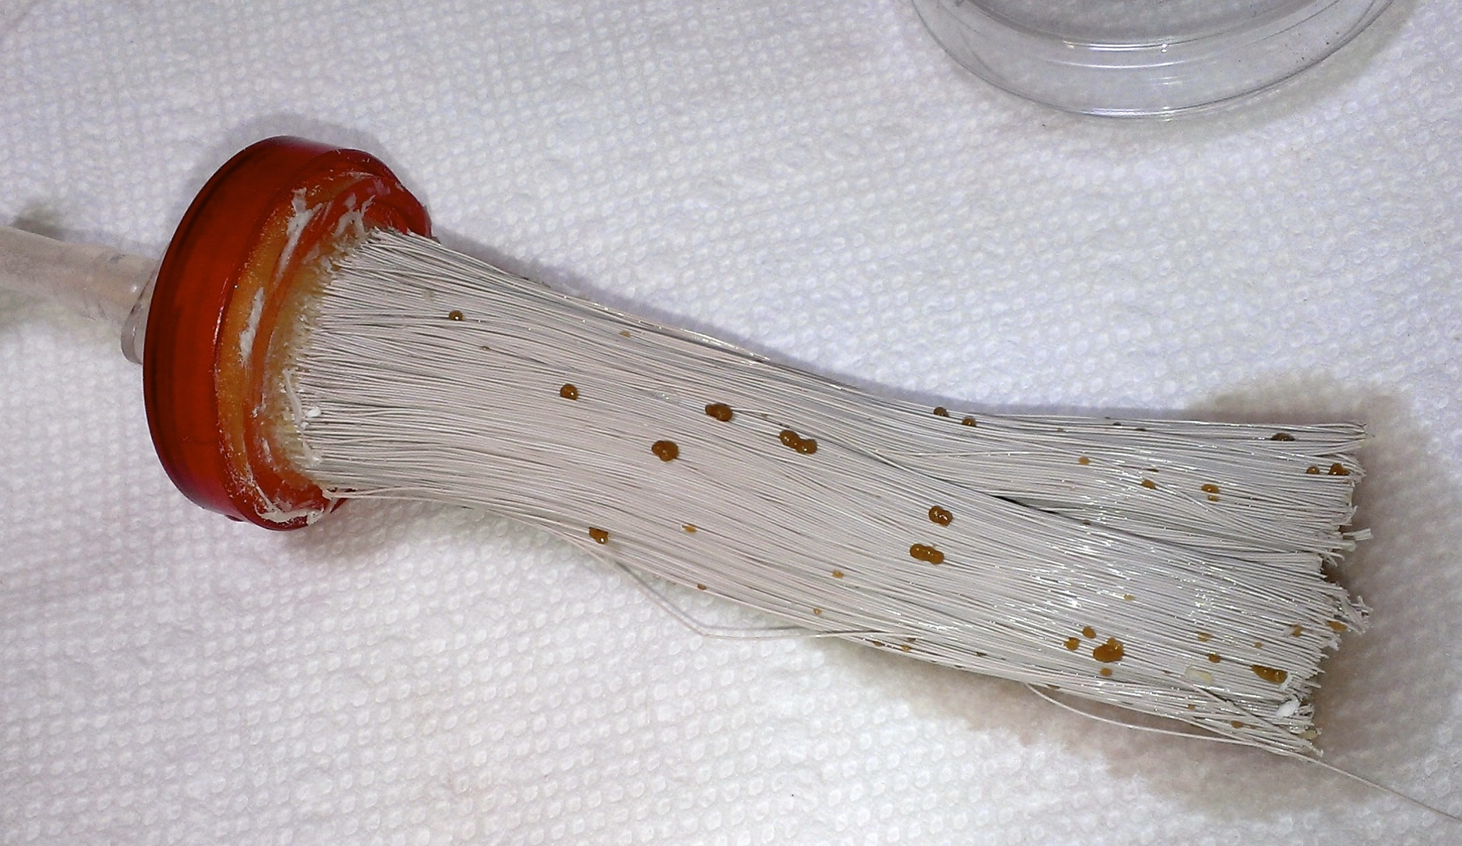
Placental Co-Culture

Slide 38
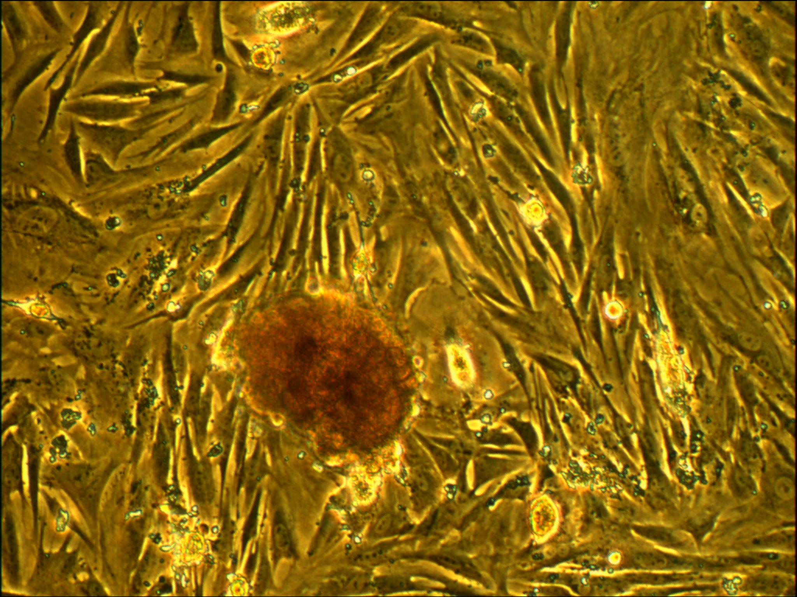
Notes:
Embryoid bodies as also observed, highly reactive with CD102

Slide 39
Harvest vs. Flask
Phenotype | ECS Harvest | Flask
CD 45 | 4% | 1%
CD 34 | 0% | 0%
CD 133/2 | 2% | 0%
CD 31 | 3% | 48%
CD 13 | 6% | 83%
CD 105 | 43% | 99%
CD 73 | 18% | 99%
CD 90 | 5% | 96%
CD 14 | 23% | 4%
NANOG | 0% | 0%

Slide 40
Summary
Hollow fiber bioreactors are the method of choice for the culture of 10⁹ to 10¹¹ cells
Ideal for producing 100 mg to several grams of Mab, 10 to 100s mg of recombinant proteins
Concentration of products 10 to 100x higher than with conventional methods
The most in vivo method for culturing cells over long periods of time
Saves time, space, purification costs

Slide 41


Slide 42

Thank you.

