Slide 1
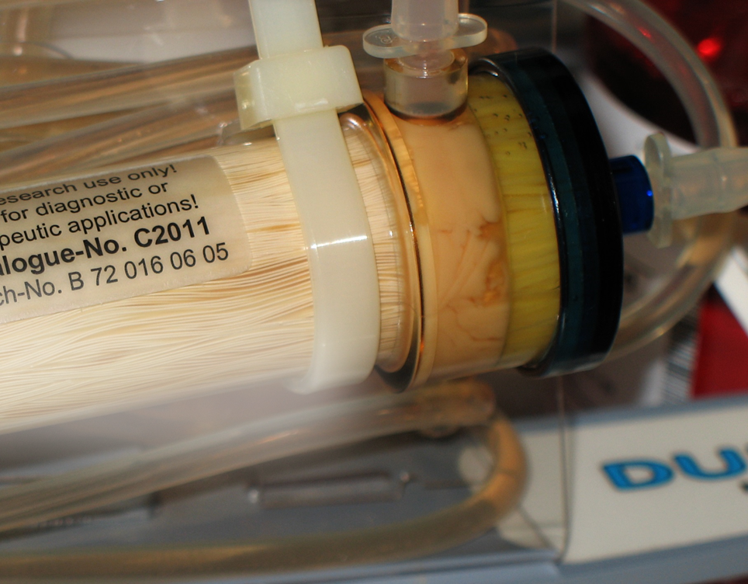

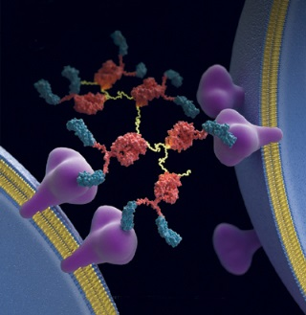
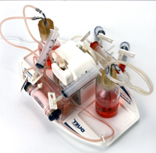
Production of Exosomes and Culture of Stem Cells in Hollow Fiber Bioreactors
www.fibercellsystems.com
By John J. S. Cadwell
Notes:
FiberCell Systems, the only supplier of laboratory scale hollow fiber bioreactor systems since 2001

Slide 2
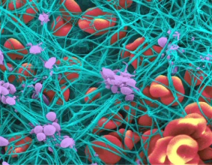
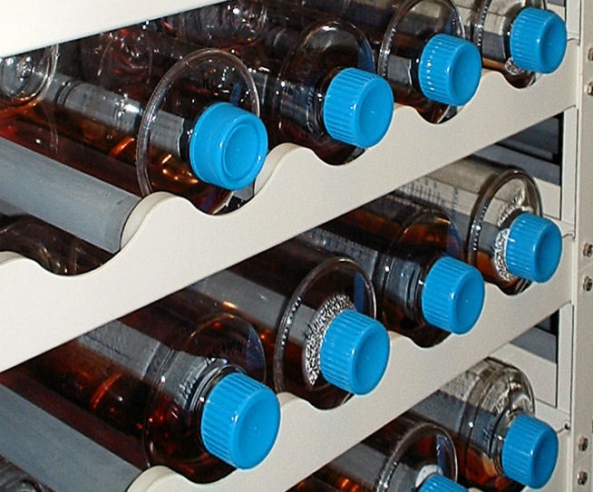
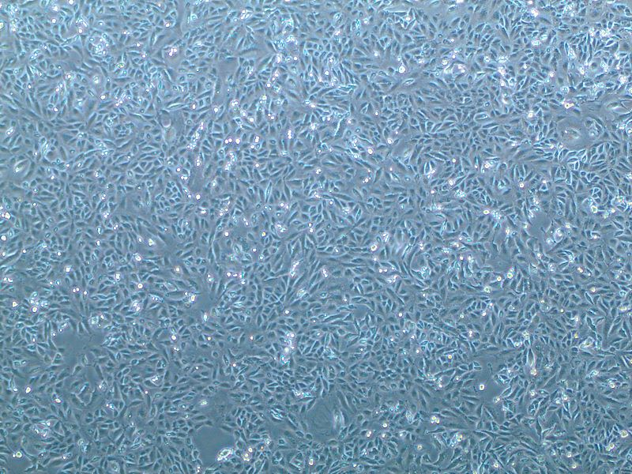
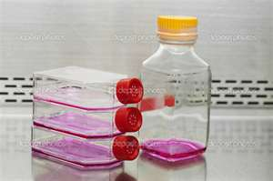
Cell Culture Through the Ages

Slide 3
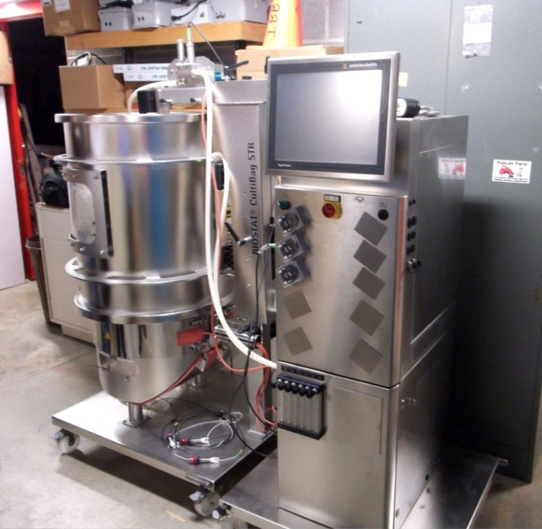
Cell Culture Options for Scale-up
Roller Bottles
Cell Factory
Cell Cube
Cell Culture Bags
Spinner Flasks
Bioreactors
Notes:
Scale up options are all based upon surface area increases but the cells are still bound to a non-porous plastic surface. Larger scale systems rely upon micro-carriers or some other sort of non-porous support or the adaptation of the cells to suspension culture using specialty mediums. The culture of cells under these conditions are non-physiologic.

Slide 4
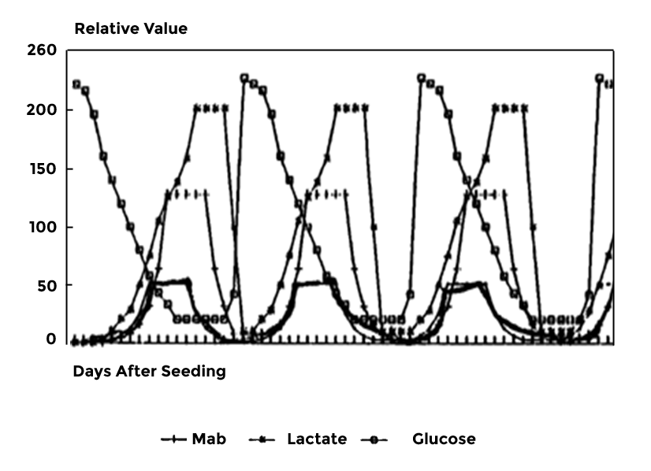
“Feast or Famine”
www.fibercellsystems.com
Notes:
Feast or famine cycle. The cells are exposed to constantly changing conditions with their optimum conditions for protein and antibody production being only a small part of this cycle. Just when things get good it is time to split the cells and start the process all over again.

Slide 5
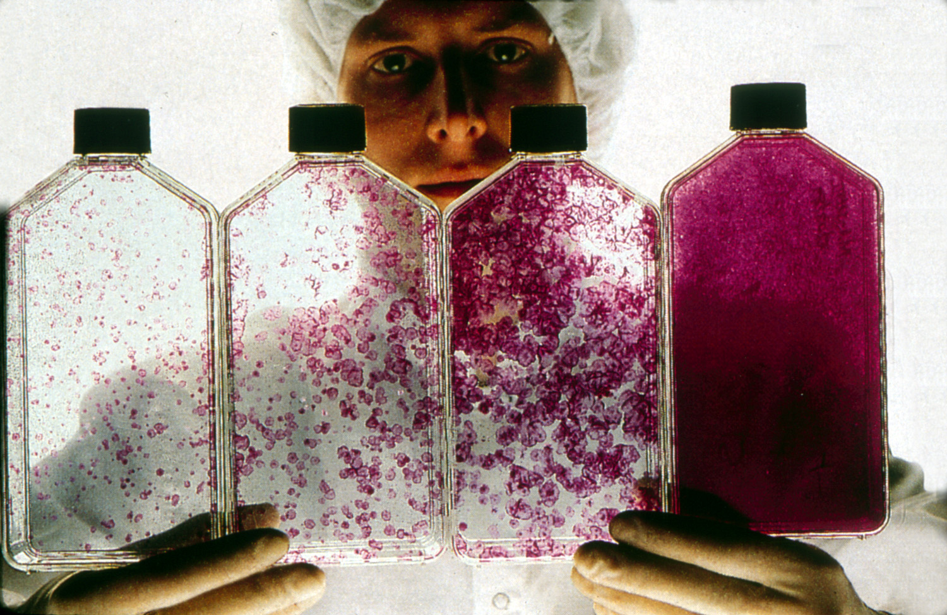
Notes:
Cells are sensitive to plating density. Since the nutrients come from the top down when cells reach confluence it is necessary to split the cells, otherwise the bottom layer does not receive oxygen and nutrients and the cells peel off and die.

Slide 6
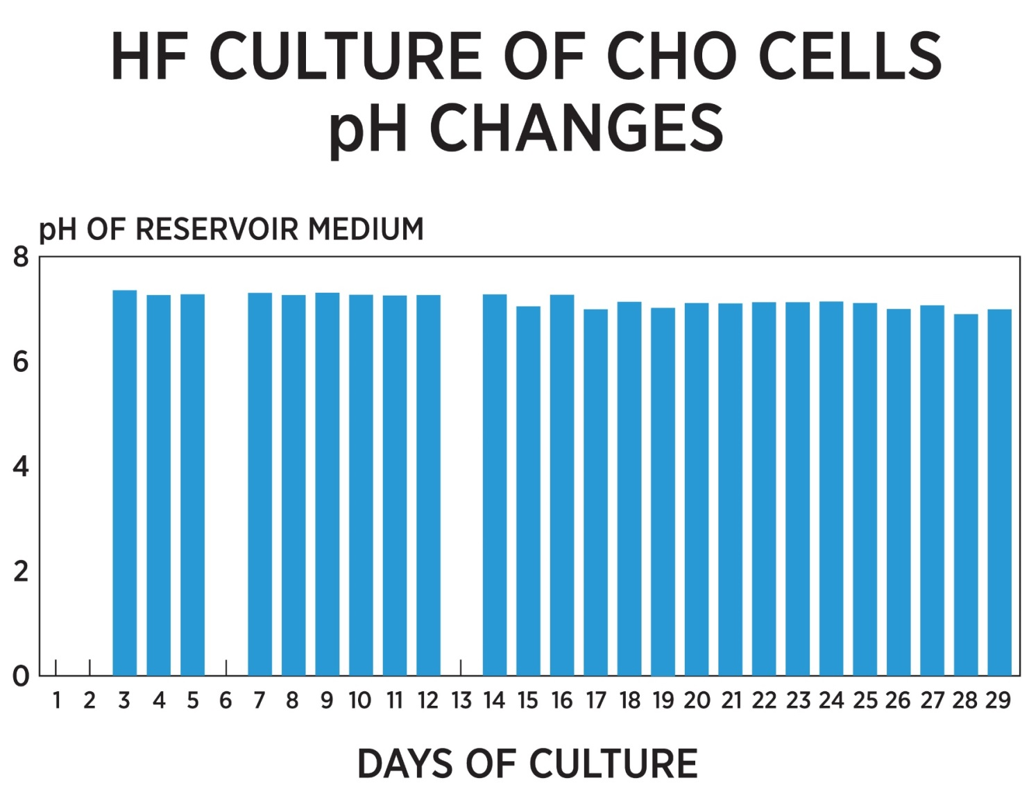

Slide 7
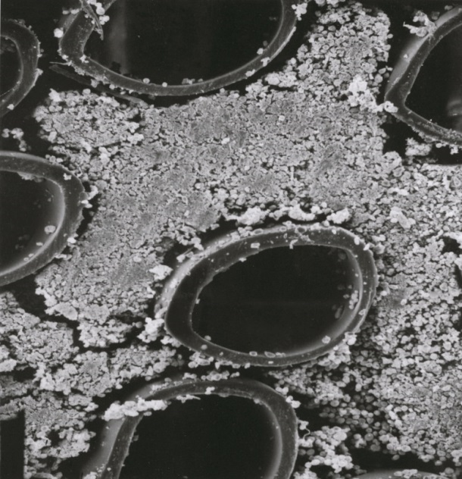
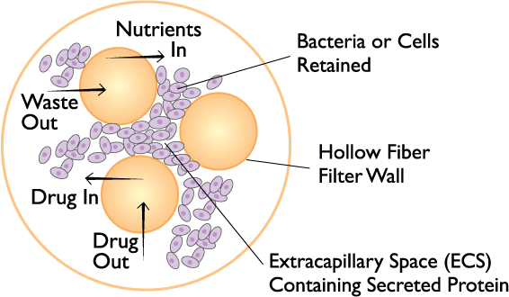
Hollow Fiber: How it works
Notes:
Cells densely populated in FiberCell Systems hollow fiber bioreactor. When harvesting it is not unusual to collect a 1-5 ml pellet. The cells at the end of the cartridge are viable due to the high gross filtration rate of the fibers.

Slide 8
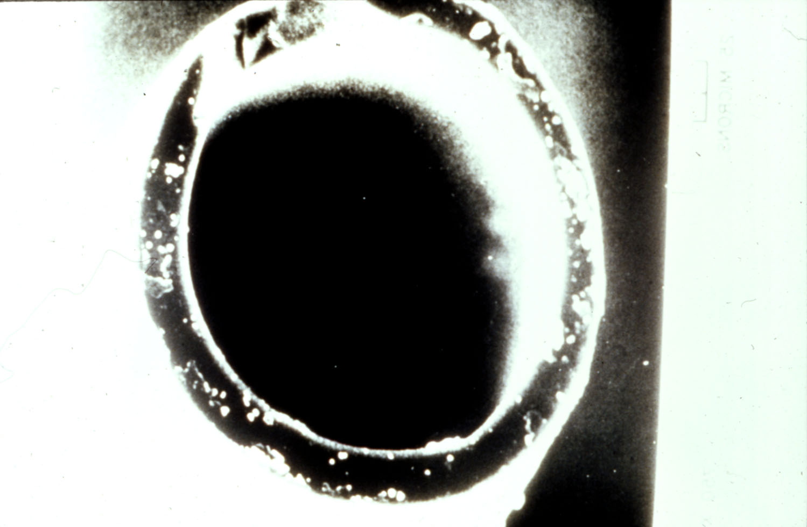
Hollow Fiber Specifications
Hydrophilic Polysulfone or PVDF
210 µm O.D.
8 µm wall thickness
GFR of 20 kd fiber in excess of 140
Notes:
High gross filtration rate fiber used by FiberCell advances the technology over what was available in the past. This results rapid exchange of nutrients and waste products and renders the cells resistant to high levels of lactate.

Slide 9
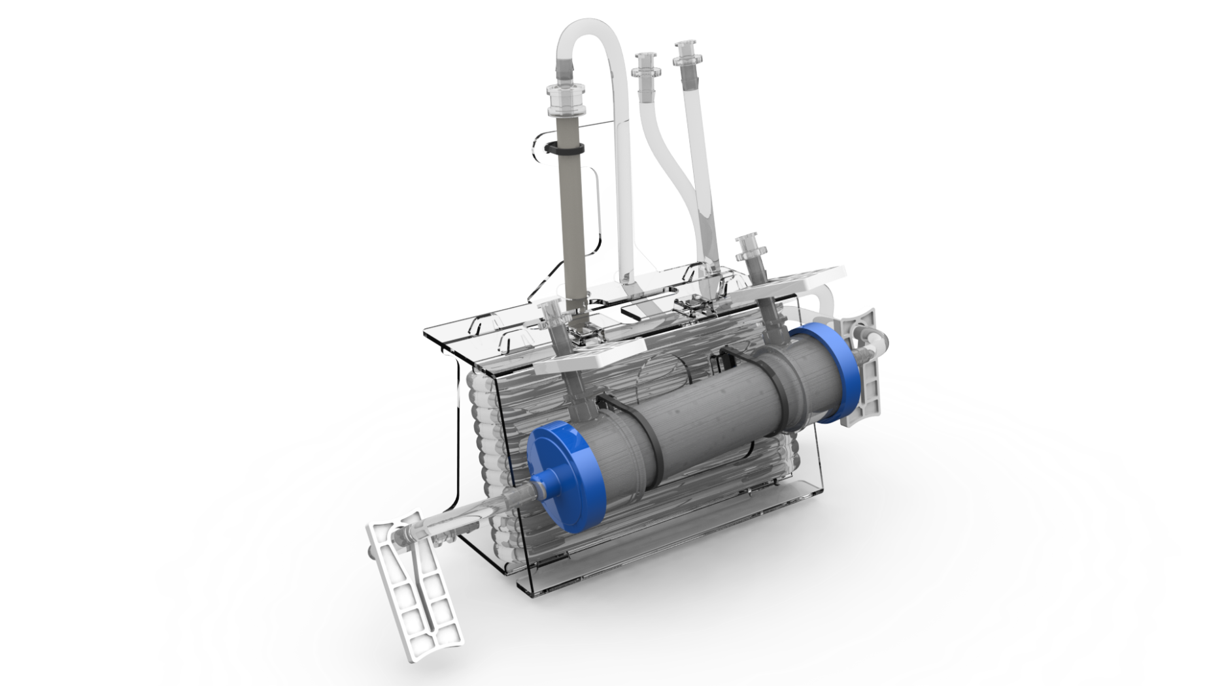
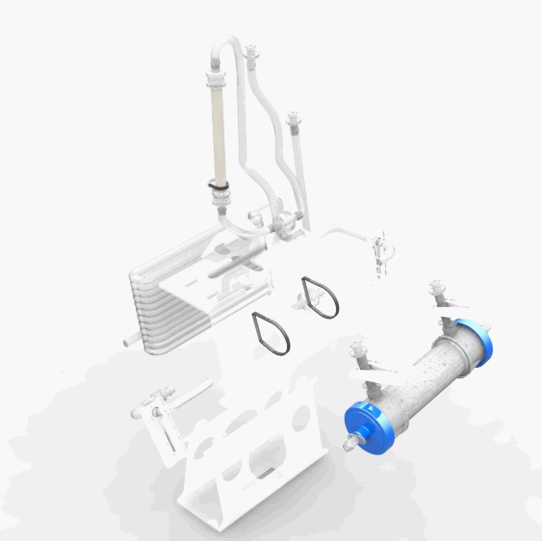

Slide 10
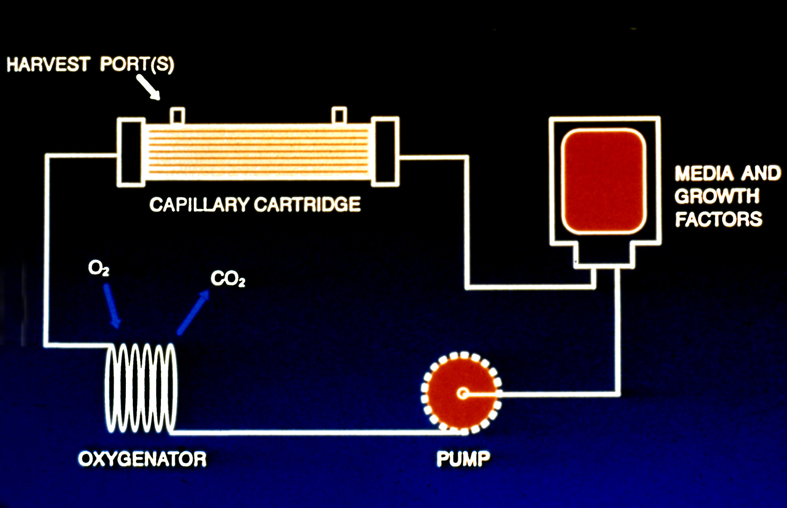
Positive pressure displacement pump
Silicone tubing for gas exchange
Closed, bio-safe system
Notes:
Schematic of the cartridge system. FiberCell utilizes a proprietary positive pressure displacement pump system, a squishy pump, that uses two one way check valves and a piston to generate up to 140 mls/minute flow rate with no wear on the pump tubing. Pulsatile flow enhances exchange across the fibers. The system is totally sealed for bio-safety, making culture of pathogens easy,

Slide 11
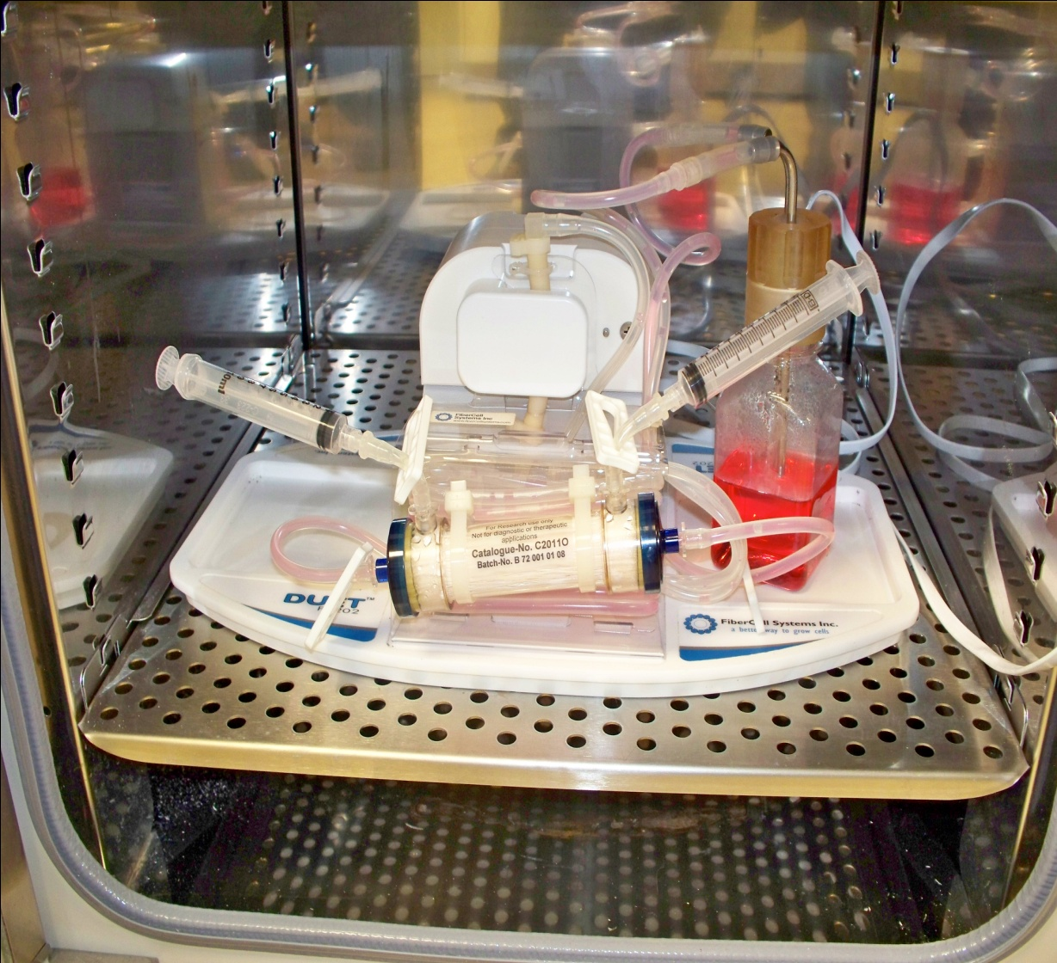
In the Laboratory
Fits in any standard sized incubator
Gas controlled by incubator
Temperature controlled by incubator
Thin cord for power
Notes:
The FiberCell Duet pump utilizes a thin cord to pass through the door of the incubator. Gas and temperature is controlled by the incubator. Gas exchange takes place across the loop of silicone tubing at the back of the flow path.

Slide 12
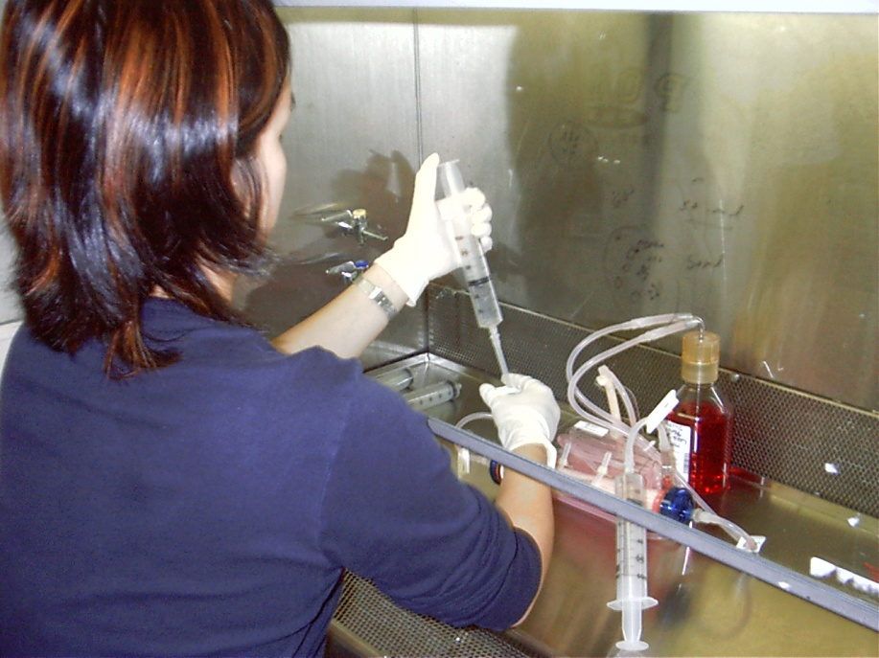
Working with the cartridge
Moves easily into hood
Good sterile technique always a plus
Maintenance only 15 minutes per day
Harvest product and measure glucose consumption
Notes:
Easy to work with. Always wear a lab coat and use good sterile technique.

Slide 13
HF Applications
Monoclonal antibody production
Recombinant protein production
Conditioned medium
Exosome production
Endothelial cell culture under shear stress
Cell co-cultivation
In Vitro toxicology
Notes:
Culturing in a hollow fiber bioreactor is the most in vivo like way to grow cells.

Slide 14
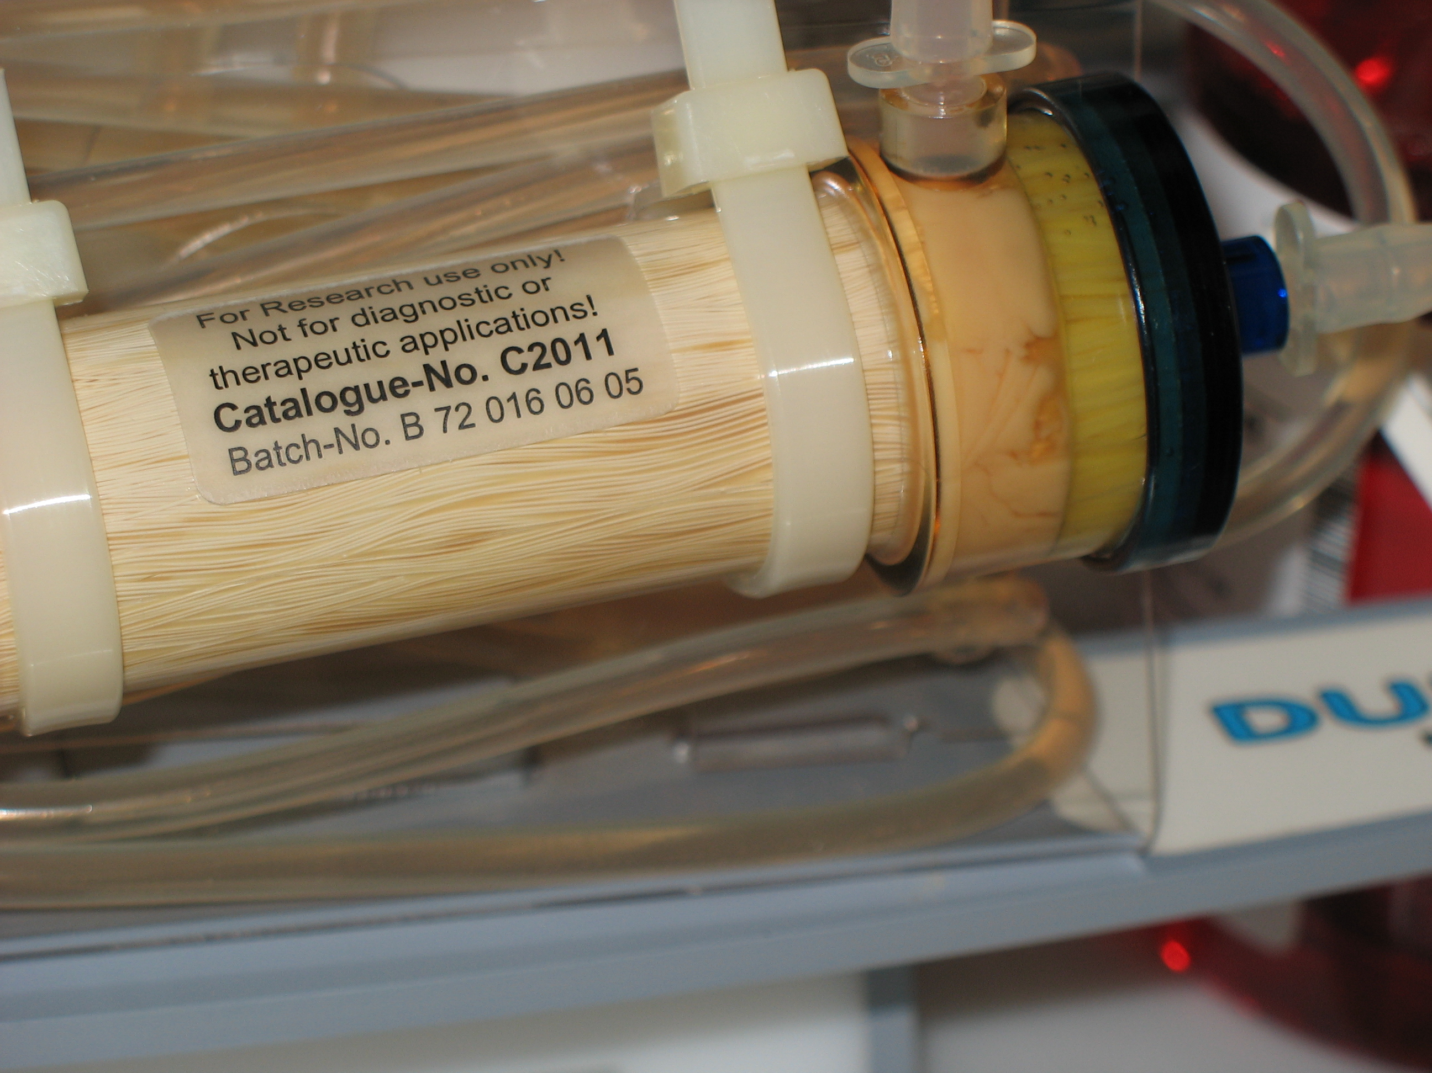
Notes:
Cells densely populated in FiberCell Systems hollow fiber bioreactor. When harvesting it is not unusual to collect a 1-5 ml pellet. The cells at the end of the cartridge are viable due to the high gross filtration rate of the fibers.

Slide 15
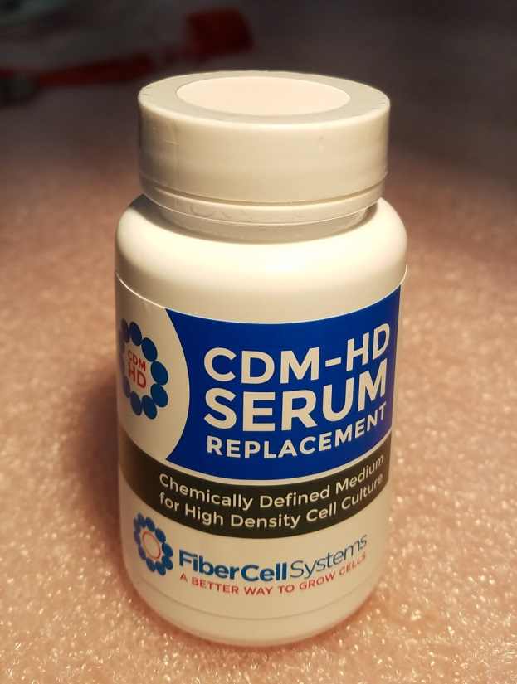
Advantages of Hollow Fiber Cell Culture
Concentrated product
Uniform and complete post-translational modifications
Low apoptosis, less contamination with intracellular proteins and DNA
Protein free medium (CDM-HD) contains no surfactants
Consistency of production over many months.

Slide 16
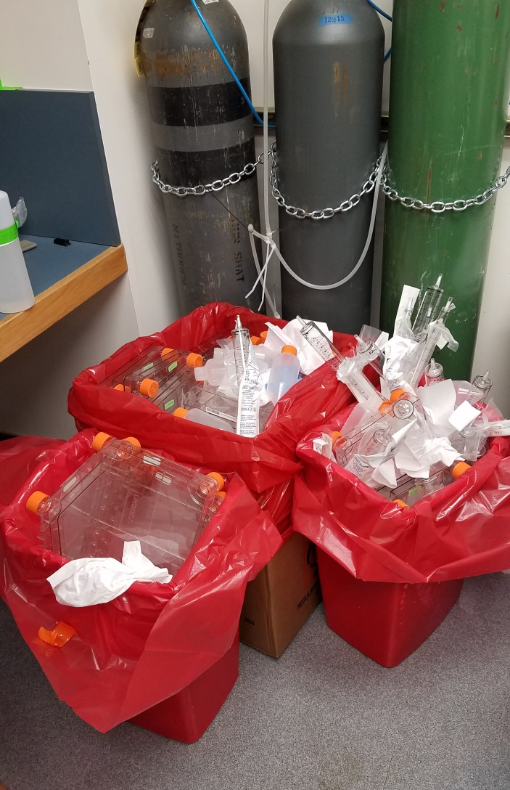

Slide 17

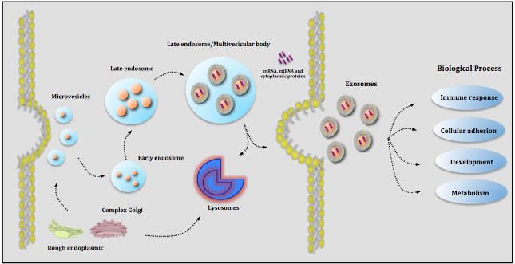
Exosomes
Cell-derived vesicles in biological fluids
Including medium of cultured cells
Dia. between 30 and 100 nm
Contain cellular proteins and RNA
Facilitate cell-to-cell transfer of cargo
May play a role in cell-to-cell signaling
May mediate adaptive immune responses

Slide 18
Advantages for Exosome Production
Large numbers of cells can be cultured in a small space
Secreted exosomes are concentrated
Continuous production over several months
Serum can be used without contamination from endogenous exosomes
CDM-HD can be used for cGMP production
Cell proliferation may be limited

Slide 19
Human Adipose Derived Adult MSC
130 T225 FLASKS
ONE C2011 BIOREACTOR
Harvest Volume:
4000 mL
Protein: 0.9 mg
Particles: 1.6x10⁹
Harvest Volume:
120 mL
Protein: 28.45 mg
Particles: 8.6 x 10¹¹
Equals 540 T225 flasks
1x10⁹ cells seeded

Slide 20
Incorporation of Exosomes into Human Endothelial Cells
Vybrant DiI cell labeling solution (Life Technologies) was incubated with approximately 5x10⁸ exosomes and added to cultured endothelial cells. Following incubation at 37°C, cells were removed from the plate by trypsinization and analyzed by flow cytometry. Exosome preparations from the bioreactor are capable of delivering their cargo (i.e.: nucleic acid, protein) into the cell.

Slide 21
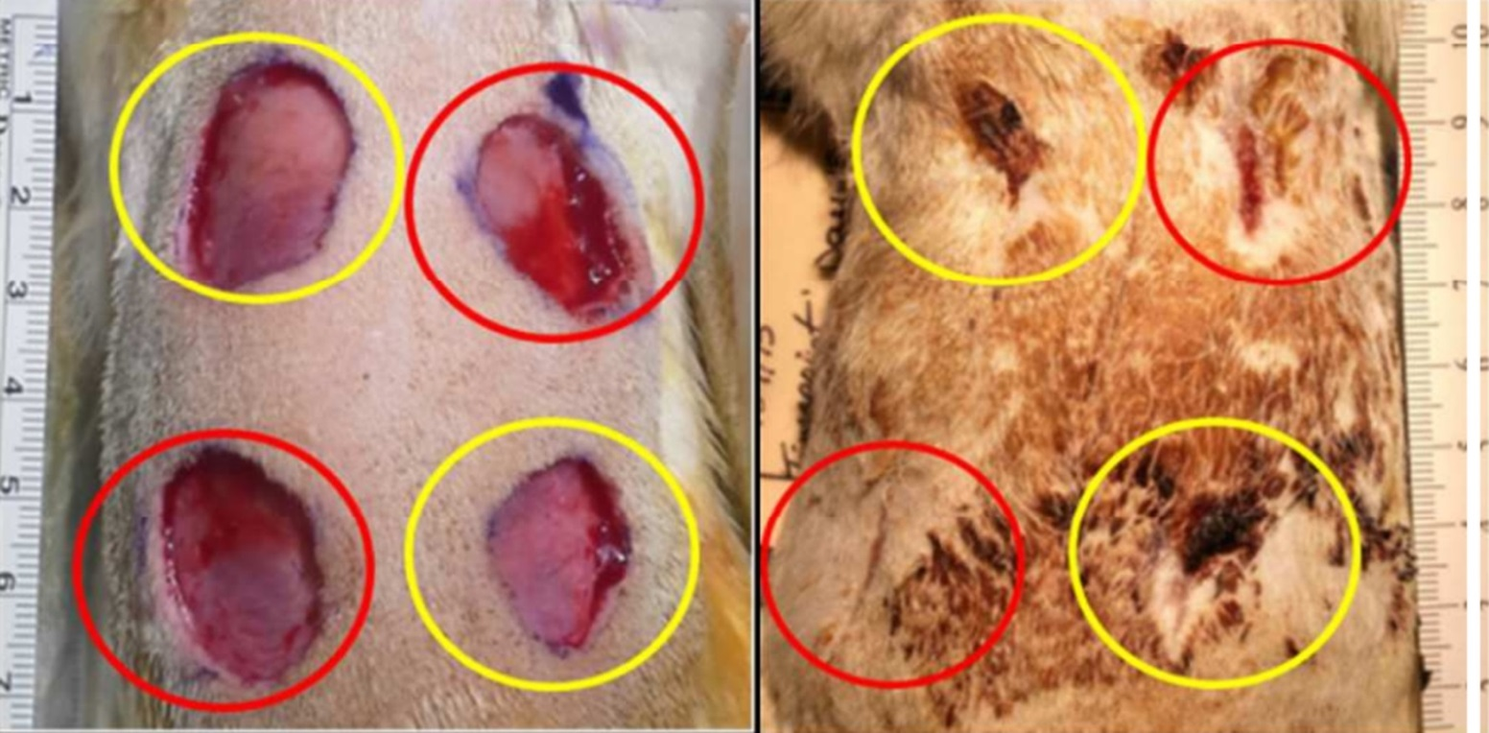
Wound Healing Promotion by Exosomes

Slide 22

Exosome Based Facial Moisturizer
95.57% reduction in wrinkles
133.07% increase in skin luminescence
17.19% acceleration of cell renewal
Smarticles!

Slide 23
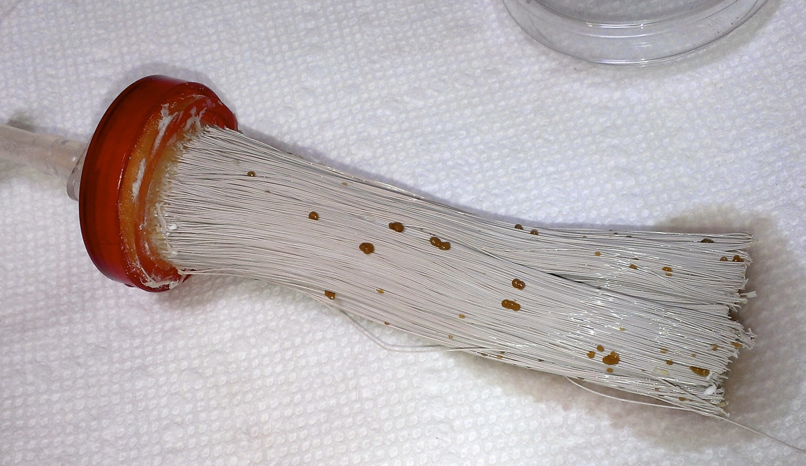
Placental Co-Culture

Slide 24
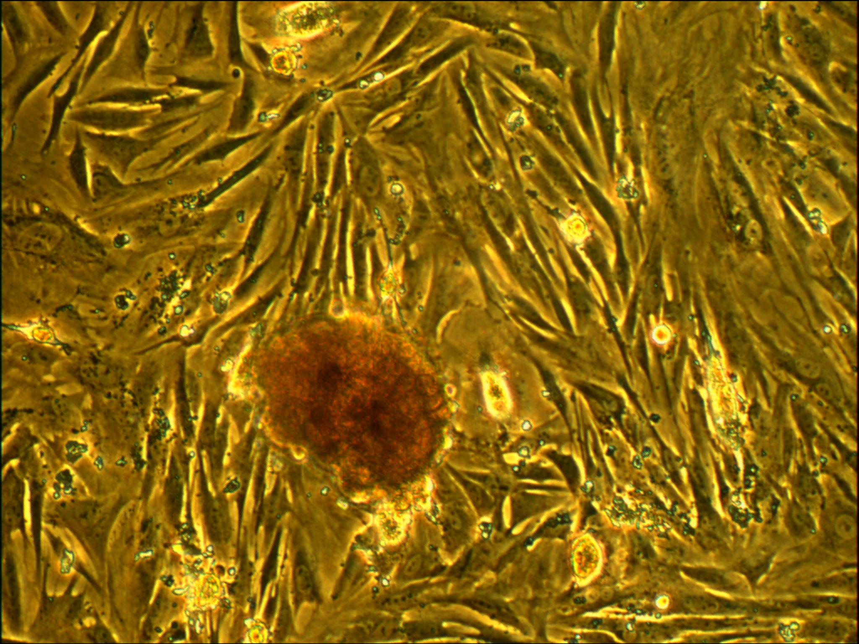
Notes:
Embryoid bodies as also observed, highly reactive with CD102

Slide 25
Harvest vs. Flask
Phenotype ECS Harvest Flask
CD 45 4% 1%
CD 34 0% 0%
CD133/2 2% 0%
CD31 3% 48%
CD 13 6% 83%
CD 105 43% 99%
CD 73 18% 99%
CD 90 5% 96%
CD 14 23% 4%
NANOG 0% 0%

Slide 26


Slide 27
Summary
Hollow fiber bioreactors are the method of choice for the culture of 10⁹ to 10¹¹ cells
Can produce gram quantities of exosomes
Concentration of 100x higher than with conventional methods
The most in vivo method for culturing cells over long periods of time
Suitable for cGMP production
Permits use of FBS without endogenous EV contamination
Saves time, space, purification costs

Slide 28


Slide 29

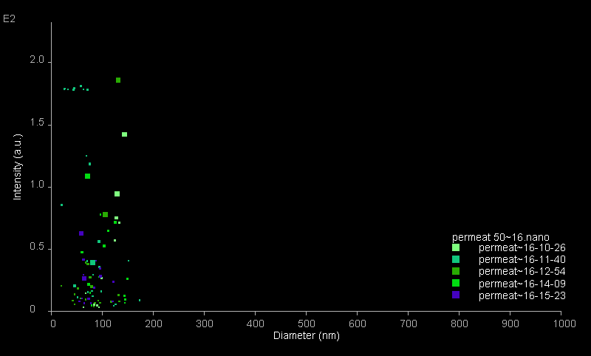
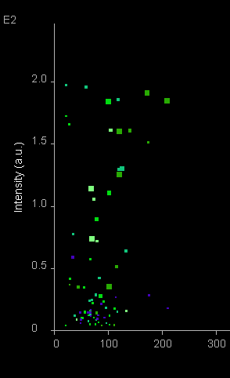
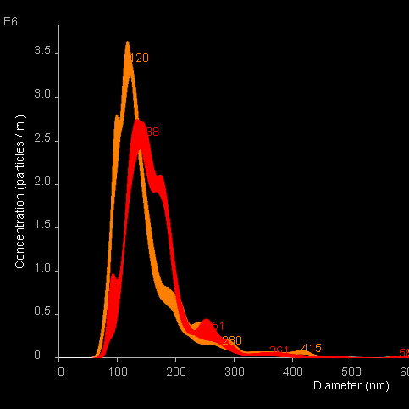
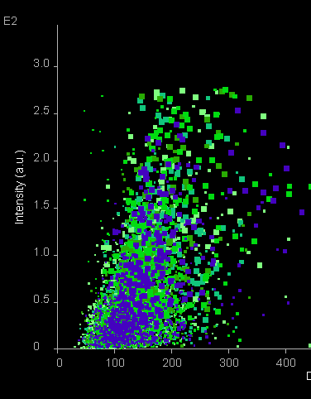
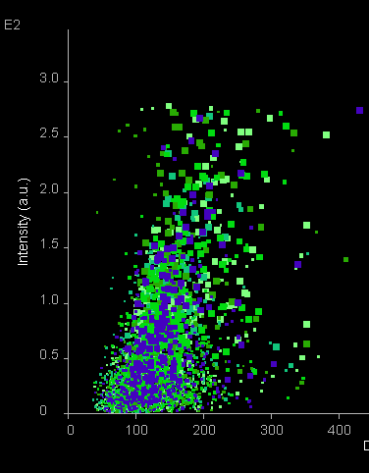
Qualitative Analysis of EVs production by Cord-Blood MSC in
FiberCell Duet Bioreactor C2025D Cartridge
NTA Quantification
Before Depletion
After Depletion
Solvant
FCS (1/1000e)
(3,4 10⁸ particules/ml)
FCS (EV⁻) (1/100e)
(6,5 10⁶ particules/ml)
PBS
(4,1 10⁶ particules/ml)
Depletion
D27 Last Sample
D3 First Sample
EVs from FCS
Evs from MSC
conditionned medium

Slide 30
Conclusions
In our particular assay conditions, i-e, incubation of cells in the presence of EVs depleted FCS in the extracapillary compartment, we foud that:
Bone-Marrow as well as Cord-Blood MSC remain viable for weeks
Following FACS analysis, a conserved MSC phenotype of Cord-Blood MSC after a 4 weeks incubation was observed.
HOWEVER,The linear production of Evs as a function of the incubation time as well as a low consumption of glucose all along the experiment suggest that MSC Cells (both from Cord-Blood and Bone-Marrows) remain viable BUT DO NOT PROLIFERATE.
The MSC phenotype of these Evs producing cells at the end of the experiment as to be confirmed by studying their capacity of differentiation along the
Adipocytes
Chondrocytes lineages
Osteocytes

Slide 31
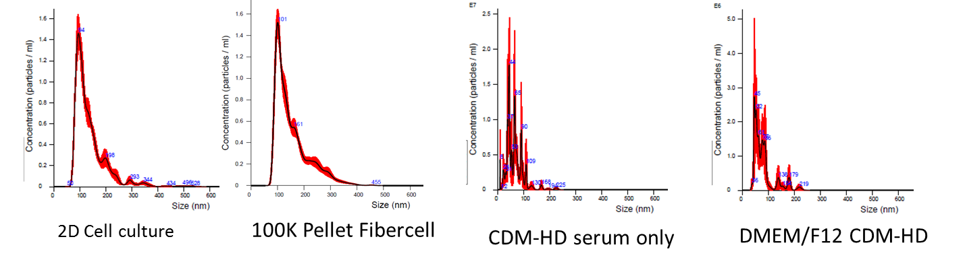
NTA Analysis of Vesicles, CDM-HD and Media

Slide 32
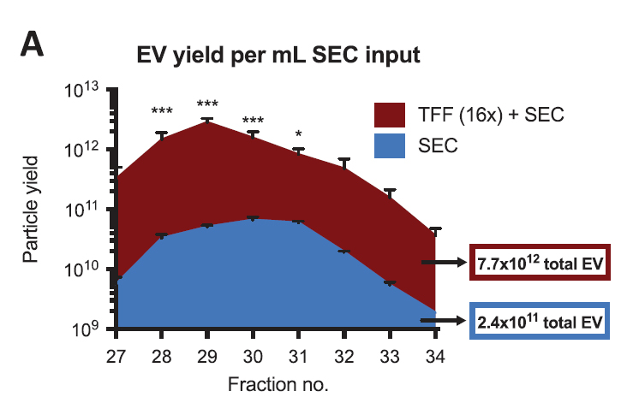

Slide 33
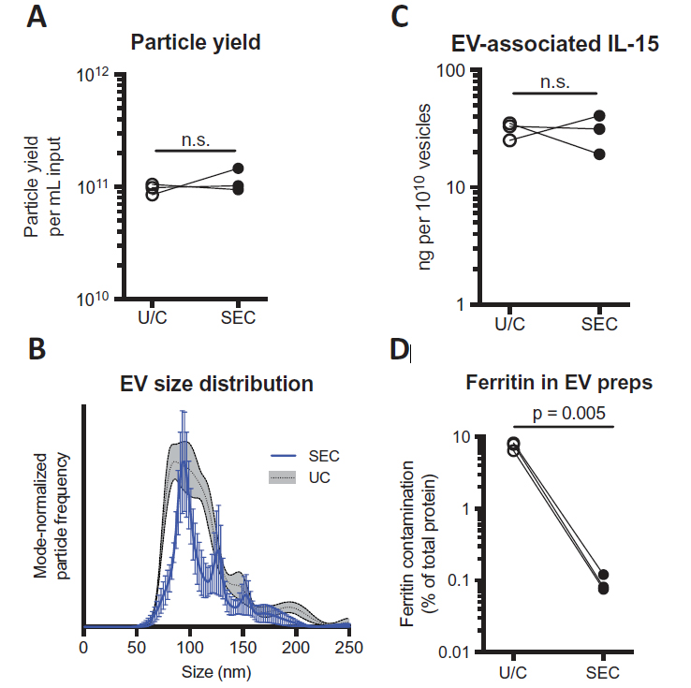

Slide 34

Thank you.

