Slide 1
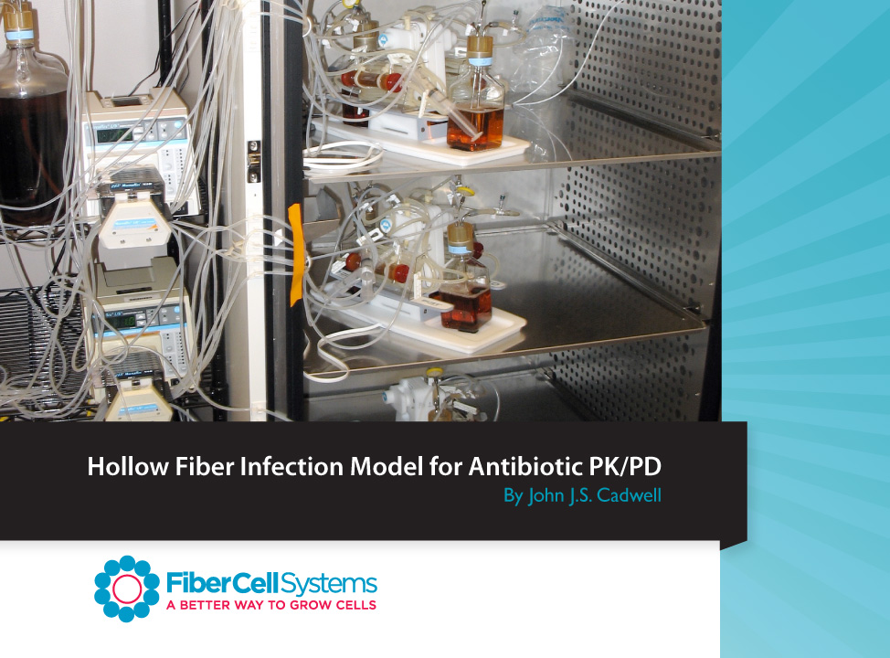

Slide 2
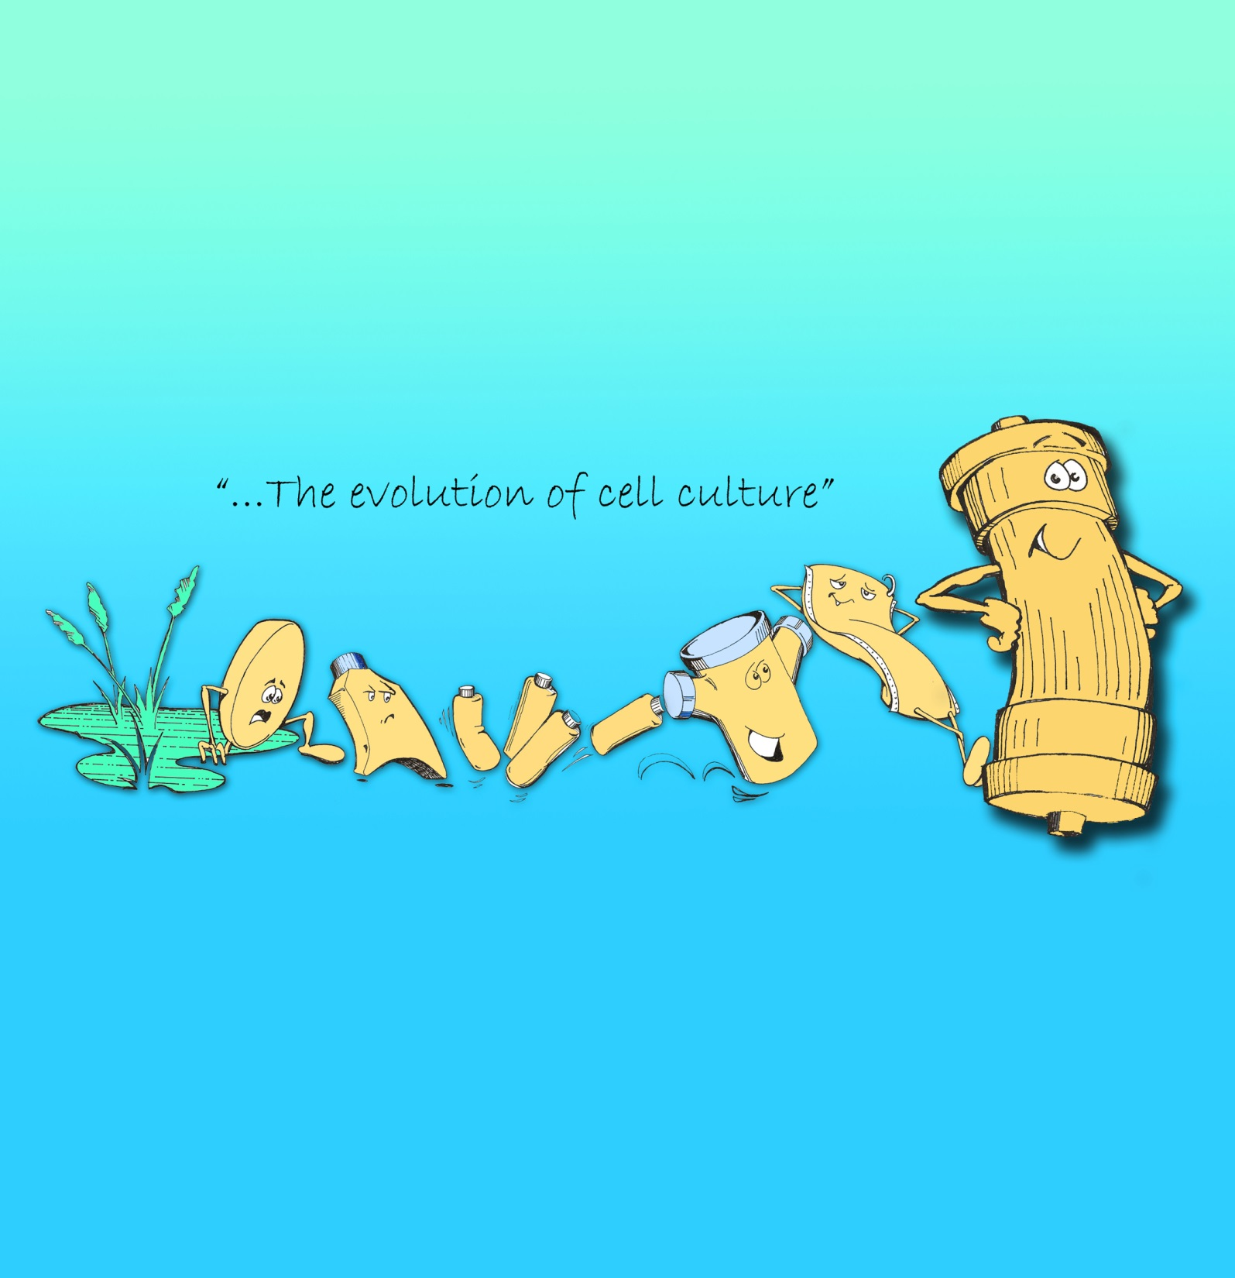

Slide 3
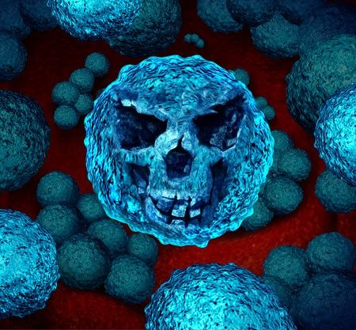
Antibiotic Resistance
Emerging antibiotic resistance is a major health concern.
2 million people in the U.S. infected with antibiotic resistant bacteria last year
23,000 people died as a result of these infections, many more die from complications
Most deaths related to antibiotic resistance occur in hospitals and nursing homes.
Notes:
Cell culture devices through the ages. The tools used for cell culture haven’t changed fundamentally in 100 years, now they are made of plastic instead of glass for disposability. They all have two things in common 1) cells are attached to a non-porous support and scale-up can involve just more flasks.

Slide 4

Lack of new antibiotics
Only 2 systemic antibiotic agents approved since 2008
16 approved between 1983 and 1987
3 reasons:
  Scientific: Easy to discover antibiotics have already been found
  Economic: Antibiotics represent a poor return on investment and new antibiotics reserved for difficult cases
  Regulatory: FDA approval process increasingly complex and expensive.

Slide 5
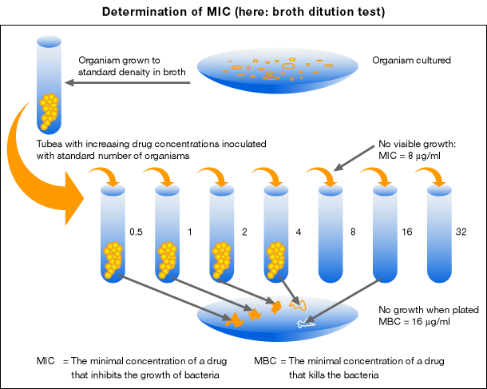
MIC: Minimum Inhibitory Concentration
Lowest concentration of a drug that prevents a bacterial inoculum from growing to visibly detectable levels
Time a drug concentration remains above the MIC
Ratio of maximal drug concentration to MIC
Ratio of the area under the concentration time curve to MIC

Slide 6
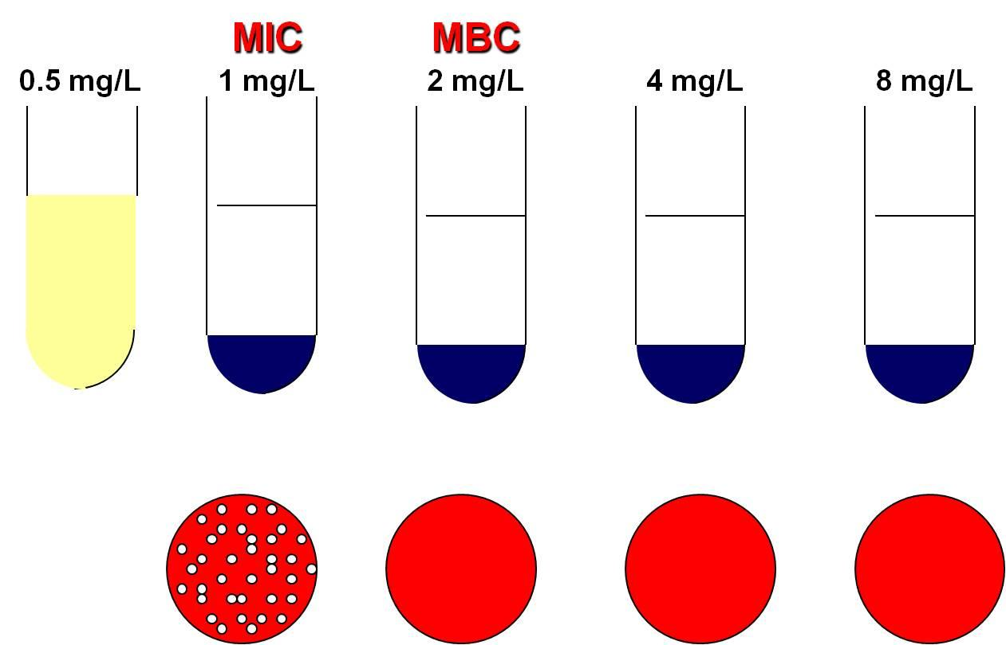
MIC tells us nothing about:
Bacteriostatic or bactericidal
Time or dosage dependent
Rate of Bacterial killing
Post-antibiotic effect
Dosing profiles that prevent or facilitate resistance
Notes:
Feast or famine cycle. The cells are exposed to constantly changing conditions with their optimum conditions for protein and antibody production being only a small part of this cycle. Just when things get good it is time to split the cells and start the process all over again.

Slide 7
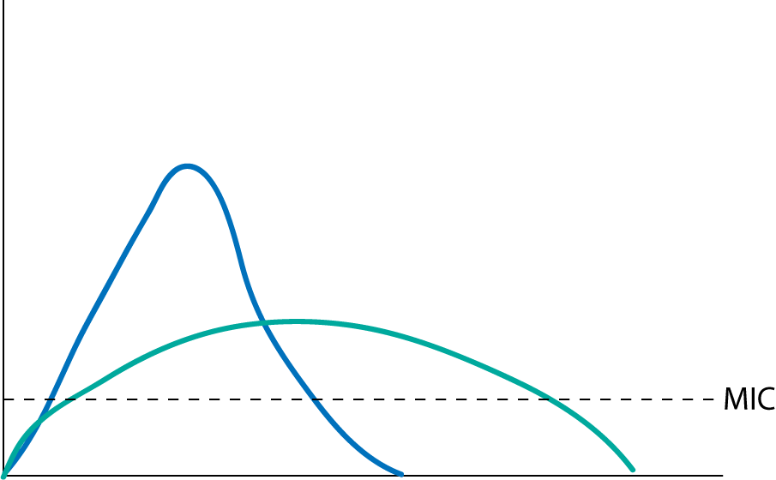
Antibiotic efficacy is tied to both concentration and time.

Slide 8
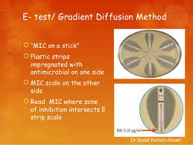
In vitro Testing Methods
Broth dilution test
Antimicrobial gradient test
Disc diffusion test
E-test

Slide 9
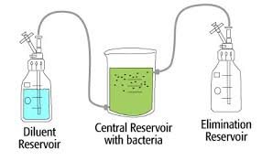
Assays in which both time and concentration are variable:
Static kill assay
Mouse thigh infection model
Hollow fiber infection model

Slide 10
Static kill assay
Open system, not bio safe
Bacteria numbers change over time
Large volume requires large amount of drug and diluent
Rapid changes in drug concentration not possible, cannot model short half-lifes

Slide 11
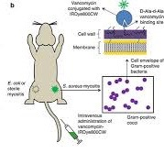
Mouse Thigh Infection Model
PK/PD may not mimic human values
Cannot sample over time
Hard to do large numbers of bacteria to reveal resistance
Many infections cannot be modeled in mouse

Slide 12
Hollow Fiber Infection Model

Slide 13
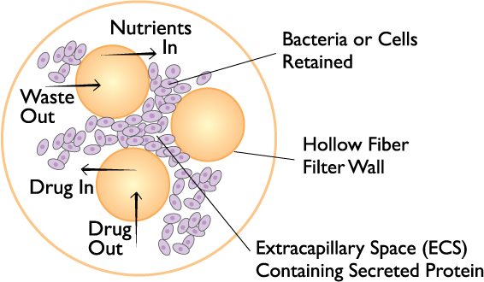
Hollow Fiber Cross-Section

Slide 14
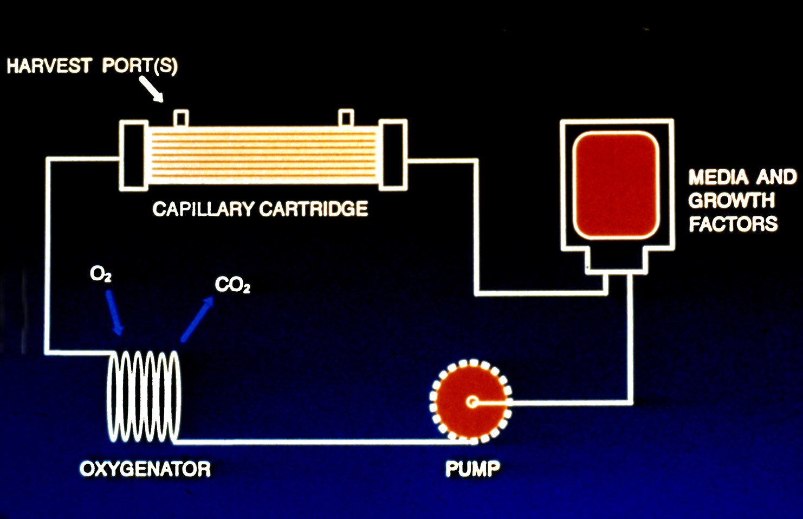
Hollow Fiber Cartridge

Slide 15
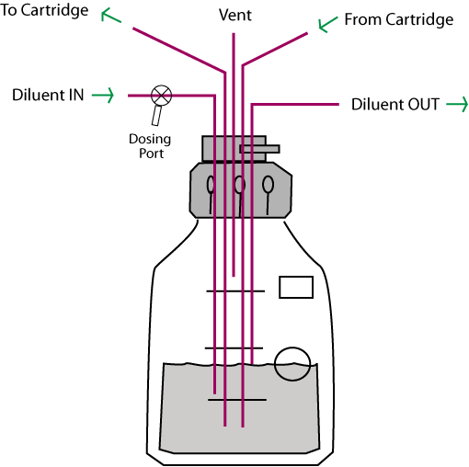
Reservoir cap

Slide 16
Advantages of the Hollow Fiber Infection Model
Closed, bio-safe system
Sampling over time
Large number of organism can be tested, revealing resistance
Precisely simulates human PK/PD
Repetitive sampling over time, both drug and organism
Total kill
Single use, disposable, consistent
Two drug models can be tested
Can model both dosing curve and elimination curve
Can look at bacteria in different growth phases and in combination with cells. Antiviral PK/PD as well.

Slide 17
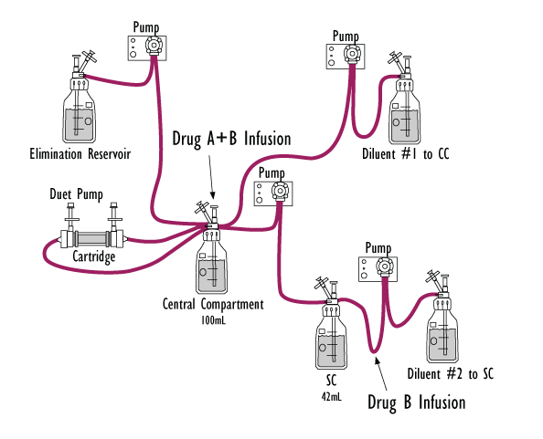
Two Drug Model

Slide 18
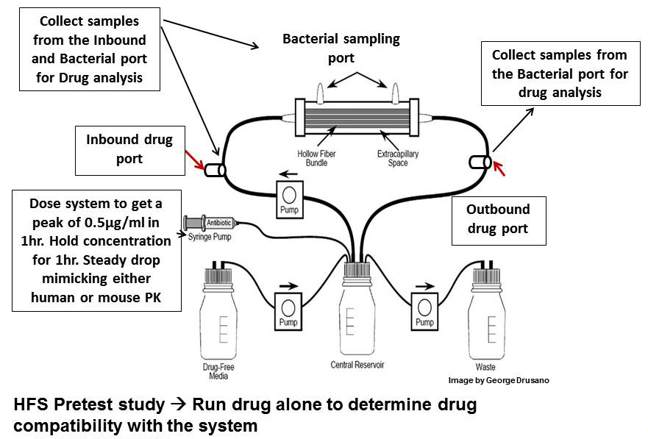
Hollow Fiber Pretest Study Scheme

Slide 19
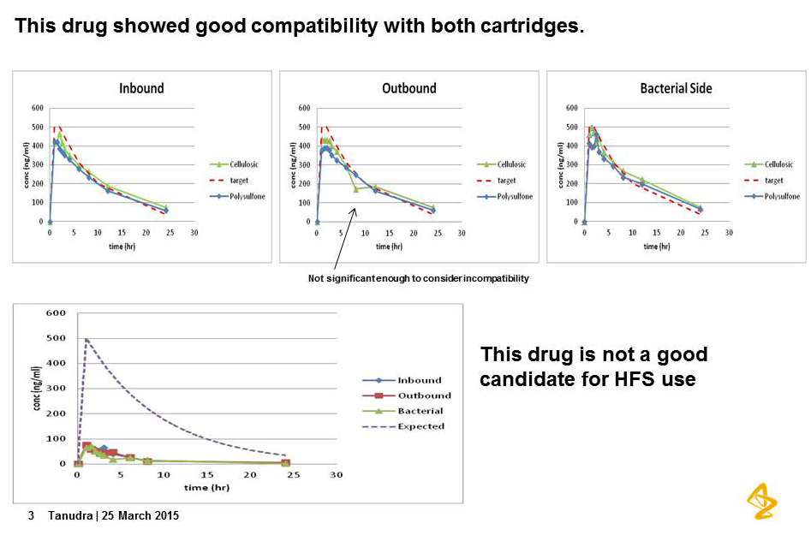
PK Profile

Slide 20
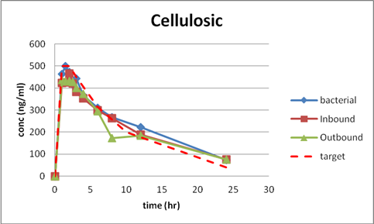

Slide 21
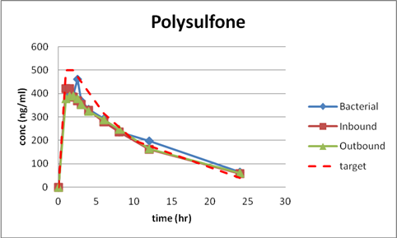

Slide 22
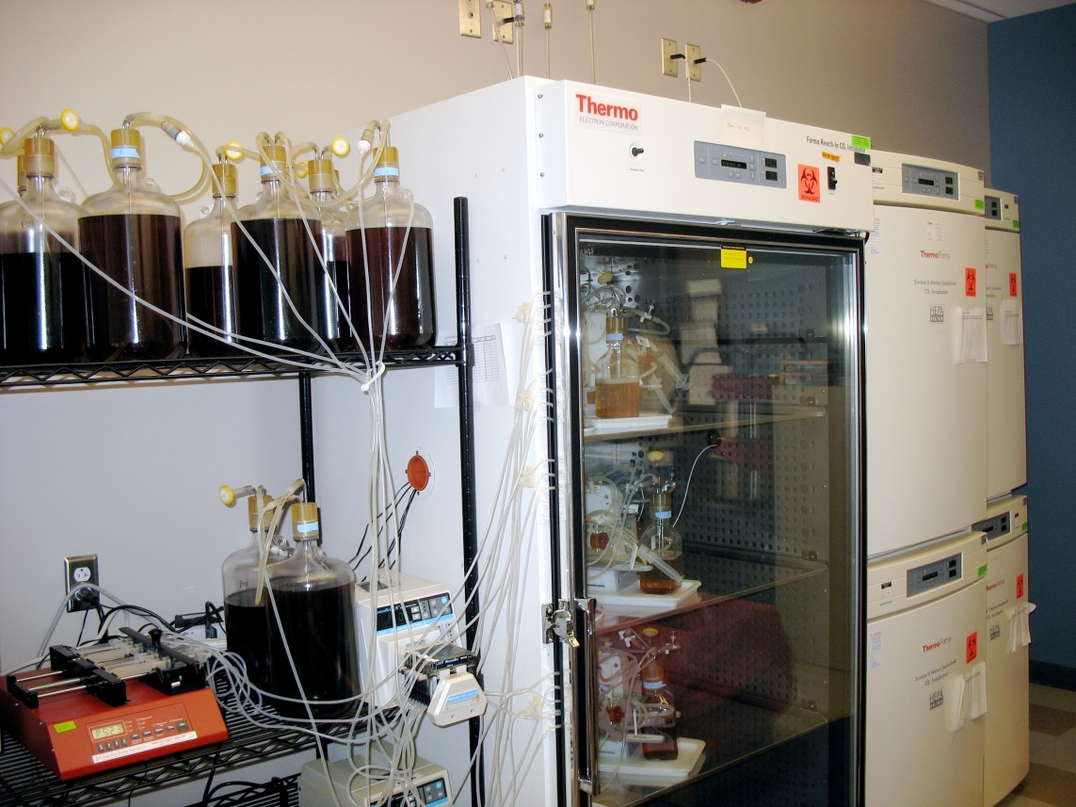
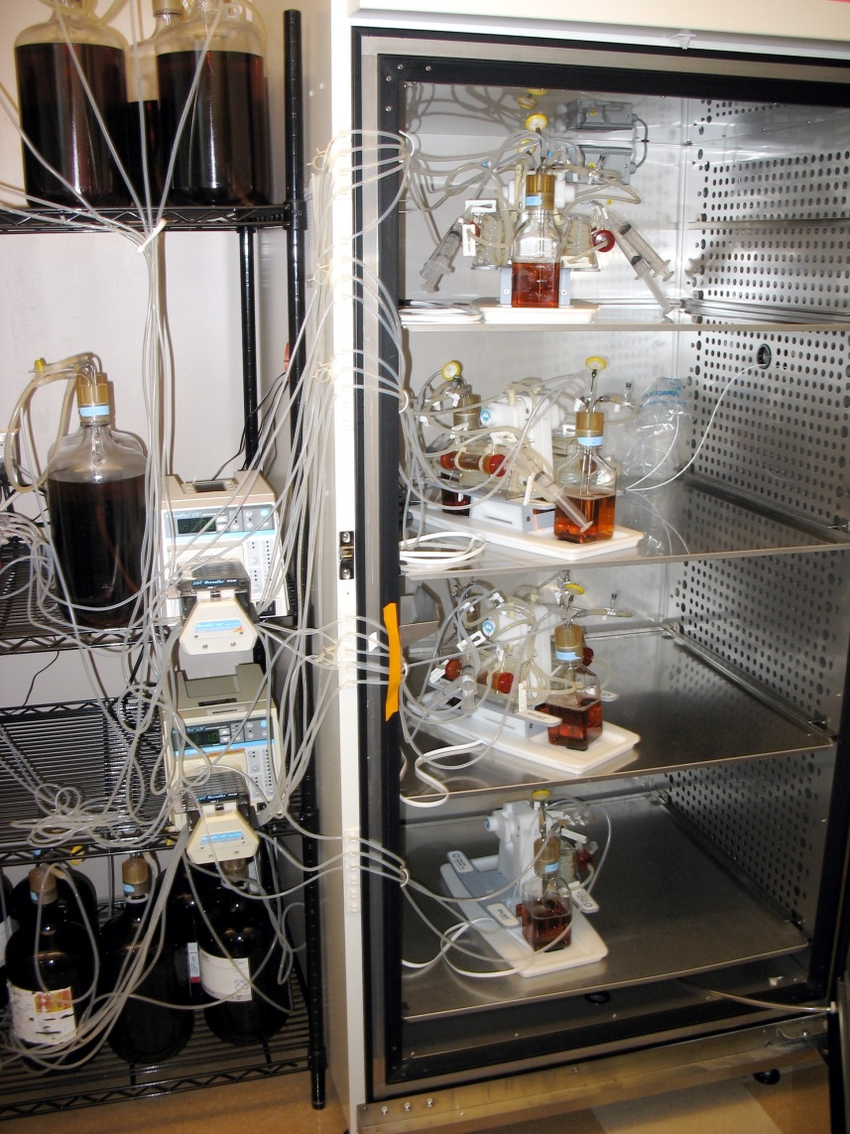

Slide 23
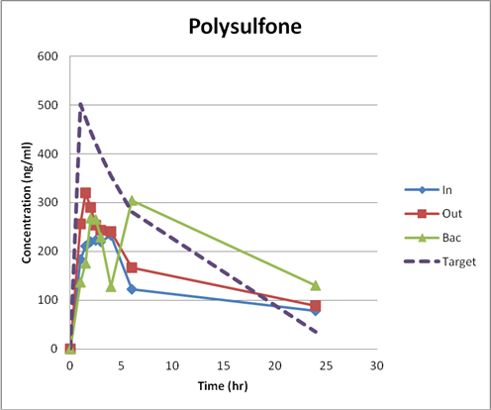

Slide 24
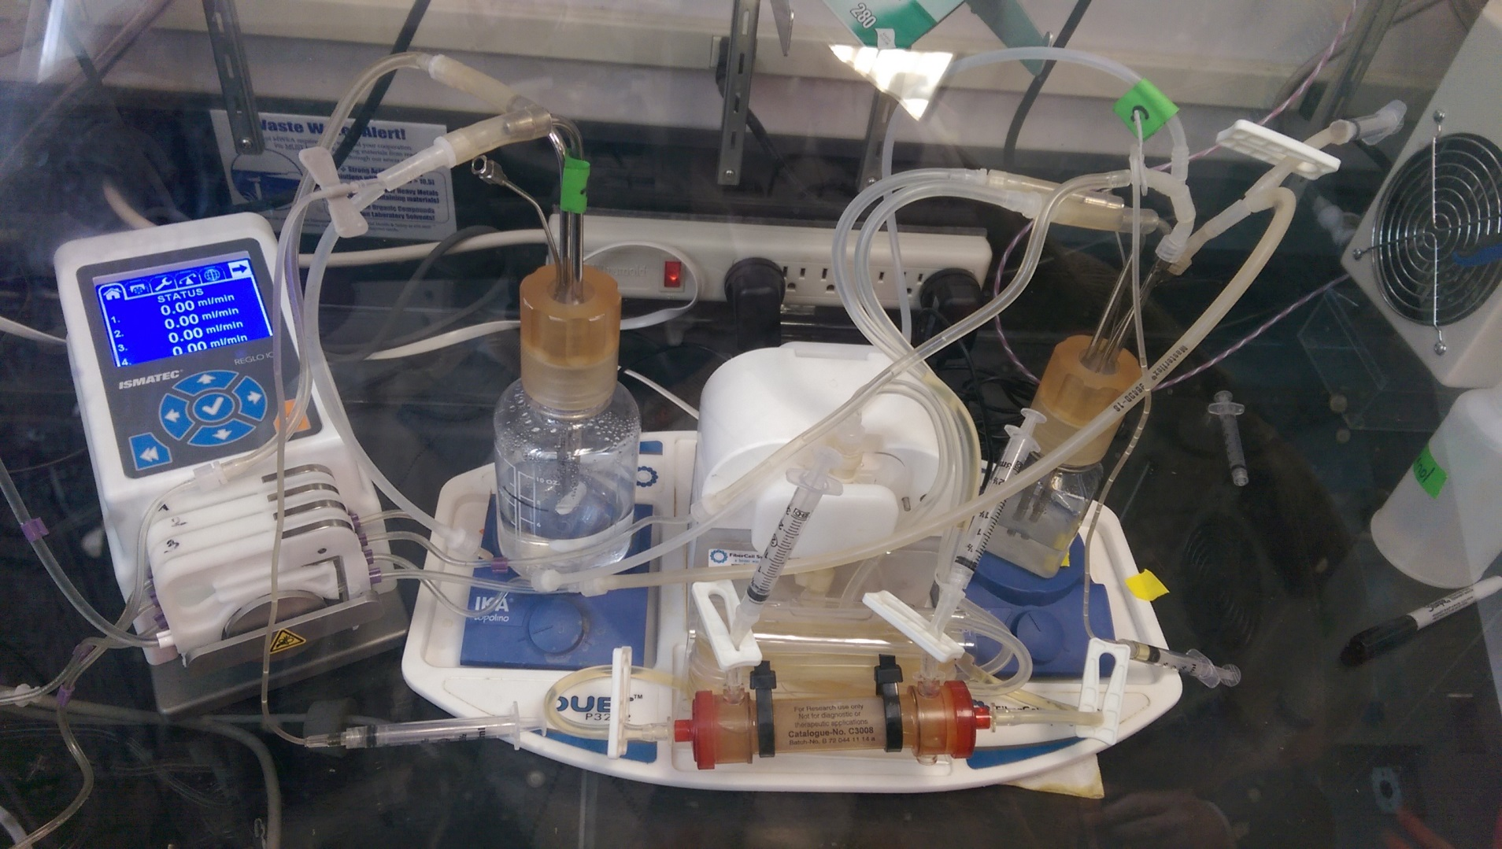

Slide 25
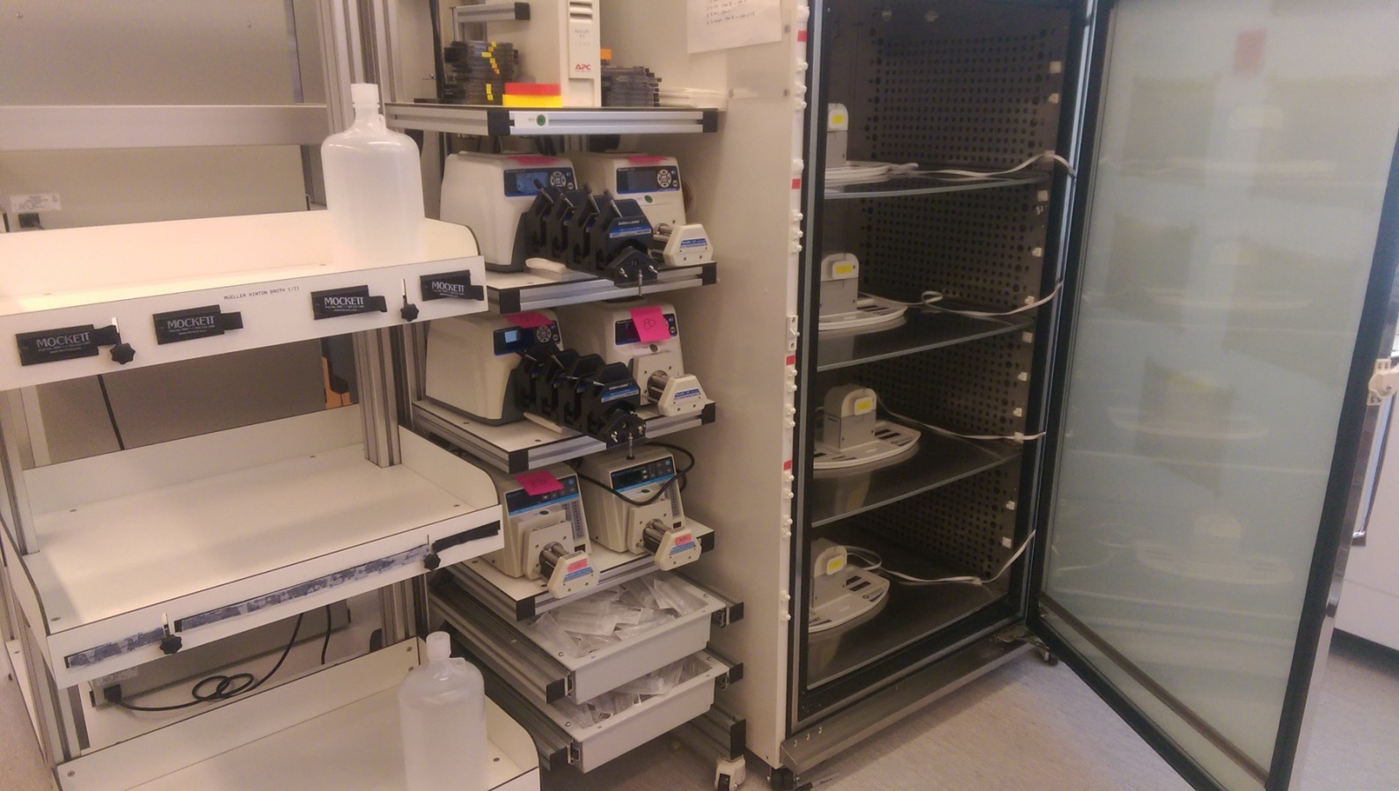
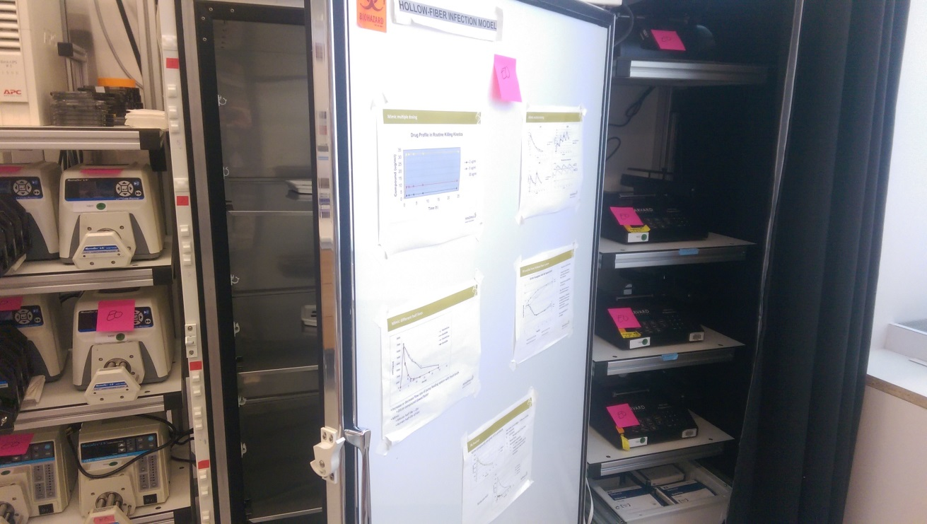

Slide 26
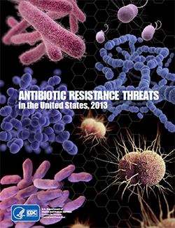
Regulatory position
EMA endorsement for TB
FDA expected to follow suit
Cartridges manufactured under ISO-14644-1 class 8

Slide 27
The hollow fiber infection model is a complementary and additional tool for drug development, to be implemented at the earliest stages
Optimal dose selection and route of administration
Optimal dosing schedule
Possible combination therapies
Defines emerging resistance
Defines total kill
Post-approval drug regimen optimization
Can support trial design for Phase I, II, III and IV clinical trials

Slide 28
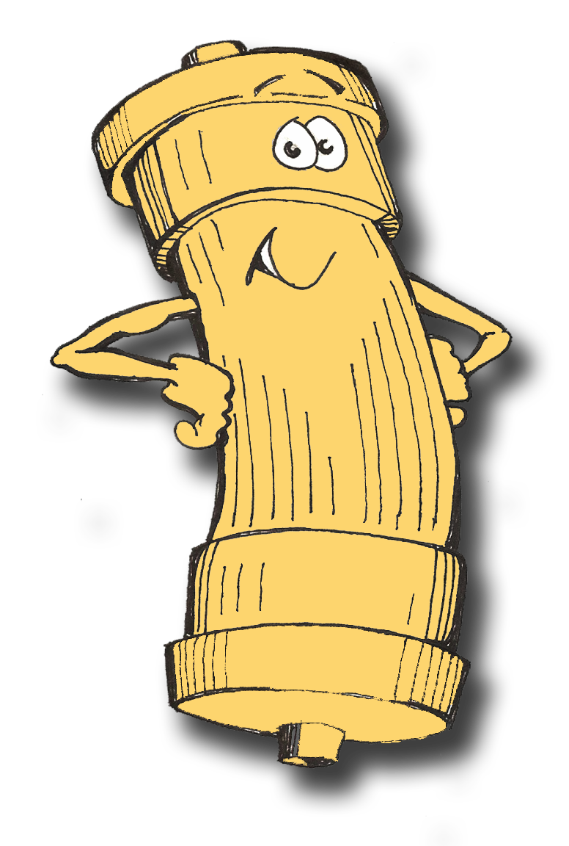
Thank you!
www.fibercellsystems.com

