Slide 1

Notes:
FiberCell Systems, the only supplier of laboratory scale hollow fiber bioreactor systems since 2001

Slide 2
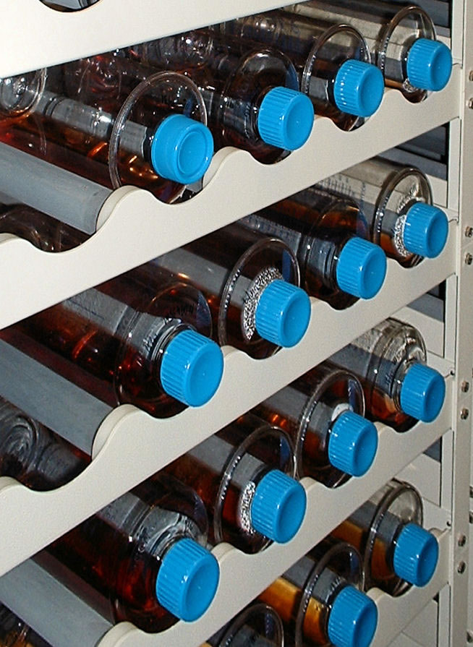
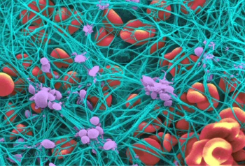
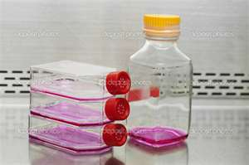
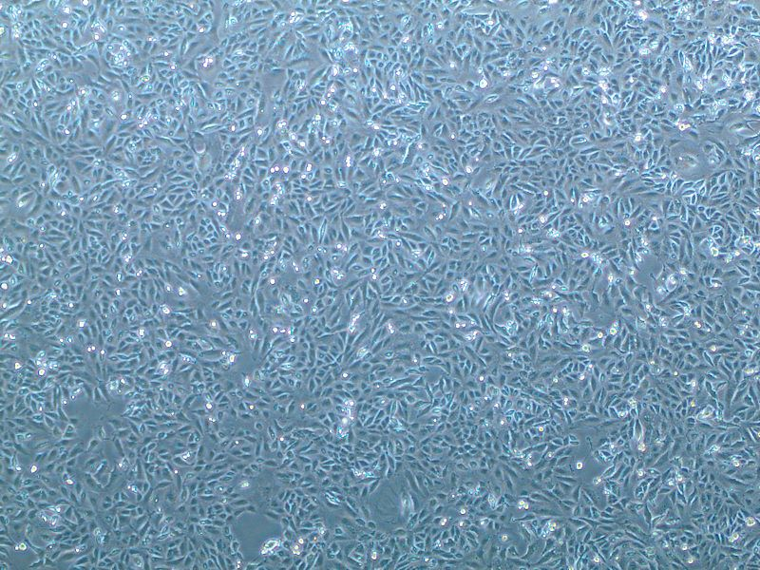
Cell Culture Through the Ages

Slide 3
Cell Culture Options for Scale-Up
* Roller Bottles
* Cell Factory
* Cell Cube
° Cell Culture Bags
° Spinner Flasks
° Bioreactors
Notes:
Scale up options are all based upon surface area increases but the cells are still bound to a non-porous plastic surface. Larger scale systems rely upon micro-carriers or some other sort of non-porous support or the adaptation of the cells to suspension culture using specialty mediums. The culture of cells under these conditions are non-physiologic.

Slide 4
Notes:
Feast or famine cycle. The cells are exposed to constantly changing conditions with their optimum conditions for protein and antibody production being only a small part of this cycle. Just when things get good it is time to split the cells and start the process all over again.

Slide 5
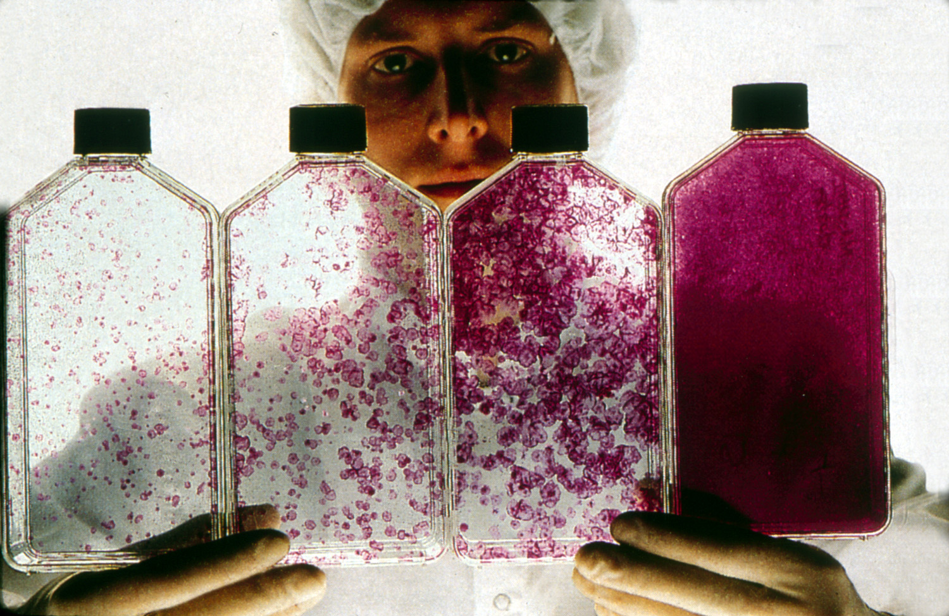
Notes:
Cells are sensitive to plating density. Since the nutrients come from the top down when cells reach confluence it is necessary to split the cells, otherwise the bottom layer does not receive oxygen and nutrients and the cells peel off and die.

Slide 6
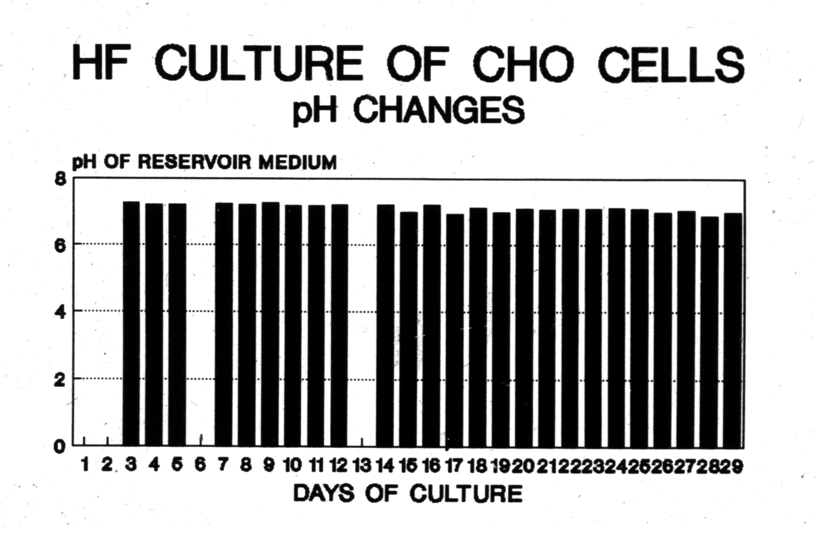
Notes:
Hollow fiber cell culture maintains the cells at their optimum growth and production conditions consistently for long term culture. A glioma cell line has been maintained for 2 years of continuous culture, a hybridoma for one year of continuous production. Cytokines are concentrated around the cells eliminating lag phase, the cells do not need to be split and product is concentrated.

Slide 7
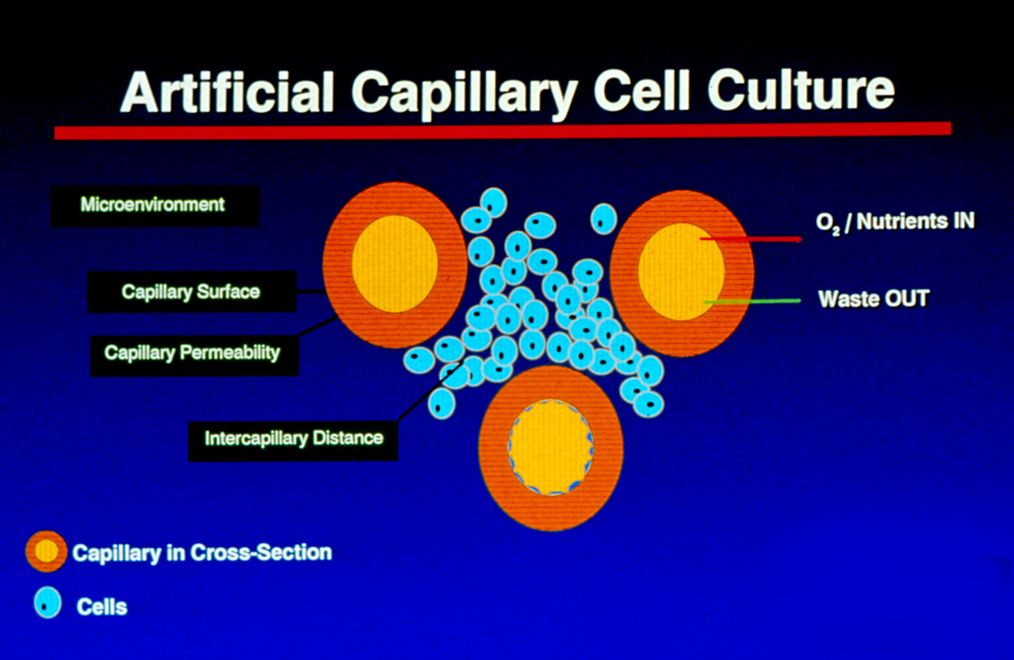
Notes:
Cross section of a hollow fiber cartridge. Hollow fiber is fundamentally different from flask culture in three ways: 1) provides a tremendous amount of surface area to volume. Typically 150cm2 per ml of volume 2) provides a porous support for cell attachment. It is not necessary to split the cells, they can be maintained in post-confluent conditions for many months 3) small molecules such as glucose and lactate can freely cross the fiber but larger ones such as secreted proteins and antibodies cannot cross the fiber and become highly concentrated.

Slide 8
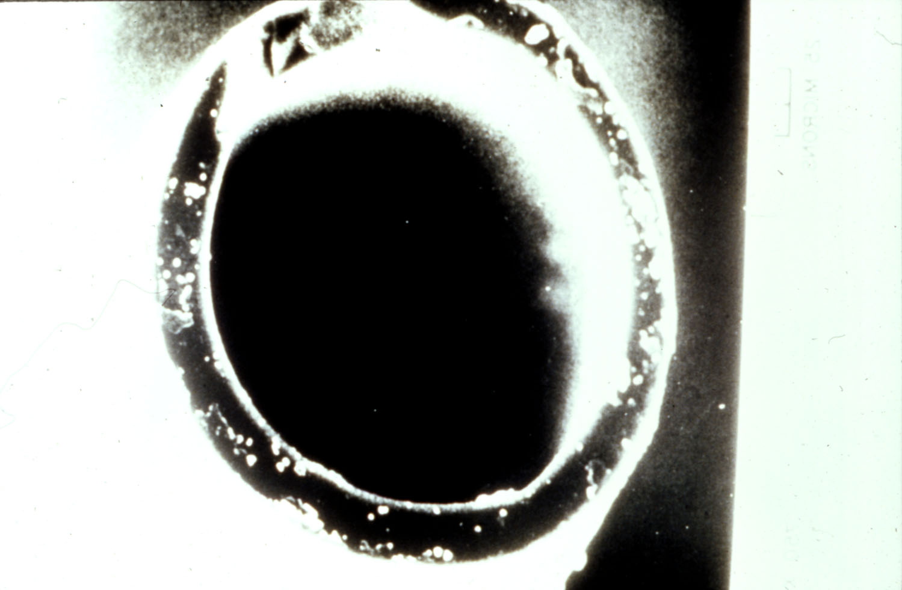
Hollow Fiber Specifications
Hydrophilic Polysulfone or PVDF
210µm O.D.
8µm wall thickness
GFR of 20kd fiber in excess of 140
Notes:
High gross filtration rate fiber used by FiberCell advances the technology over what was available in the past. This results rapid exchange of nutrients and waste products and renders the cells resistant to high levels of lactate.

Slide 9
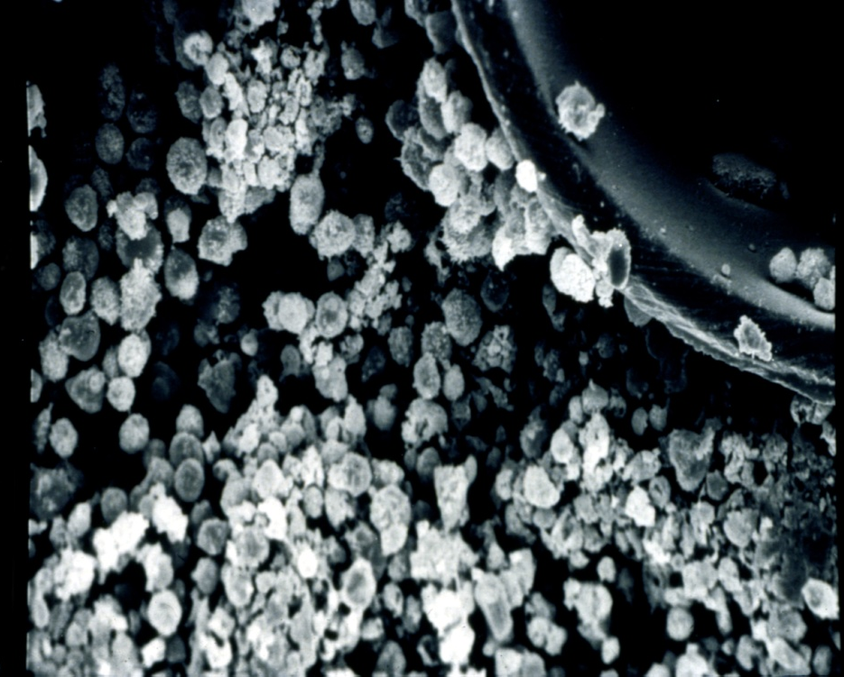
HF Culture of Lymphocytes
10⁸ + cells/ml
“Wavy” fibers optimized for suspension cells
High cell density permits adaptation to lower serum concentrations
Notes:
High cell density permits the reduction of dependence upon serum, lower concentration of serum, serum free medium or CDM HD can support cells at this high density. FiberCell utilized wavy fibers resulting in even distribution of the fiber bundle inside the cartridge optimizing it for suspension cells as well as adherent cells.

Slide 10
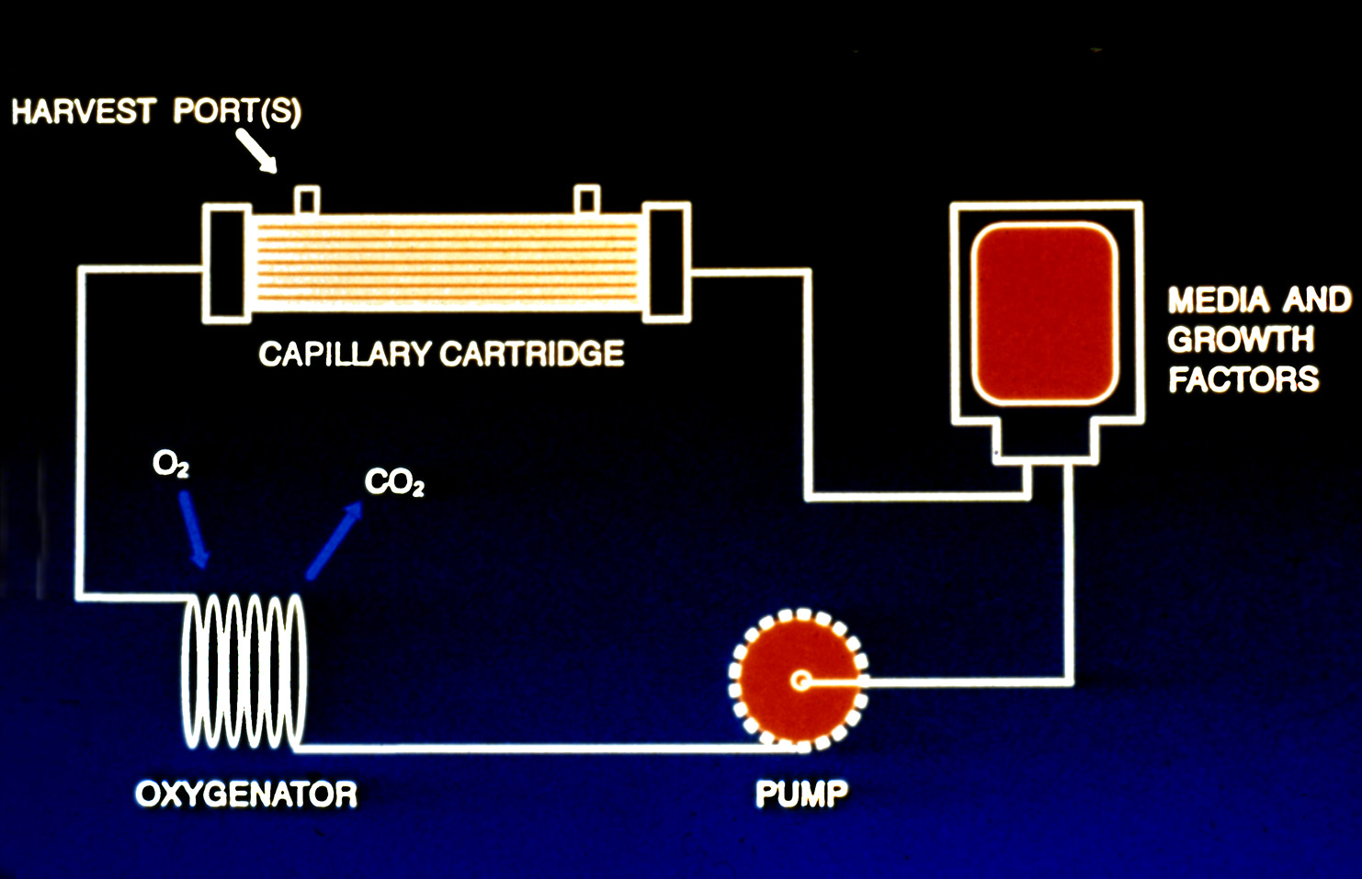
Positive pressure displacement pump
Silicone tubing for gas exchange
Closed, bio-safe system
Notes:
Schematic of the cartridge system. FiberCell utilizes a proprietary positive pressure displacement pump system, a squishy pump, that uses two one way check valves and a piston to generate up to 140 mls/minute flow rate with no wear on the pump tubing. Pulsatile flow enhances exchange across the fibers. The system is totally sealed for bio-safety, making culture of pathogens easy,

Slide 11
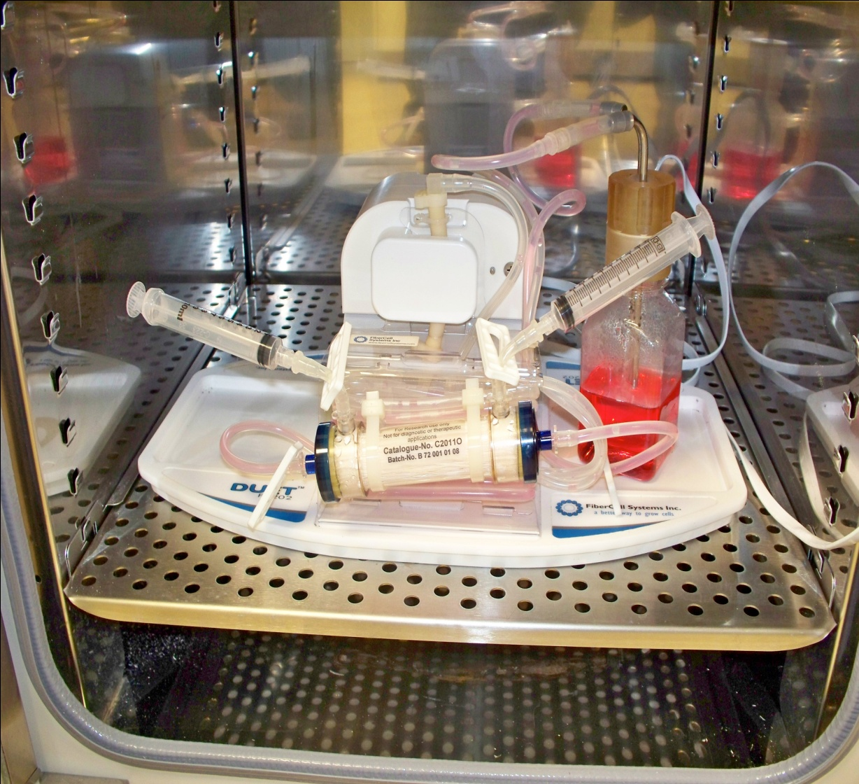
In the Laboratory
Fits in any standard sized incubator
Gas controlled by incubator
Temperature controlled by incubator
Thin cord for power
Notes:
The FiberCell Duet pump utilizes a thin cord to pass through the door of the incubator. Gas and temperature is controlled by the incubator. Gas exchange takes place across the loop of silicone tubing at the back of the flow path.

Slide 12
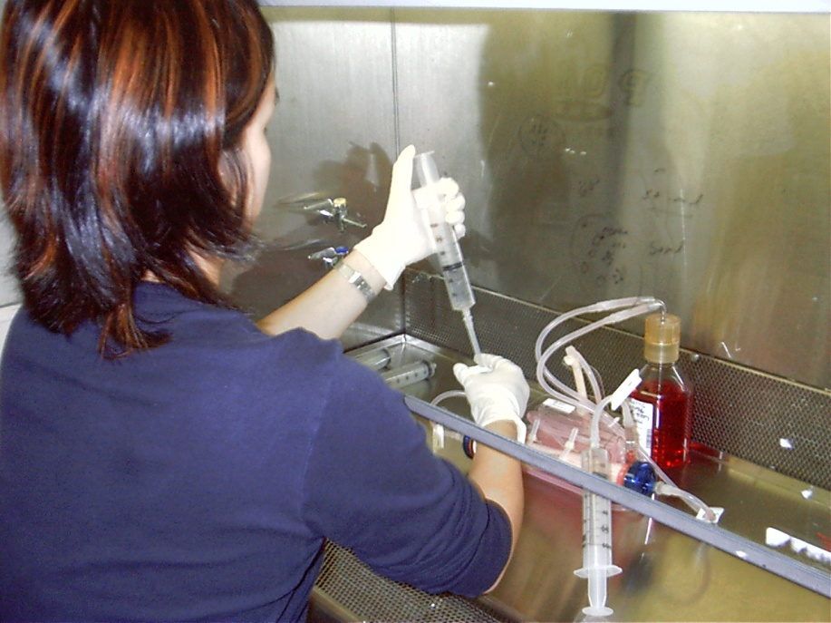
Working with the cartridge
Moves easily into hood
Good sterile technique always a plus
Maintenance only 15 minutes per day
Harvest product and measure glucose consumption
Notes:
Easy to work with. Always wear a lab coat and use good sterile technique.

Slide 13
HF Applications
Monoclonal antibody production
Recombinant protein production
Conditioned medium
Lymphocyte expansion and activation
Endothelial cell culture under shear stress
Cell co-cultivation
Virus production
In Vitro toxicology
Notes:
Culturing in a hollow fiber bioreactor is the most in vivo like way to grow cells.

Slide 14
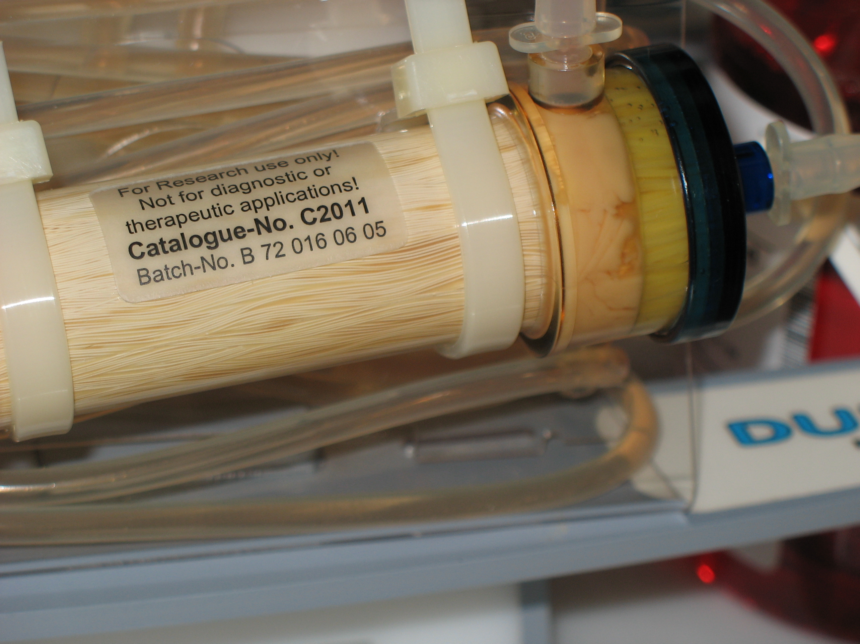
Notes:
Cells densely populated in FiberCell Systems hollow fiber bioreactor. When harvesting it is not unusual to collect a 1-5 ml pellet. The cells at the end of the cartridge are viable due to the high gross filtration rate of the fibers.

Slide 15
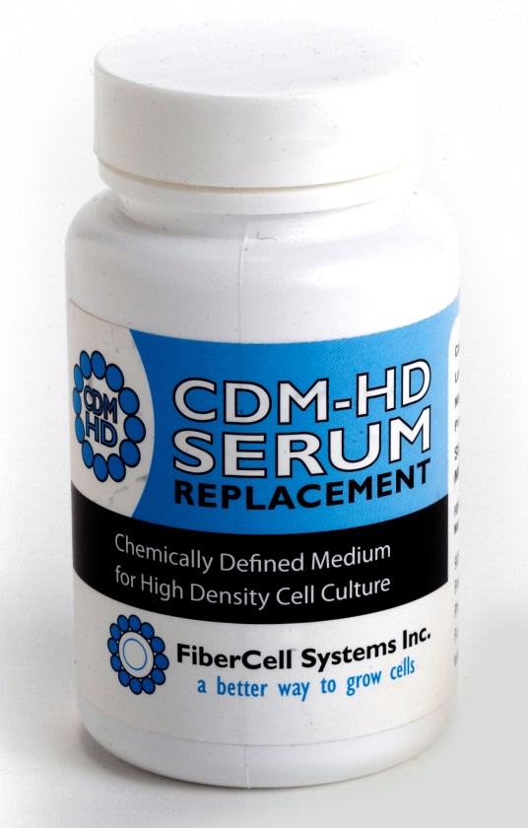
Advantages of Hollow Fiber Cell Culture
Concentrated product
Uniform and complete post-translational modifications
Low apoptosis, less contamination with intracellular proteins and DNA
Protein free medium (CDM-HD) contains no surfactants
Consistency of production over many months.

Slide 16
* TGF Beta diffuses out
* MAB trapped in ECS
* Easily adapt to SFM/CDM HD
* Lower endotoxin
* .5 to 5 mg/ml conc.
* 5-100 mg per harvest
* Continuous production for over 6 months
MAb 1 week 2-3
MAb 2 week
MAb 2 week 4
MAb 1 week 4
MAb 2 week 3
Mab 1: 168 mgs in 60mls volume, 2.8 mgs/ml. 9 liters of medium consumed, three weeks culture
170
130
95
72
55
Mab 2: 159 mgs in 70mls volume, 2.3 mg/ml. 11 liters of medium consumed, three weeks culture
Heavy Chain
43
34
Light
Chain
26
Monoclonal antibody production using CDM HD
Notes:
Easily produce 100 mgs or more of antibody per week. These antibodies were produced using DMEM and CDM HD at 10%. Please note, this is not purified antibody but a straight harvest from the cartridge. Note the lack of contaminating proteins from serum or cytoplasmic proteins from the cells.

Slide 17
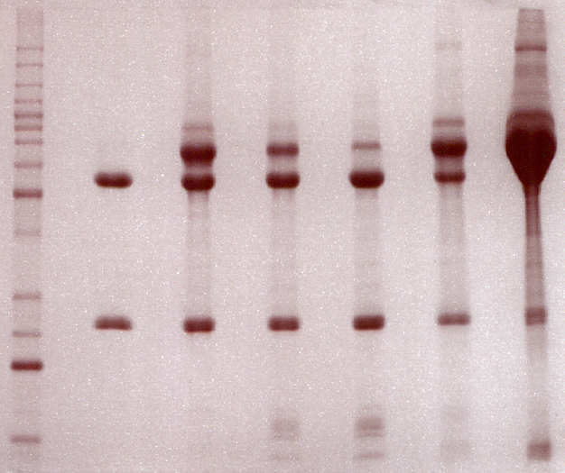
Sup. From HFB 10x concentrated Sup
from T-flasks
MW purified D 7 D 9 D 12 W/DMEM w/DMEM
M5114 +10%CDM-HD +10% FBS
kDa
70
60
50
40
Heavy Chain
Light Chian
30
SDS-PAGE analysis of RAb M5114 supernatant

Slide 18
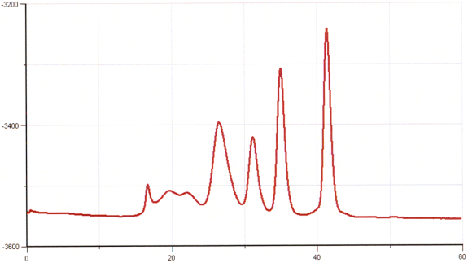
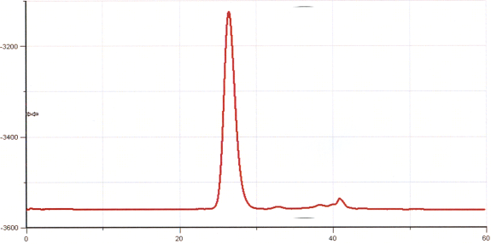
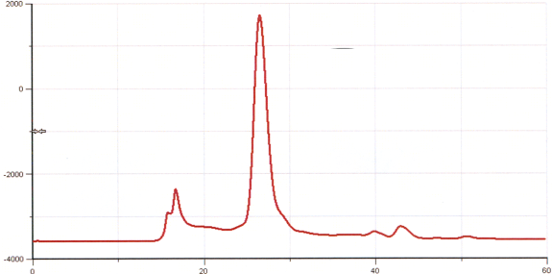
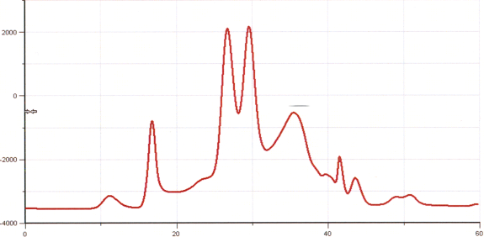
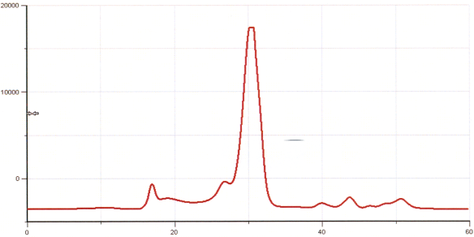
153 kDa
44 kda
Abs 280
Standard
Pure M5114
Abs 280
Purified M5114
Abs 280
Sup. from HFB D12 with DMEM+10% CDM-HD
Abs 280
Sup. From T-flask with DMEM+10% CDM-HD
Abs 280
Sup. From T-flask with DMEM+10% FBS
minutes
Gel filtration Superdex 200 analysis of RAb M5114 supernatant

Slide 19
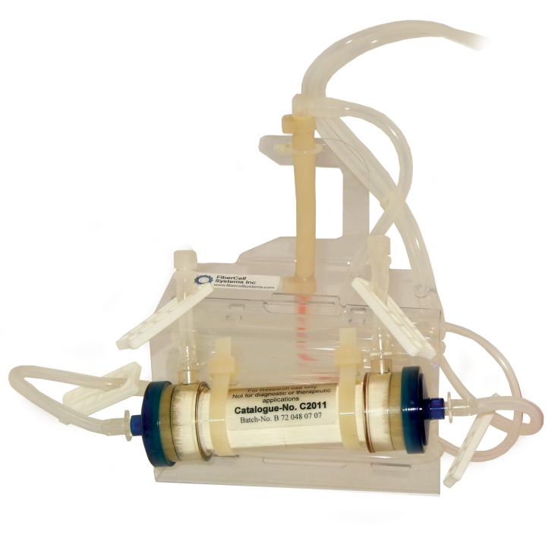
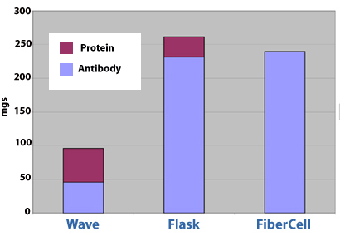
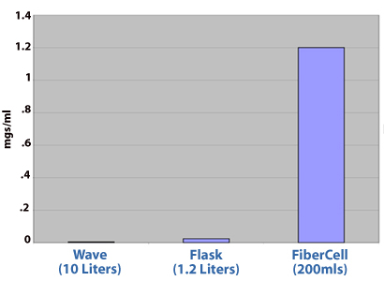
Hollow Fiber/Wave Comparison
Scale up of hollow fiber is limited by oxygenation

Slide 20
Recombinant Protein Production
Both suspension and adherent cell types
100X + higher concentration
Easily adapt to SFM
Can provide improved protein folding
Notes:
Gel filtration chromatography of a hexeramized IgG produced in CHO cells. Top graph shows results when cells are cultured in flasks, bottom trace shows results when cultured in a FiberCell Catalog number C2018. 95% of the protein is now produced as a properly folded hexamer, better cell culture conditions in the cartridge result in better protein folding and production.

Slide 21
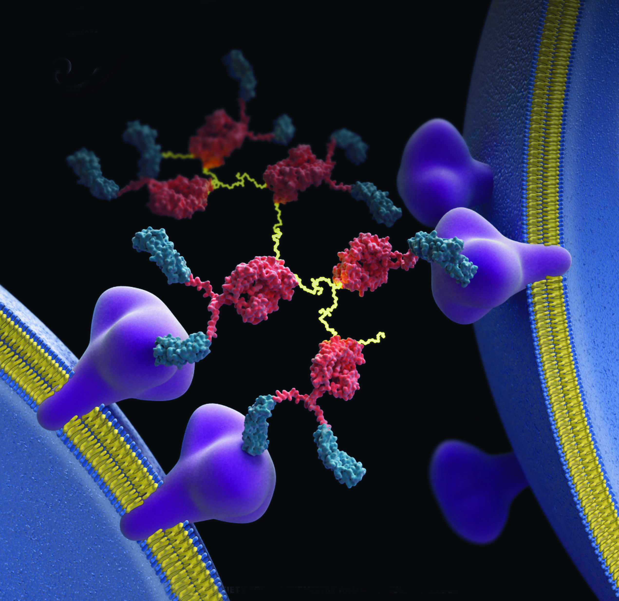
Journal of Biological Chemistry 9/20/2007
Notes:
Hexeramized IgG produced in CHO cells in the C2018 cartridge. .5 gram produced in 60 days in a total harvested volume of less than 5 liters. This is a cryo-electron tomograph of the actual protein showing the 6 IgG1 subunits held together with 3 IgA tails. The Fv region has been replaced with CD 4 receptor. It is shown cross-linking two HIV viruses together via attachment to the GP120 protein on the surface of the virus, inactivating the virus.

Slide 22
Rec. Protein Production in 293 cells
Rec. IgG from 293 cells
Produced 276 mg in 2 months using C2011
900 mls total volume in SFM
Notes:
Cells grown in the hollow fiber cartridge are resistant to high levels of lactate. This makes running the cartridge over the weekend easy. Productivity from 293t cells is very good in serum free medium and CDM HD.

Slide 23
Six proteins constitute 95%
of plasma proteins
albumin (63%)
OTHER (5%)
anti-trypsin (4%)
transferrin (4%)
haptoglobin (4%)
IgG, IgM, IgA (19%)
fibrinogen (3%)
Notes:
Proteins found in serum. IgG can interfere with antibody production, albumin can interfere with everything and the unknown proteins produce variability in serum lots.

Slide 24
Alphavirus Production in C2011
* Seed 1X10⁸ Vero Cells, EMEM 10% FBS.
* When glucose rate equals 1 gram per day infect with 1.5X10⁸ PFU virus.
* Maximum yield in 72 hours.
* Harvest volume 15 mls
* Yield 8X10⁹ PFU total.

Slide 25
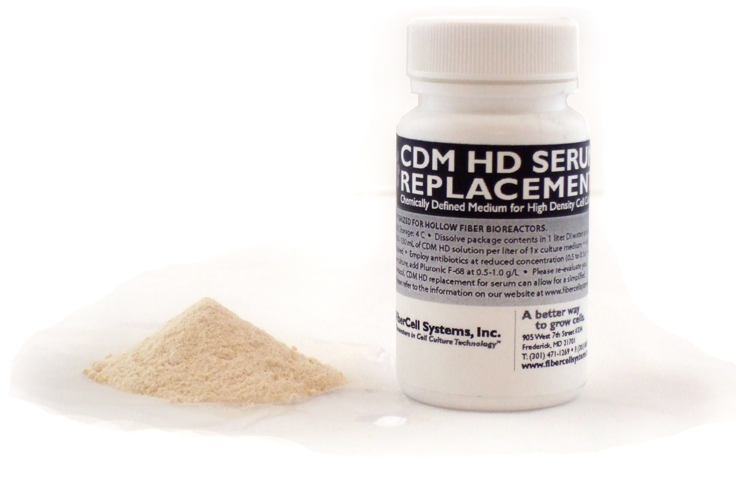
CDM HD Serum Replacement
Notes:
CDM Hd is a protein free, animal component free chemically defined serum replacement optimized for hollow fiber cell culture. It is the first time that a simplified medium takes advantage of specific cell culture conditions (i.e. high cell density) found in a bioreactor.

Slide 26
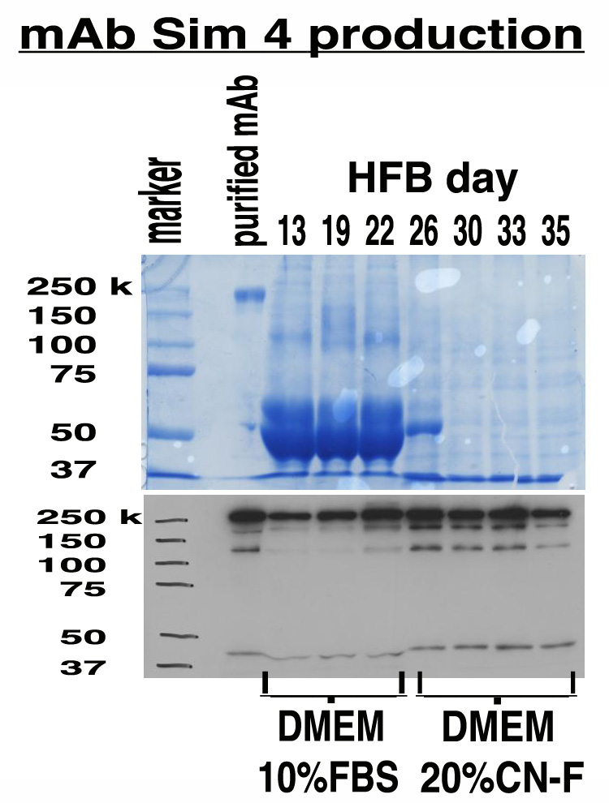
Notes:
Comparison of CDM HD and DMEM with 10% FBS. No adaptation is required, antibody production improves and the antibody is the only protein present in the supernatant.

Slide 27
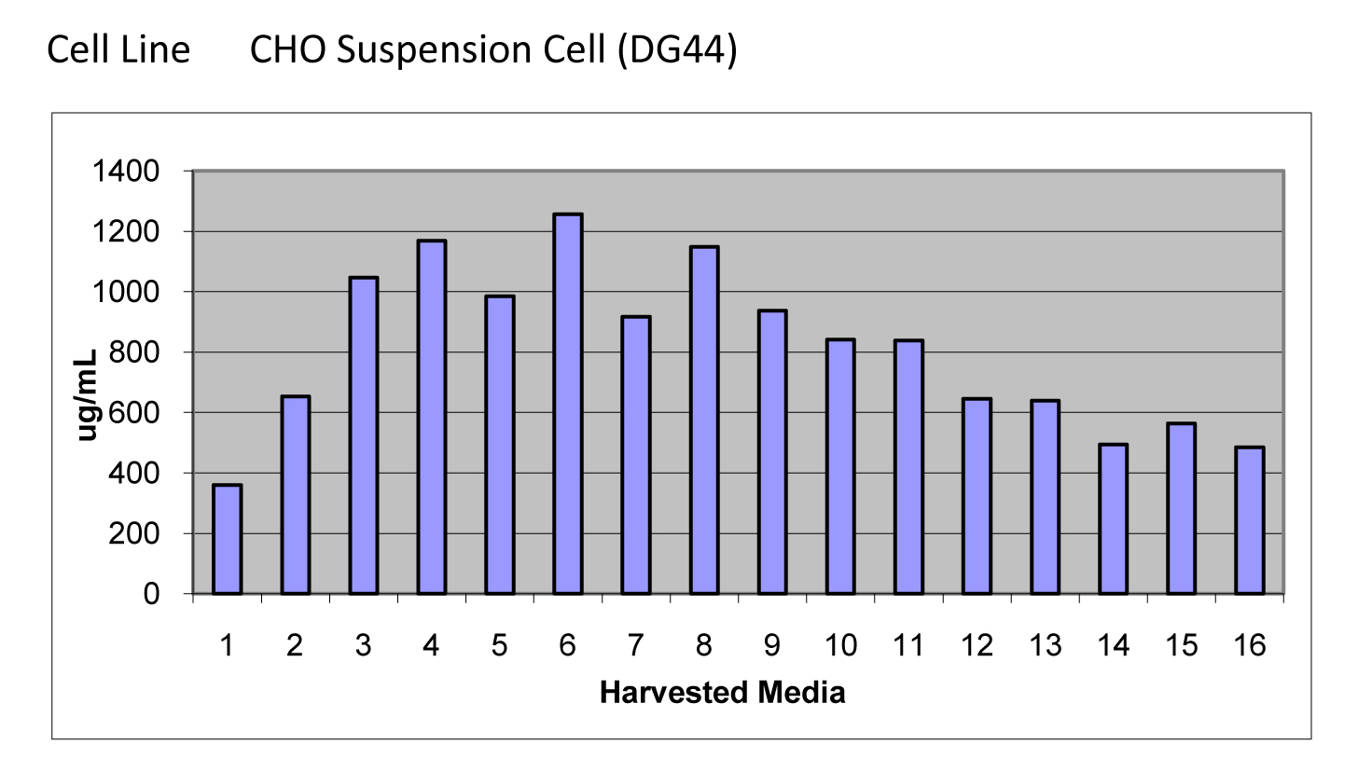
Protein produced: 246.6 mgs
Harvest Volume: 304 mls
Medium consumed: 10 liters
Culture time: 35 days
Notes:
Productivity from a DG44 CHO cell line in a FiberCell Hollow Fiber Bioreactor using CDM HD.

Slide 28
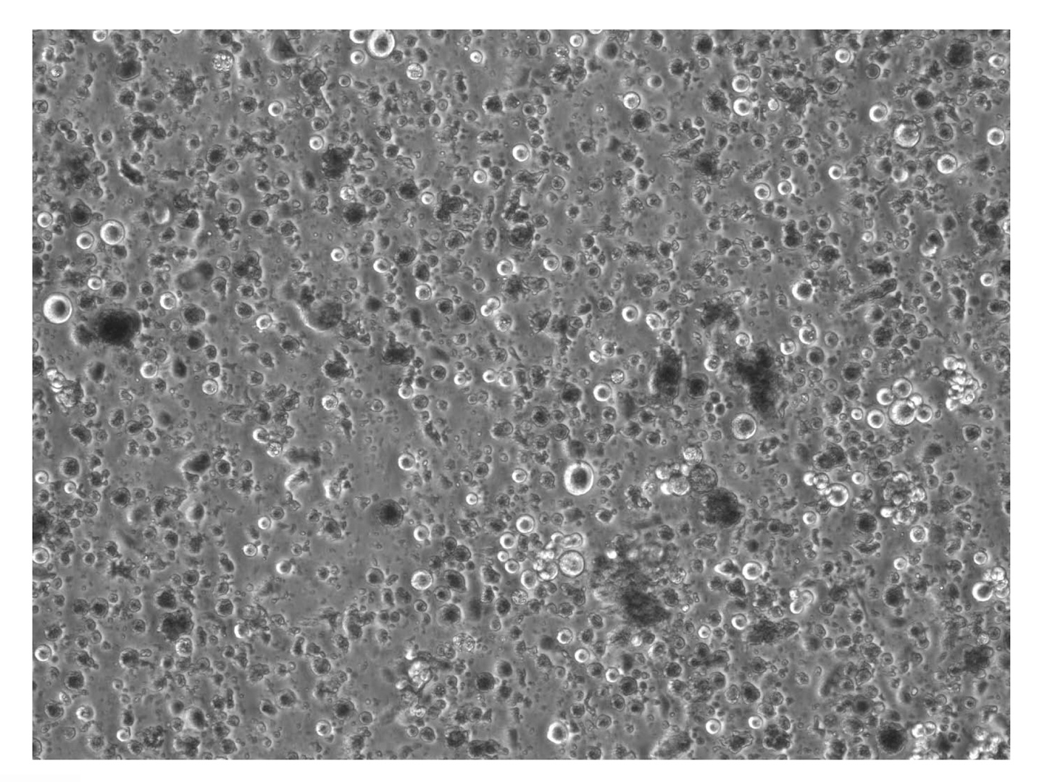
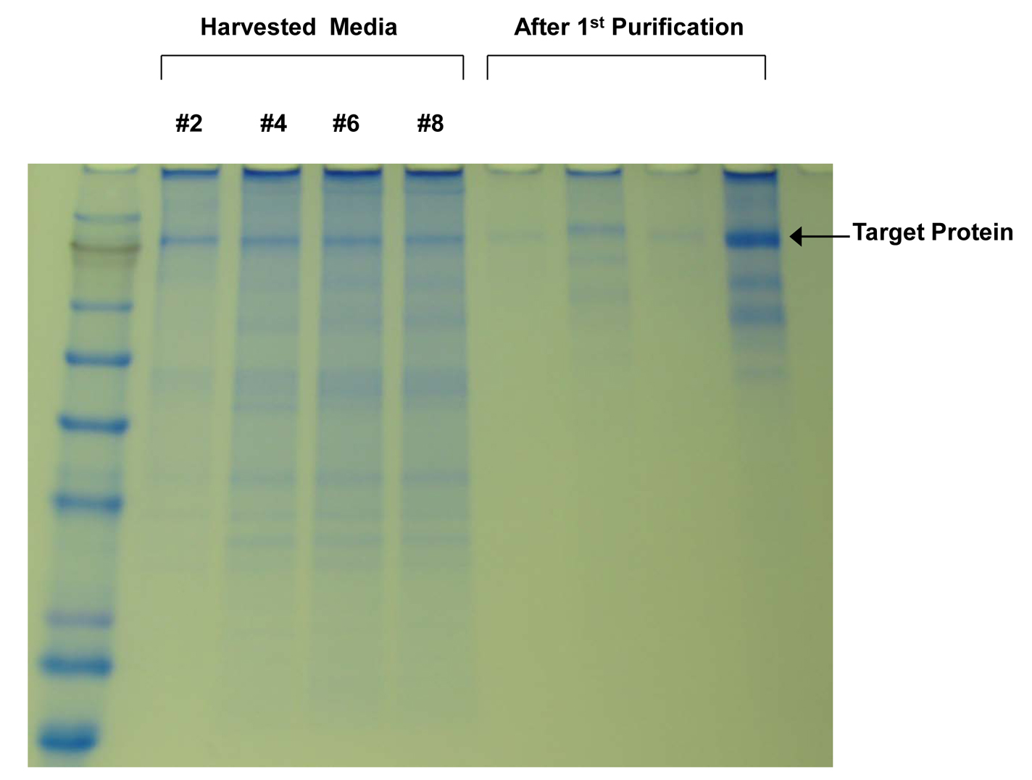
Raw Harvests from DG44 CHO Cell Line
Notes:
Raw harvest from hollow fiber bioreactor. The protein of interest makes up the majority of protein present.

Slide 29
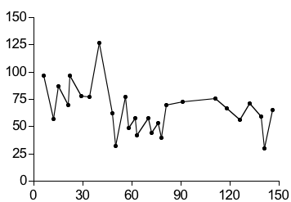
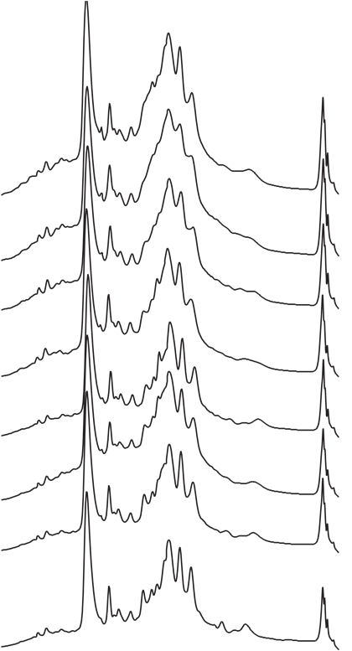
Stable Cytokine Production In Fibercell Hollow Fiber
Bioreactor Over 5 Months
Cytokine
Cytokine, mg/L
Day 29
Day 42
Day 60
Days of culture
Day 74
Day 89
Fibercell Production, mg/Lt
Day 103
Day 118
Day 137
RP-HPLC Analysis, Serum Free Harvest
Bergamaschi & Pavlakis, NCI

Slide 30
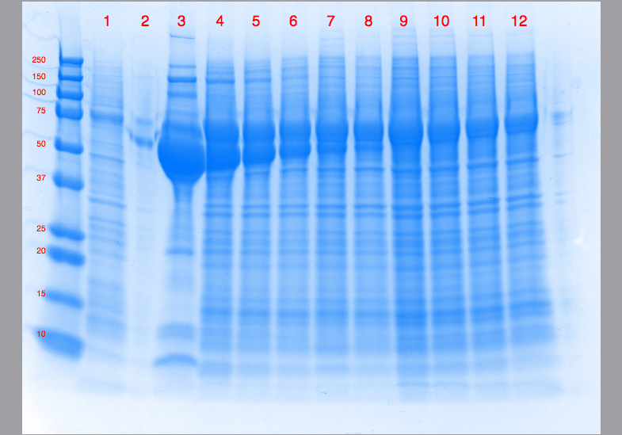
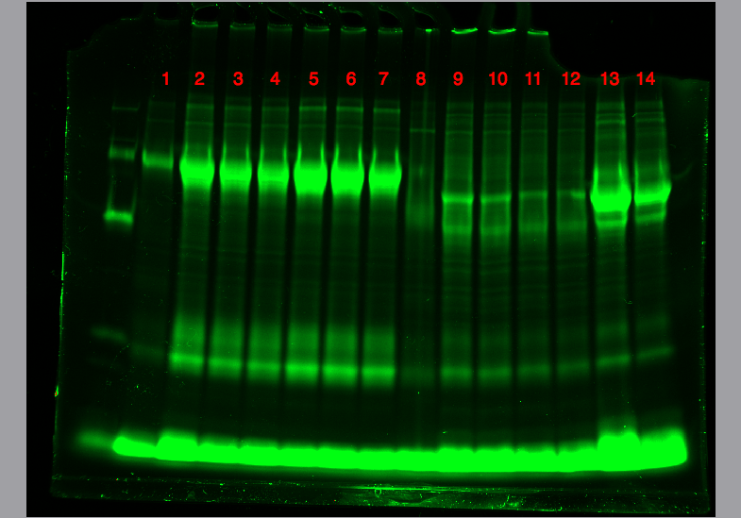
Adaptation to CDM-HD
Flask
1 2 3 4 5 8 9 10 11
Day in Fibercell
Cytokine
BSA
Cytokine
Flask
9 10 11
Day in Fibercell
Glycosylated Cytokine
Glycosylated Cytokine
Notes:
The Fibercell cartridge was seeded with cells in Fetal Bovine Serum and then serum was removed. Cells continue to produce cytokine for 5 months. The heavily glycosylated cytokine molecule is stained with Emerald Green (bottom).

Slide 31
S2 Protein Production
Notes:
Follow fiber culture works with constituitive expression systems like S2 cells. Note that 75% less induction agent is required to produce 50X higher protein concentration.

Slide 32
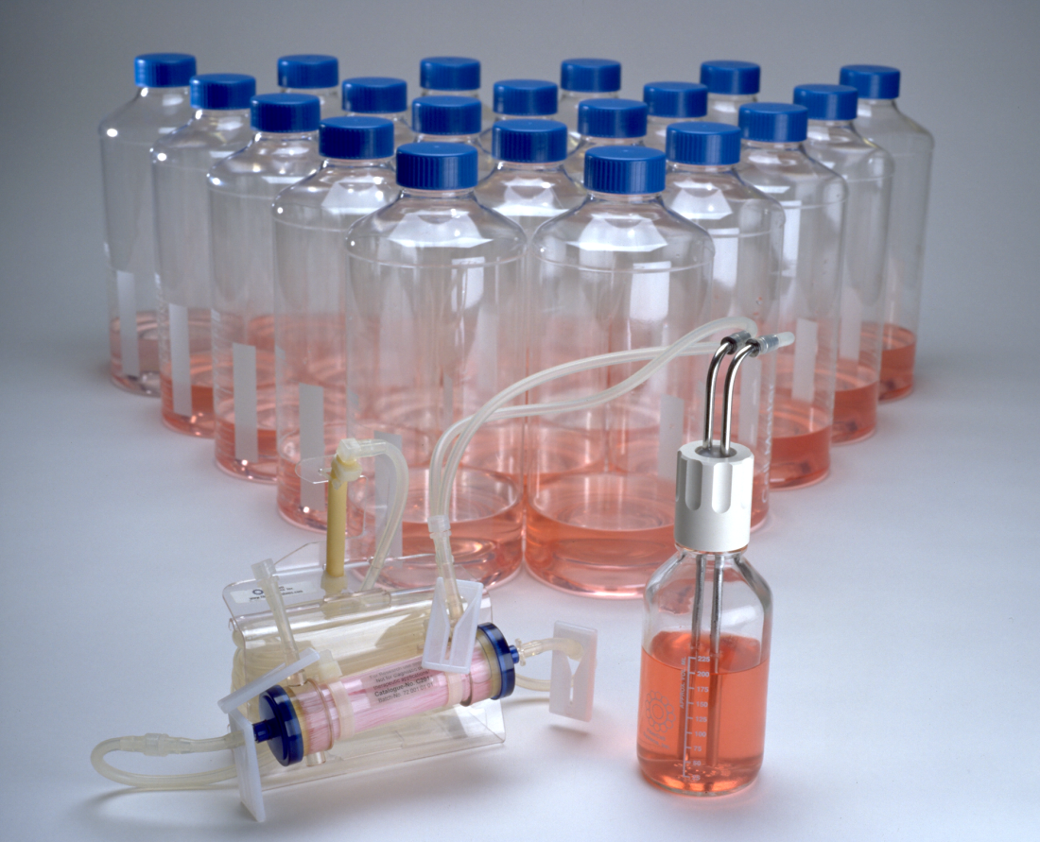
FiberCell Equivalents
A single harvest from C2011 can equal 20 roller bottles per day
A single harvest from C2018 can equal 200 roller bottles per day
10mls harvest volume can equal 1 liter of cell culture supernatent
Notes:
A single hollow fiber cartridge can replace 100’s of roller bottles over months of culture.

Slide 33
In Vitro Toxicology Using the FiberCell Systems Hollow Fiber Bioreactor
Notes:
Hollow fiber cartridges can be used to mimic in vivo bio-availability of antibiotics and other drugs on a real time basis.

Slide 34
Cellular Co-cultivation
Only way to get two cell types in close enough proximity and high enough density to observe effects
Thymic epithelium and thymic fibroblasts co-cultured to form thymic nodules

Slide 35
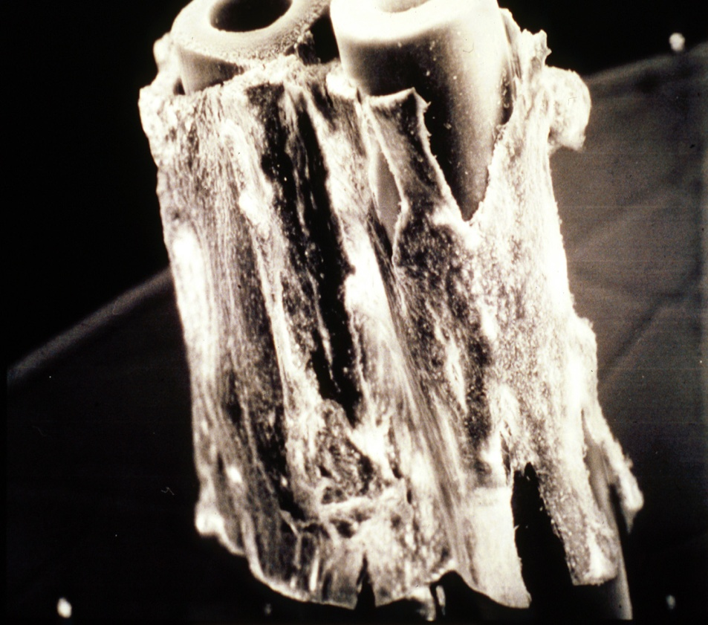
Asymmetric Cell Co-cultivation
Co-cultivation of endothelial cells (inside) and vascular smooth muscle (outside)
Brain endothelial and astroglial cells to form in vitro blood brain barrier
Notes:
Demonstration of the 3-D culturing of endothelial cells on the inside of the cartridge and vascular smooth muscle on the outside. As the shear stress changes on the endothelial cells g protein formation and endothelin receptor expression in the smooth muscle cells is directly affected.

Slide 36
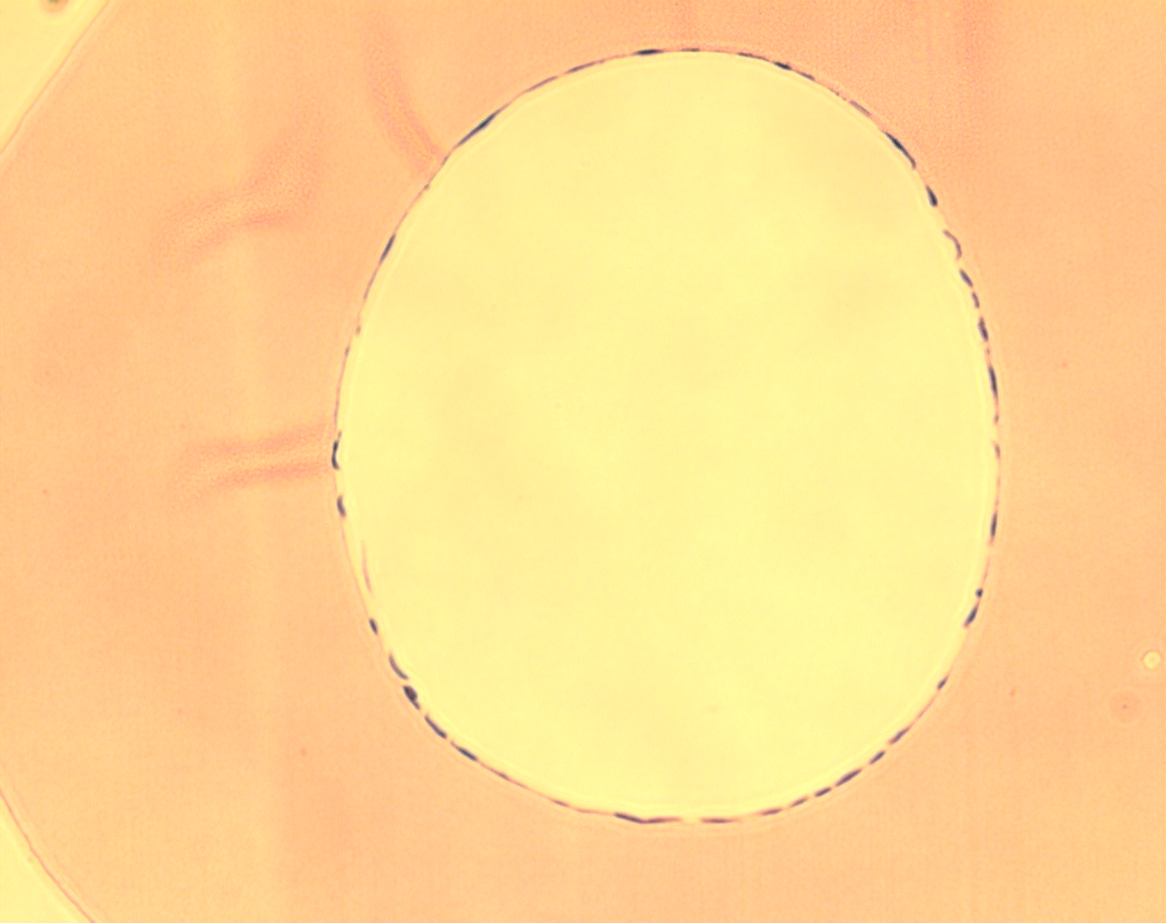
Endothelial Cell Culture
Notes:
Endothelial cells on the interior of the C2025 cartridge. The C2025 permits the attachment of cytokines and other matrix proteins to the surface of the fiber. In this case glycosylated fibronectin is used to mimic changes associated with diabetes.

Slide 37
Static WT MPMVEC Proliferation and Flow-adapted EC Growth Arrest
Static
0
0
50
100
150
200
250
50
100
150
200
250
Channels (FL2-H-PKH26)
0
50
100
150
200
250
Flow-adapted (5 dynes/cm²)
Time, h
0 24 48 72 96 120
Notes:
Proliferation assay for endothelial cells cultured in flasks (no shear) and inside the fiber exposed to shear stress. Note that the cells exposed to shear behave like endothelial cells in vitro and do not divide.

Slide 38
Endothelial Cells under Shear
Utilizes unique PVDF fiber
ECM, antibodies and cytokines can be applied to the fiber
Can apply defined shear stress up to 25 dynes/cm2
Notes:
High levels of shears stress can mimic pulmonary hypertension.

Slide 39
Pores of fiber
Endothelial cells on the inside on a fiber- these have been adhered to the wall then subjected to very low shear force overnight followed by a few hours at 5 dynes/cm2
While the majority of the cells here are still bulky it is possible to see then begin to flatted down onto the wall of the fiber and really stretch out.

Slide 40
Pores
Fiber
Inside of fiber
CLL cells

Slide 41
Inside of hollow fibre
Crack! Likely to be a result of trying to mount a sliced hollow fibre during microscopy
Pore
Endothelial cell
Flattened endothelial cells on inside of fiber. These endothelial cells had been adhered to the inside of the fiber and subjected to minimal shear force over night followed by a minimum of 5 hours at 10 dynes/cm2. This was based on results we saw when testing the application of a different system that can apply shear force to channels lined with endothelial cells while visible under a microscope. This other system also allowed us to discover that endothelial cells will detach and roll away after alignment if a bubble passes over them so we eliminate all bubbles from the system to preserve the endothelial layer.

Slide 42
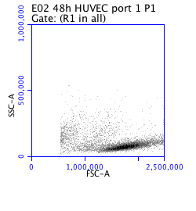
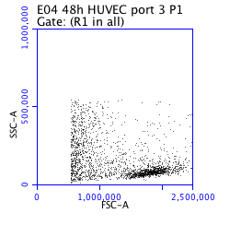
CLL cells actively migrate into the
extra-vascular space
Circulating
Compartment
Extra-vascular space (migrated
compartment)
Scanning electron micrograph of the outside of a hollow fibre after circulation of CLL cells around the system
CLL cells
Cardiff CLL Research Group

Slide 43
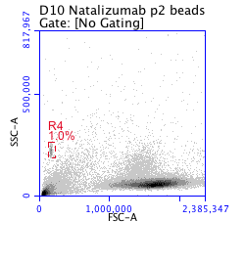
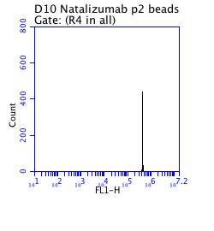
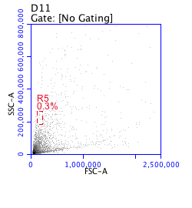
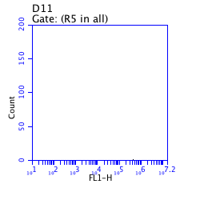
CLL cells actively migrate into the
extra-vascular space
Circulating
Compartment
Extra-vascular space (migrated
compartment)
Beads
1μM beads
CLL cells
Cardiff CLL Research Group

Slide 44
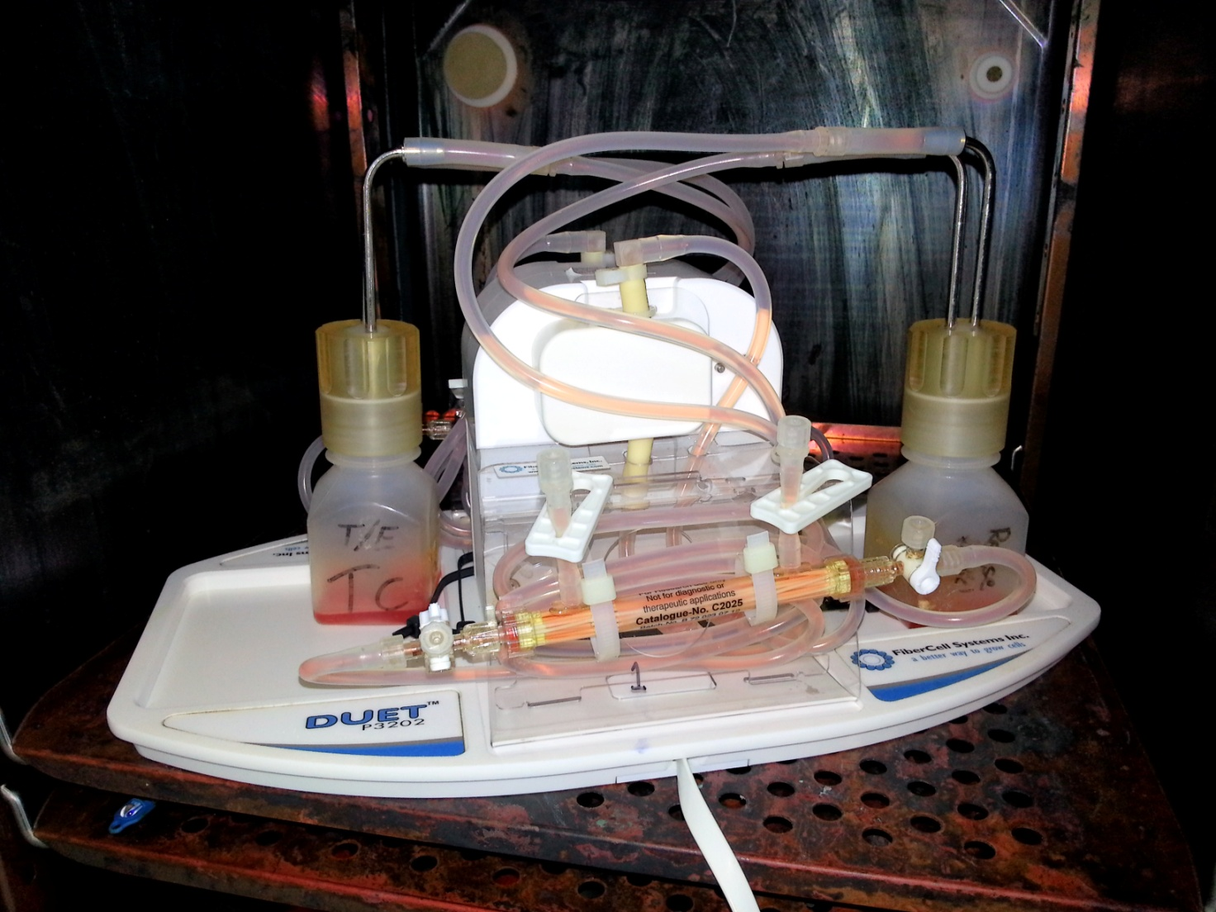
Meet Maisy- our bioreactor not being a bioreactor! She’s a very welcome addition to the lab so we really did name her.
As you can see we’ve adopted the smallest reservoir bottles possible to minimize the circulating volume as far as we can.

Slide 45
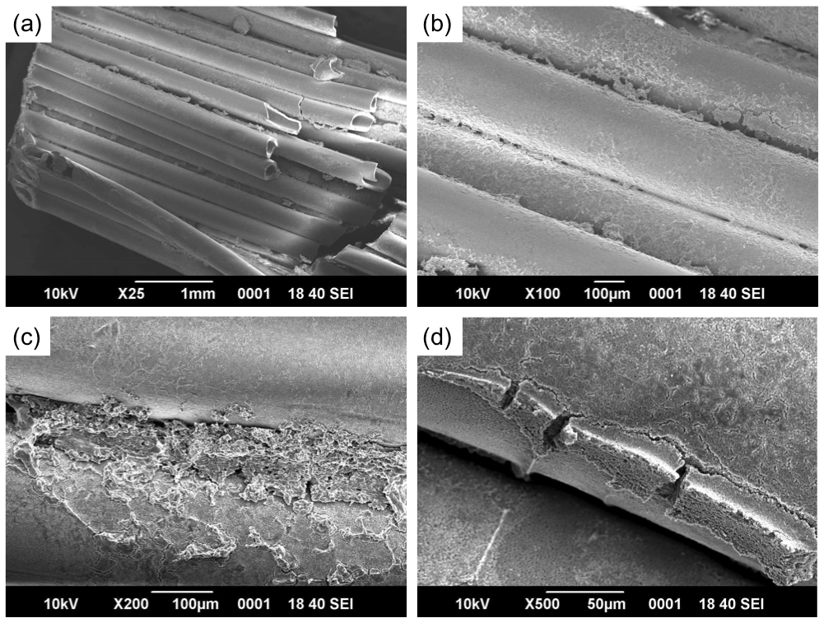
Bone Marrow Stroma/HSC Co-Culture

Slide 46
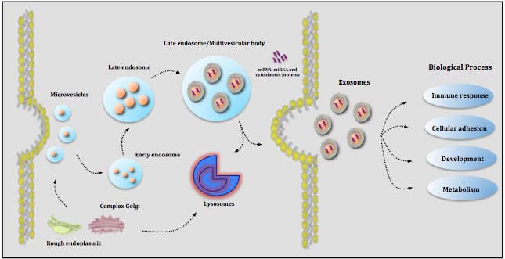
Exosomes
Exosomes
Cell-derived vesicles in biological fluids
Including medium of cultured cells
Dia. between 30 and 100 nm
Contain cellular proteins and RNA
Facilitate cell-to-cell transfer of cargo
May play a role in cell-to-cell signaling
May mediate adaptive immune responses

Slide 47
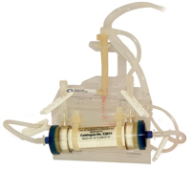



Exosome isolation via ultracentrufugation
Centrifuge sup @:
3,000xg (15min) to remove cells and debris
Centrifuge sup @:
20,000xg (30min) to remove large vesicles
Filter through 0.22μm
60ml (3 ea.) Fibercell harvests, cleared of cells
Pellet exosomes by 110,000xg ultracentrifugation for 2h
Wash by resuspending in 6ml PBS, and repelleting @120,000xg for 90min
100kDa MWCO for ~10x concentration
Resuspend in
1ml sucrose buffer*
Notes:
*sucrose buffer consists of: 20mM Tris-HCl, 1mM MgCl, 10% sucrose, pH 7.4. It enables greater solubility of exosomes.

Slide 48


Slide 49
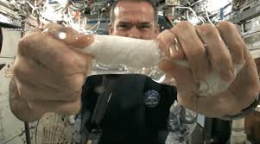

Slide 50
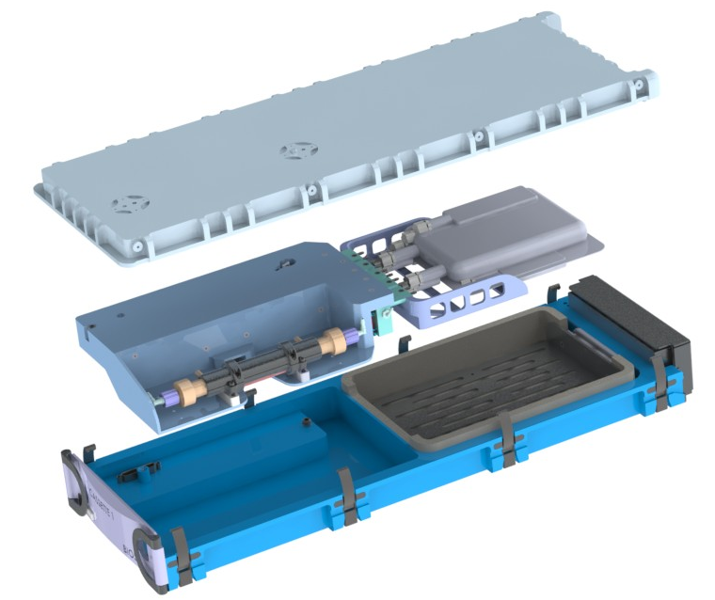
Cassette Assembly
Containment Cover
Disposable Flowpath Assembly
GoreVents
Fan Plenum
Incubated Chamber
Heatsink
Cold Chamber
VIP Insulation (.004 W/m-K)
Cassette Front Panel
Cassette Durable Base

Slide 51
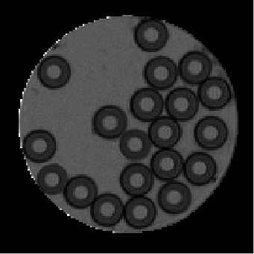
Bone Cells on PVDF
NMR image of PVDF reactor inoculated with 45 million primary osteoblasts, 6 weeks post-inoculation. Image represents a slice thickness of 2 mm and a nominal in-plane resolution of 78 μm. Fibers can be seen in cross-section with dark rings of mineral deposits on their outer surfaces.

Slide 52
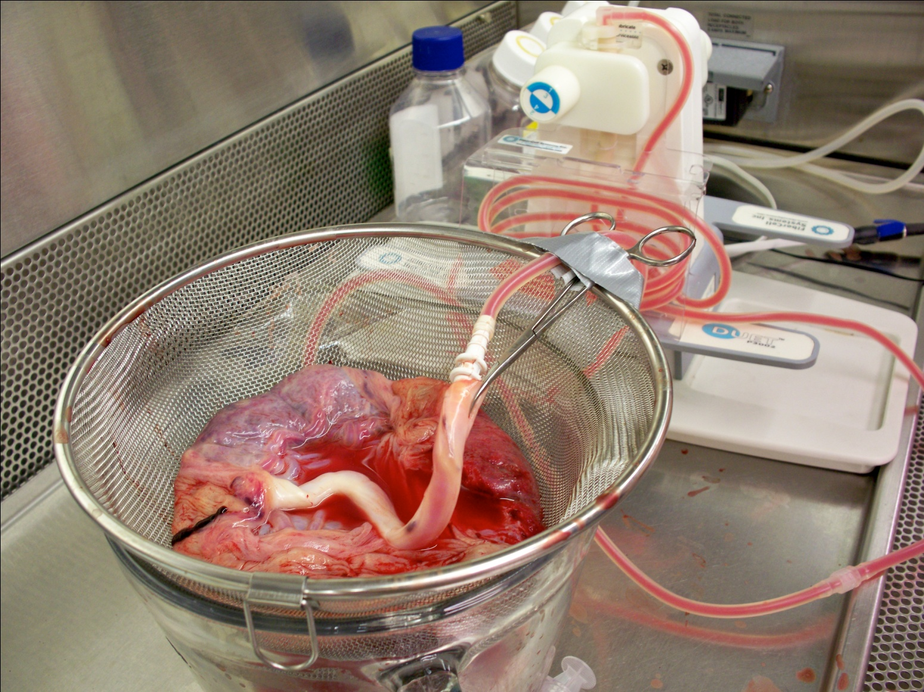
Pulsatile Perfusion of Placenta

Slide 53

Notes:
Embryoid bodies as also observed, highly reactive with CD102

Slide 54

Placental Co-Culture

Slide 55
Harvest vs. Flask
Phenotype ECS Harvest Flask
CD 45 4% 1%
CD 34 0% 0%
CD133/2 2% 0%
CD31 3% 48%
CD 13 6% 83%
CD 105 43% 99%
CD 73 18% 99%
CD 90 5% 96%
CD 14 23% 4%
NANOG 0% 0%

Slide 56
Summary
Hollow fiber bioreactors are the method of choice for the culture of 10⁹ to 10¹¹ cells
Ideal for producing 100mgs to several grams of MAB, 10mgs to 100s of mgs of recombinant proteins
Concentration of products 10 to 100X higher than with conventional methods
The most in vivo method for culturing cells over long periods of time
Saves time, space, purification costs

Slide 57
Thank you for your time!

